Slide 1
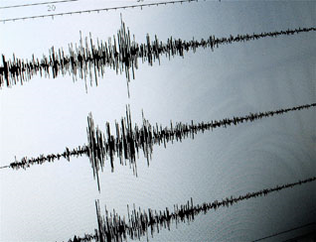
Earthquakes in Earth’s Crust

Slide 2
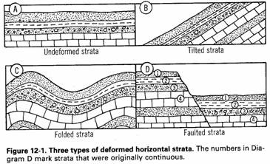
Evidence of Crustal Changes
Original Horizontality: sedimentary rocks form in horizontal layers parallel to Earth’s surface.
  Most strata found in positions other than horizontal are thought to be deformed by crustal movement.
Notes:
And some igneous rocks
Strata – beds – the layers of rocks

Slide 3
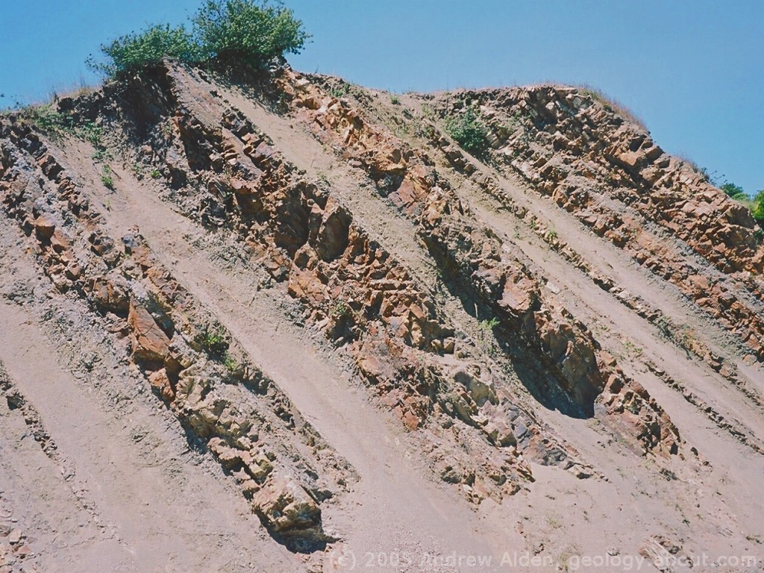
1. Crustal Deformation
a. Tilted Strata

Slide 4
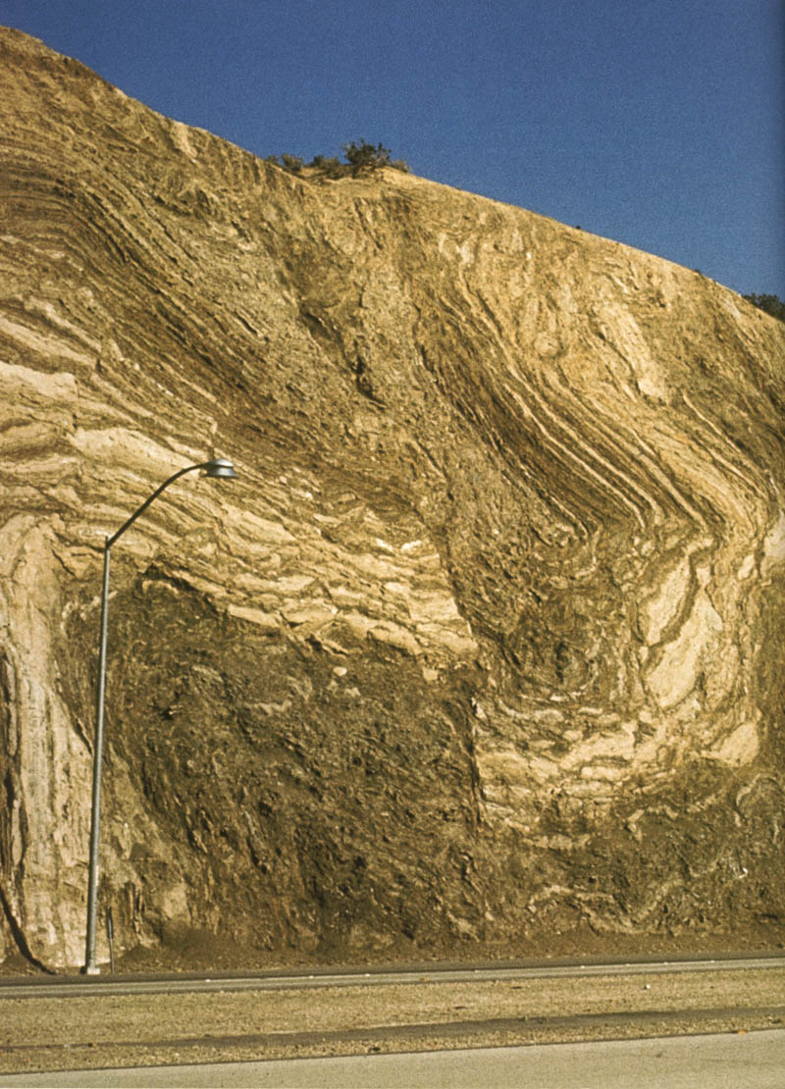
b. Folded Strata
Notes:
Layers are bent or curved

Slide 5
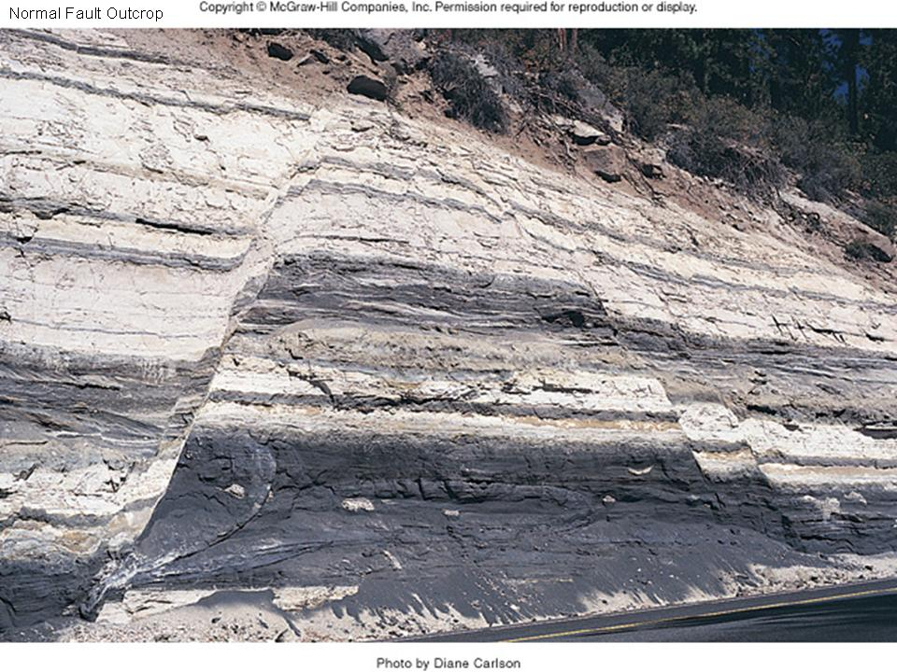
c. Faulted Strata
Notes:
Faulted rock layers are offset along a crack in the crust called a FAULT.

Slide 6
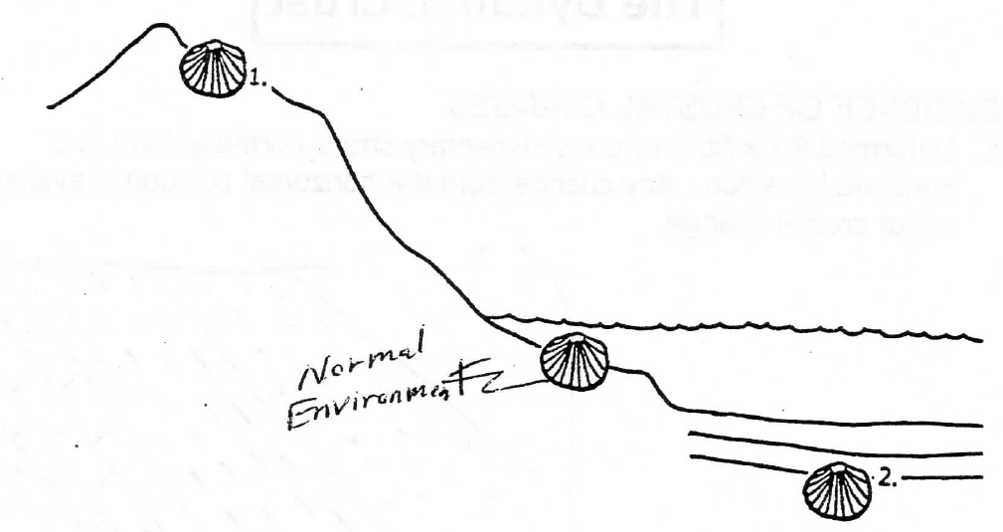
2. Fossil & Ocean Rock Evidence
Normal Environment
1. Marine fossils found at high elevations suggest uplifting.
2. Shallow water marine fossils found at great ocean depths suggest subsidence/sinking.
Notes:
Fossil – any evidence of former life.
Uplifting – raising up

Slide 7
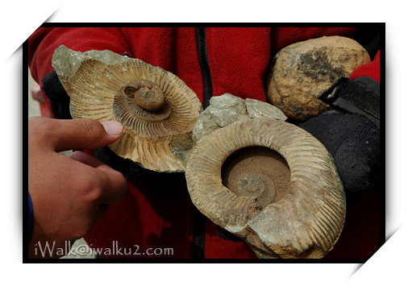
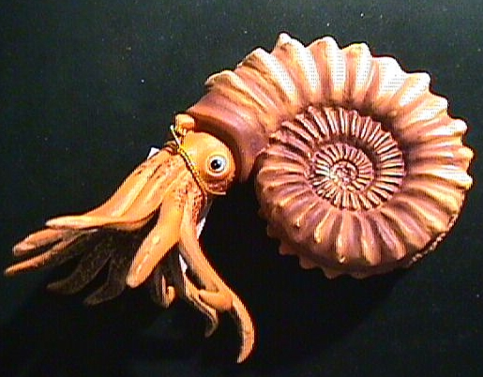
Ammonite fossils found at the Himalayan Mountains. Ammonites, which are now extinct, lived in the open water of ancient seas.

Slide 8
Earthquakes
Earthquake: natural rapid shaking of the lithosphere caused by the release of energy stored in rocks.
  Caused by:
  movement along FAULTS.
  moving magma within the lithosphere and with volcanic eruptions.
Notes:
There are several THOUSAND earthquakes every day, but most are too small to notice.
Plate movements create stress in Earth’s crust, creating faults.
Stress increases along a fault until the rock breaks, causing an earthquake.

Slide 9
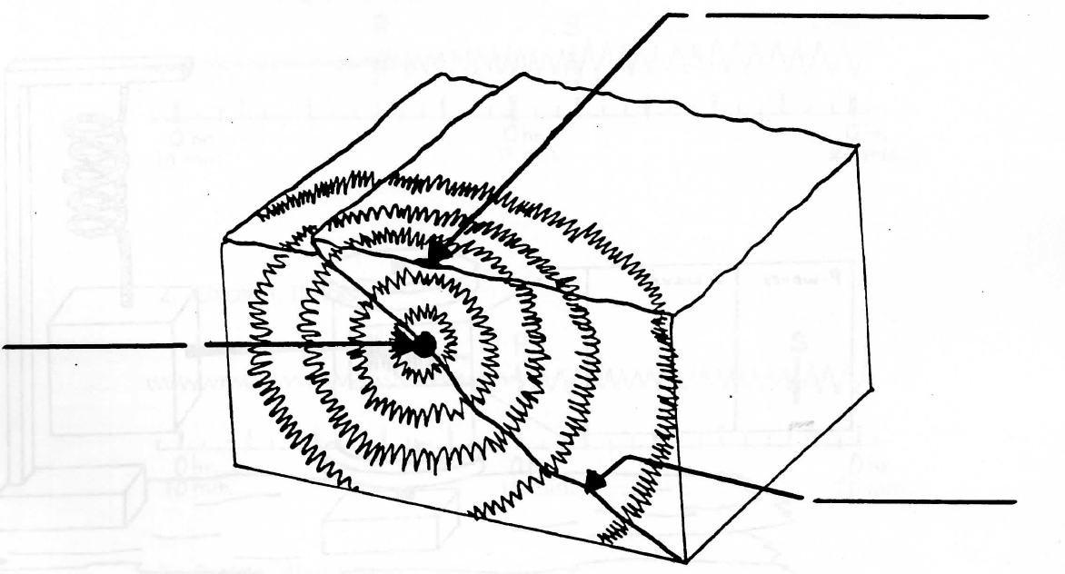
Earthquakes
Earthquakes release SEISMIC WAVES
Epicenter
Focus
Fault
Notes:
Seismic waves = earthquake waves
Focus – where the earthquake starts – releases waves
Epicenter – point on Earth’s surface directly above the focus

Slide 10


Slide 11
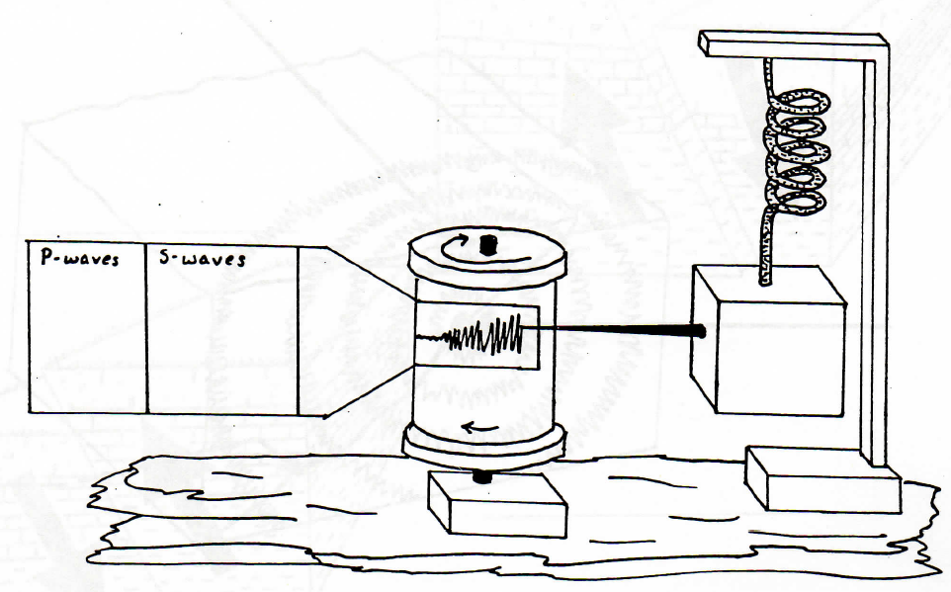
Seismograph – measures and records earthquake waves.
Spring
Rotating drum
marker
weight
Bedrock
Notes:
Makes a seismogram

Slide 12
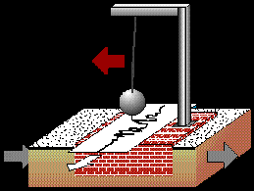

Slide 13
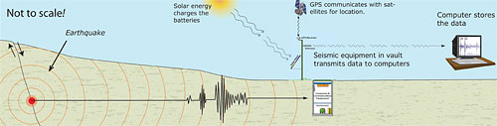
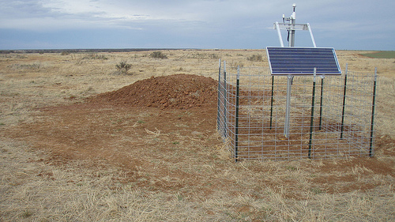

Slide 14
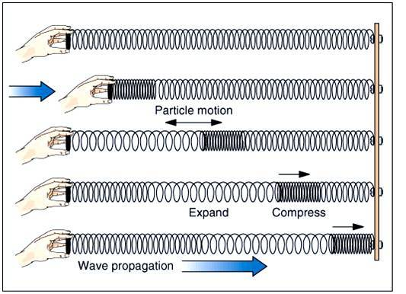
Earthquake Waves
Primary Waves
Can travel through:
Solids
Liquids
Gases
**Travel the fastest
Notes:
P-waves
Compress and expand like a slinky.

Slide 15
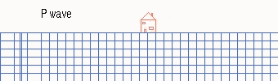

Slide 16
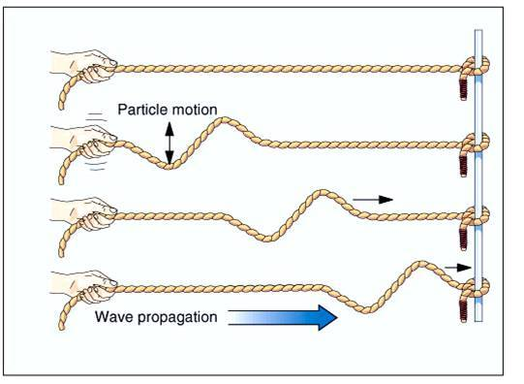
Earthquake Waves
2. Secondary Waves
Can travel through:
Solids
**Travel slower than P-waves
Notes:
s-waves
Vibrate up and down as they move forward.

Slide 17
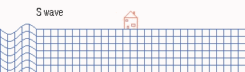

Slide 18
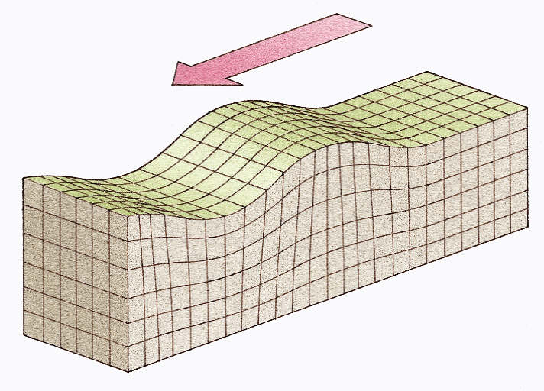
Earthquake Waves
Surface Waves
Can only travel on Earth’s solid surface
Notes:
When some P and S waves reach the surface, they can become surface waves.
Can make the ground roll like ocean waves.

Slide 19
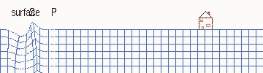

Slide 20
Properties of Earthquake Waves
P-waves reach a seismograph before S-waves.
Waves speed up when passing through more dense, rigid material.
  Waves can bend/refract when passing from one material to another.
Increase in Pressure = increase in velocity
Notes:
Bouncing – this property can be used to locate valuable rock and mineral resources in Earth.

Slide 21
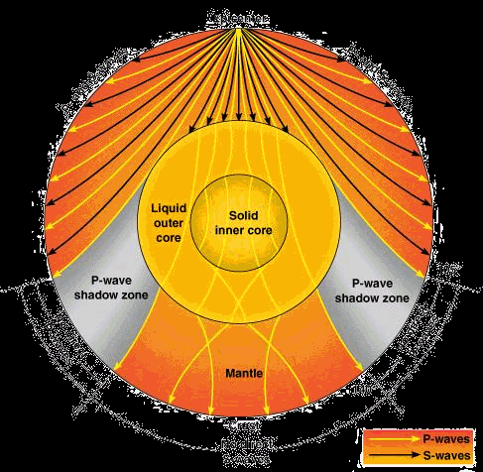

Slide 22
How do scientists know that Earth’s inner core is SOLID?
Increase in p-wave velocity
  (seismic waves speed up when moving through more dense material)
Great pressures at that depth
How do scientists know that Earth’s outer core is LIQUID?
S-waves cannot travel through the outer core.

Slide 23
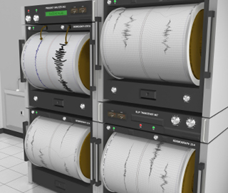
Magnitude of Earthquakes
Generally, the closer to the epicenter, the greater the damage.
Earthquake Magnitude Scale: uses the height of the wiggles on a seismogram to infer the total amount of energy released by an earthquake.
Notes:
Data used from:
seismographs
wave types and strength
movement along fault
strength of rocks that broke

Slide 24
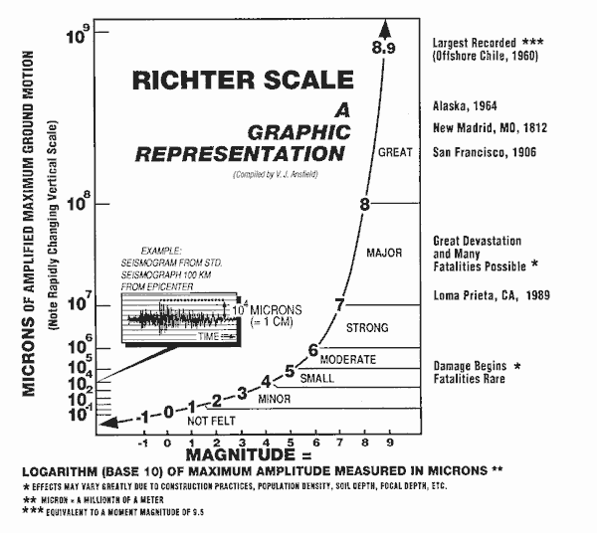
Notes:
Only good for small to medium sized earthquakes

Slide 25
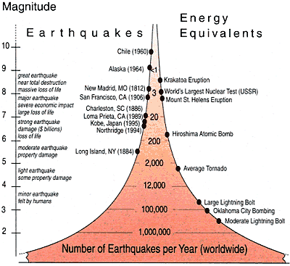
Notes:
Data used from:
seismographs
wave types and strength
movement along fault
strength of rocks that broke

Slide 26
Earthquakes Safety
During an Earthquake:
“Drop, cover, and hold”
Turn away from windows
Do not go very far (only 10-30 seconds long)
Before an Earthquake:
Make sure buildings are constructed on solid rock, bolt buildings to foundations, etc.
Notes:
Drop down under a strong object (desk, table, etc.)

Slide 27
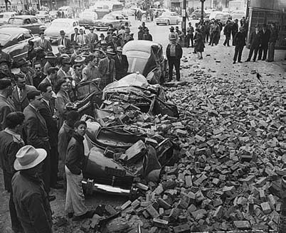
During the April 1949 earthquake near Tacoma, Washington, the owner of the Busy Bee Café barred the doors to keep panicking patrons from rushing outside. Seconds later, brick fell from the top of the Hotel Seattle, crushing several cars.

Slide 28
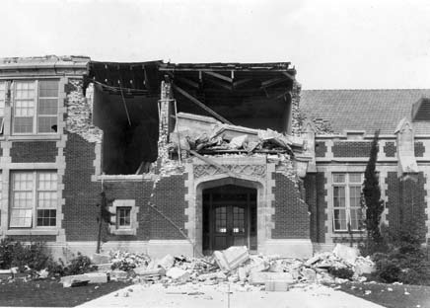
The Long Beach, California school above shows how dangerous old, brick
buildings can be. In the 1949 Olympia earthquake, the Senior Class President
of Castle Rock High School was killed by falling bricks. The gable on the school collapsed, even though the structure was more than 50 miles (80 kilometers) from the epicenter.

Slide 29
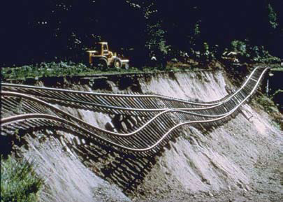
Landslides are an often-overlooked danger of earthquakes. They are particularly likely during rainy, water-soaked winter months in Cascadia. Almost 40 miles (60 kilometers) from the epicenter, this section of the Union Pacific Railway was left dangling after the hillside fill beneath it slid away in the 1965 earthquake.

Slide 30
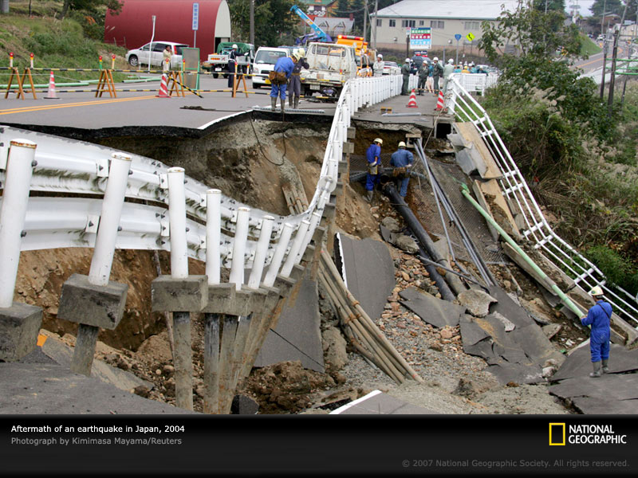

Slide 31
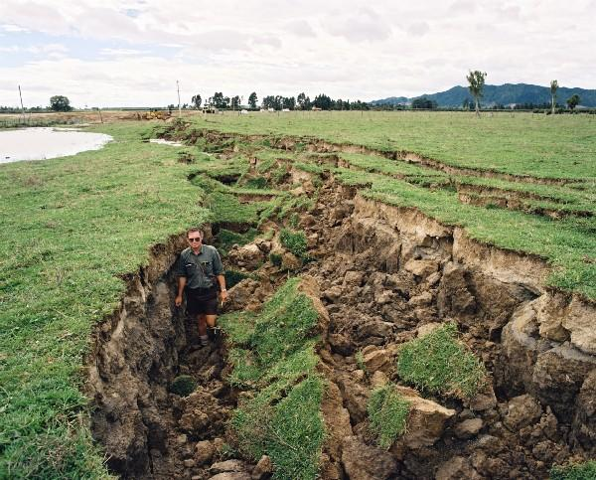

Slide 32
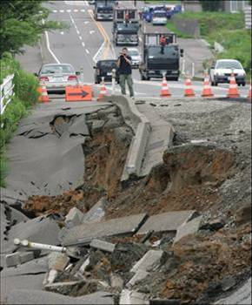
video

Slide 33
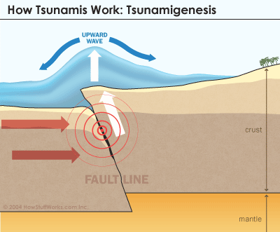
Earthquakes cause other disasters
Tsunami = large wavelength ocean wave produced by a disruption on the ocean floor.
Characteristics:
  Speed = 400 – 500 mph
  Height = 50 – 100 feet
Tsunami Video
Japan Tsunami 2011
2004 tsunami
Japan Tsunami 2
Notes:
Caused by earthquakes, volcanic eruptions, meteorite impacts, or landslides.

Slide 34
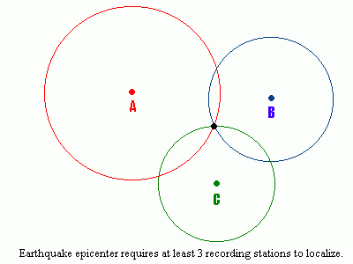
Locating an Earthquake Epicenter
P and S waves travel at different speeds, and arrive at seismographs at different times.
We use the time difference and the ESRT to determine the DISTANCE to the epicenter.
Notes:
The further a seismograph is from an earthquake, the bigger the time difference between arrival of P-wave and S-wave.

Slide 35
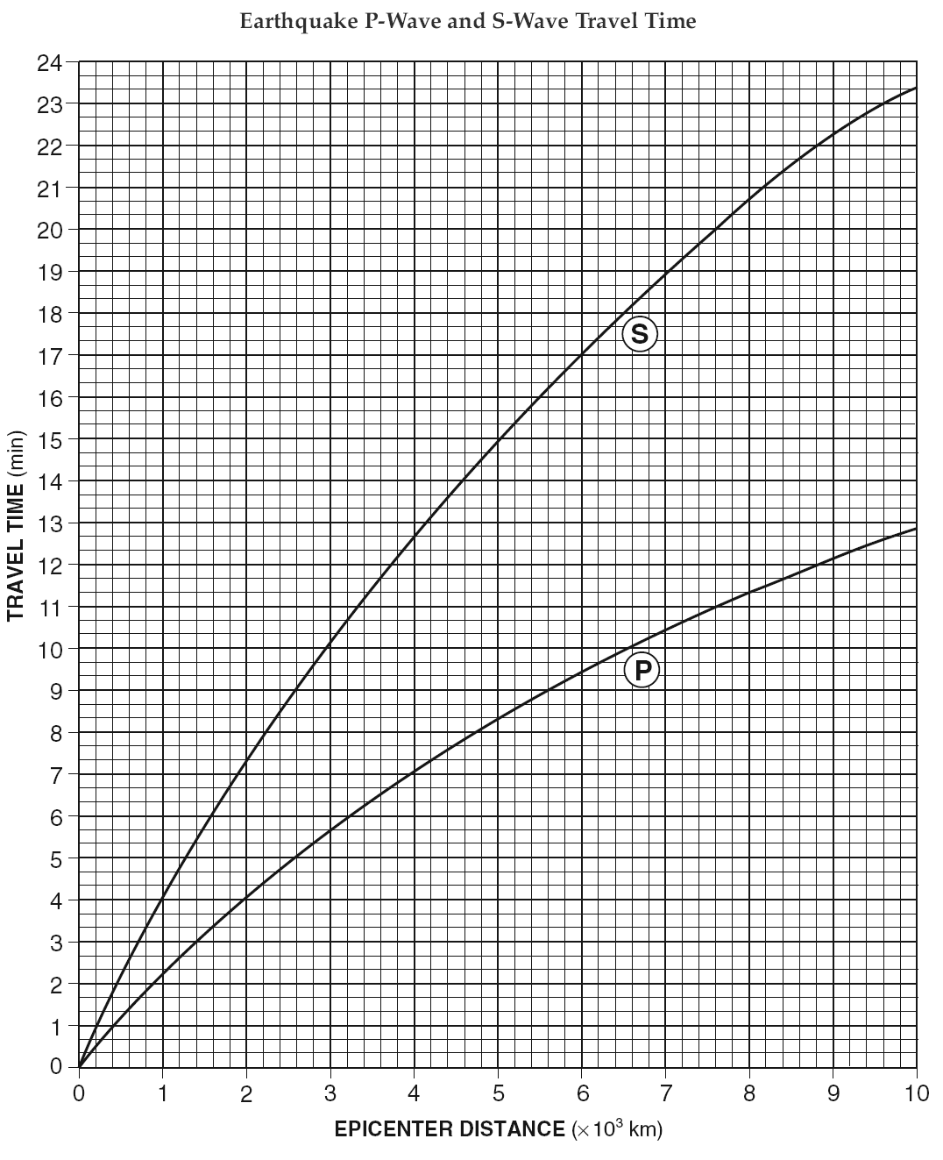
Notes:
Page 13

Slide 36
Worksheets:
Finding Epicenters

Slide 37
1. If a p-wave arrives five minutes before the s-wave arrives, how many kilometers from the epicenter is a location?

Slide 39
1. If a p-wave arrives five minutes before the s-wave arrives, how many kilometers from the epicenter is a location?
The earthquake epicenter is 3,400 km away from you.

Slide 40
2. If a p-wave arrives at 12:10:00 and the s-wave arrives at 12:16:20, how many kilometers from the epicenter is a location?
12 hours 16 minutes 20 seconds
12 hours 10 minutes 00 seconds
0 hours 6 minutes 20 seconds

Slide 42
2. If a p-wave arrives at 12:10:00 and the s-wave arrives at 12:16:20, how many kilometers from the epicenter is a location?
12 hours 16 minutes 20 seconds
12 hours 10 minutes 00 seconds
0 hours 6 minutes 20 seconds
The earthquake occurred 4,800 km away from you.

Slide 43
3. An earthquake epicenter is 2,600 km from a location. If the p-wave arrives at 9:00:20, what time will the s-wave arrive?

Slide 45
3. An earthquake epicenter is 2,600 km from a location. If the p-wave arrives at 9:00:20, what time will the s-wave arrive?
There will be 4 minutes between p-wave and s-wave arrival.
9 hours 0 minutes 20 seconds
+ 0 hours 4 minutes 0 seconds
9 hours 4 minutes 20 seconds
Or 9:04:20

Slide 46
4. An earthquake epicenter is 5,200 km from a location. If the s-wave arrives at 1:20:20, what time did the p-wave arrive?

Slide 48
4. An earthquake epicenter is 5,200 km from a location. If the s-wave arrives at 1:20:20, what time did the p-wave arrive?
The p-wave arrives 6 minutes and 40 seconds before the s-wave.
1 hour 20 minutes 20 sec
0 hour 6 minutes 40 sec
1 hour 13 minutes 40 seconds
Or 1:13:40

Slide 49
5. If a p-wave arrives 6 mins after an earthquake occurs, how many kilometers is the location from the epicenter? How long after the p-wave arrives will the s-wave arrive?

Slide 51
5. If a p-wave arrives 6 mins after an earthquake occurs, how many kilometers is the location from the epicenter? How long after the p-wave arrives will the s-wave arrive?
The epicenter is 3,200 km away.

Slide 53
5. If a p-wave arrives 6 mins after an earthquake occurs, how many kilometers is the location from the epicenter? How long after the p-wave arrives will the s-wave arrive?
The epicenter is 3,200 km away.
The p-wave arrives 4 min 40 sec after the s-wave.

