Slide 1
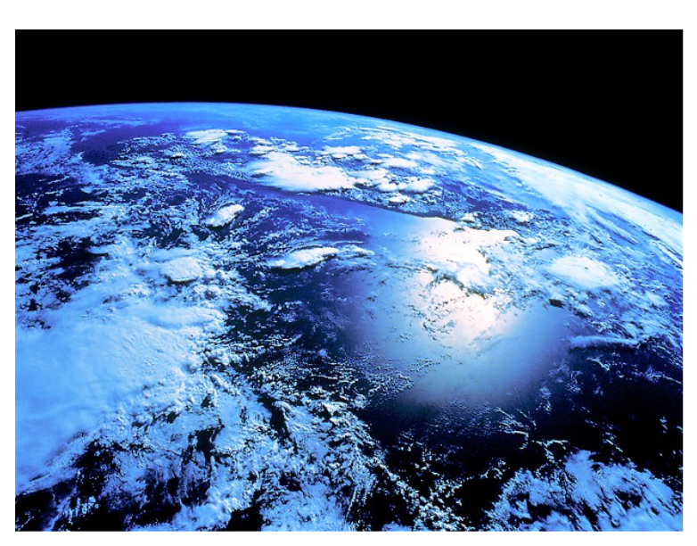
UNIT 2: MEASURING EARTH
Topic 1:
Size and Shape of Earth

Slide 2
What do you consider evidence of Earth’s Shape?

Slide 3
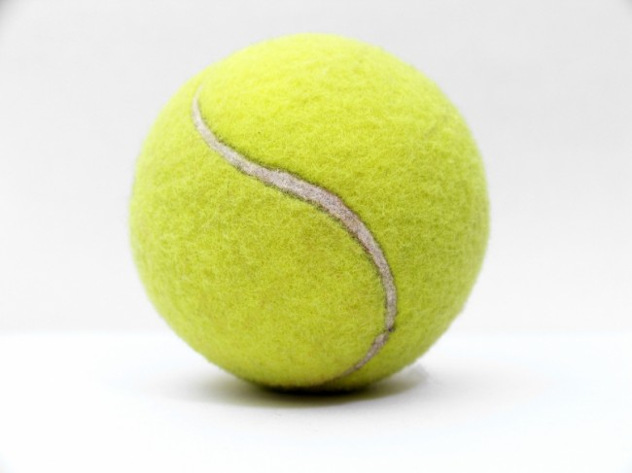
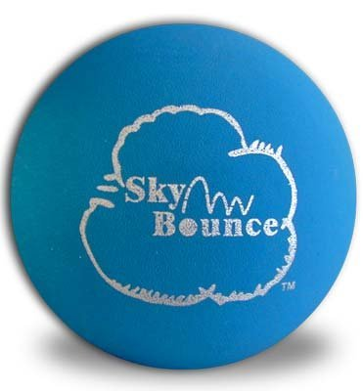
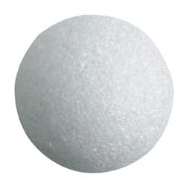
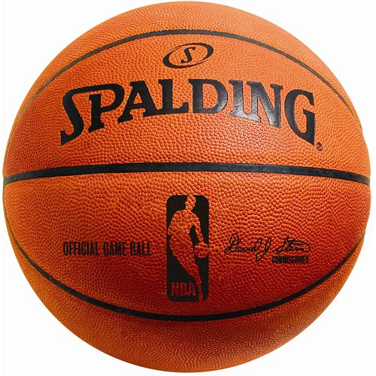
Which do you think most closely resembles Earth?
Tennis Ball
Hand Ball
Basketball
Styrofoam Ball

Slide 4
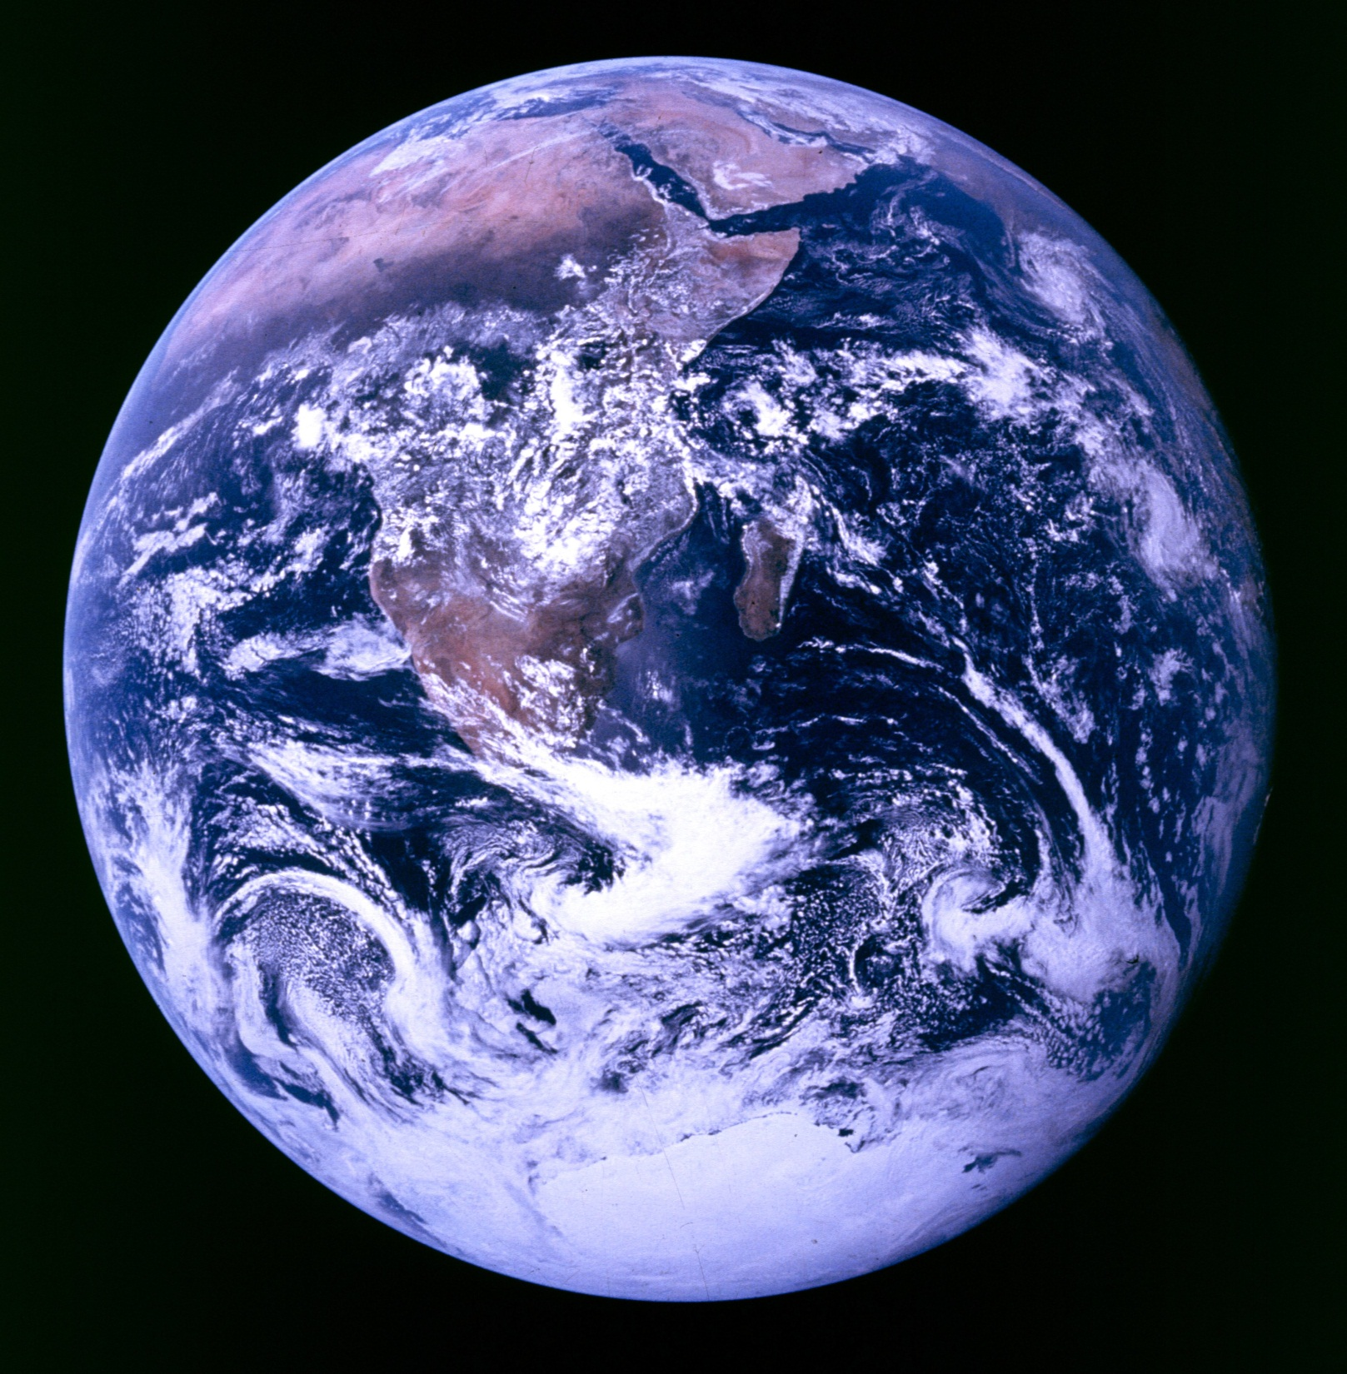

Slide 5
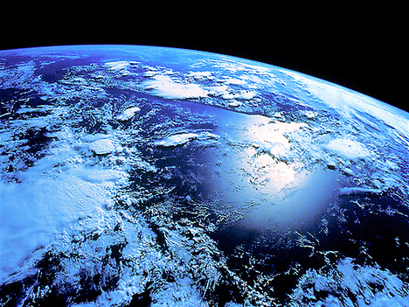

Slide 6
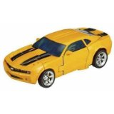
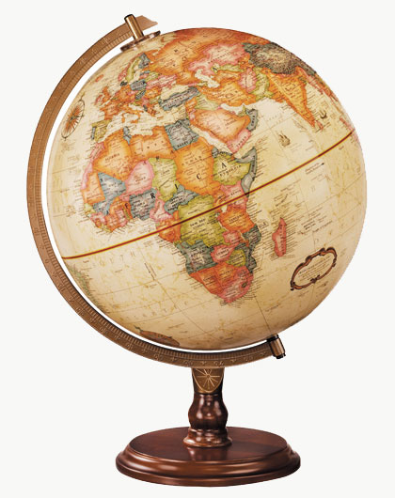
What is a model?
A model is anything that represents the properties of an object or a system.
Types of Models:
Physical
Mechanical
Mental
Mathematical
Graphic
Computer

