Slide 1
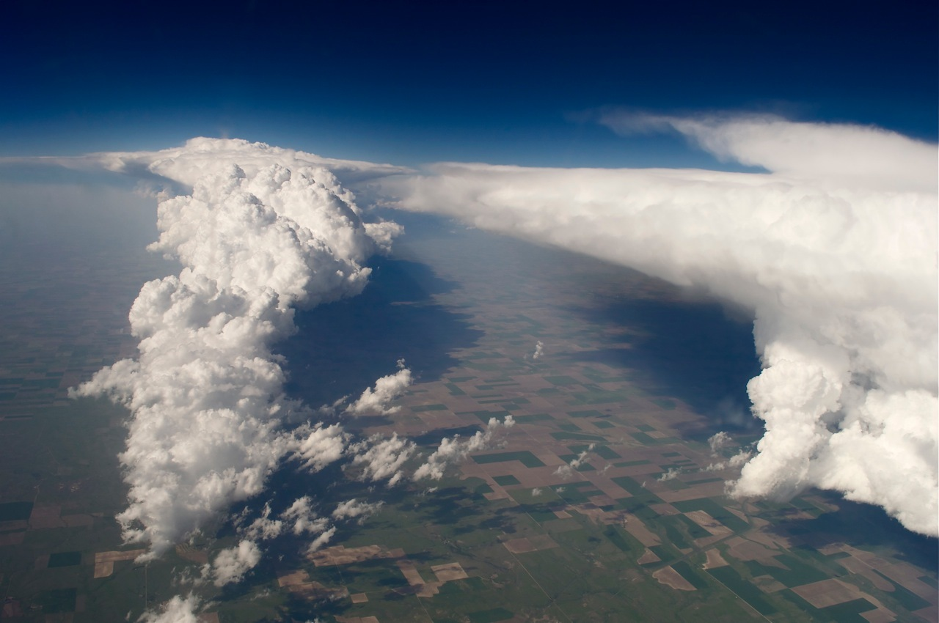
Weather
Air Temperature, Pressure, and Density

Slide 2
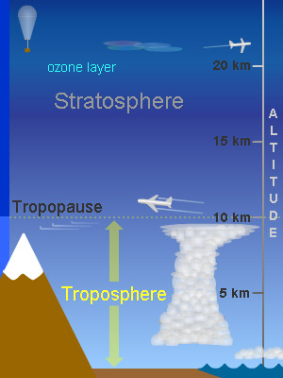
Weather is the state of the variables of the atmosphere at any given location for a short period of time.
Most weather occurs in the TROPOSPHERE.
The major cause of weather is the variation in insolation on Earth.
Notes:
Temperature, air pressure, wind, moisture, cloud cover, precipitation and storms.
Variation in insolation causes heat energy to be unevenly distributed in the atm. Heat energy moves to even things out, resulting in constant changes in the atm that are a major cause of weather.

Slide 3
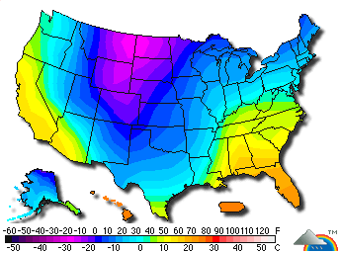
Atmospheric Temperature
Temperature is measured in degrees Fahrenheit, Celsius, or Kelvin with a thermometer.
  On a map, shown with ISOTHERMS.

Slide 4
Heating of the Atmosphere
The atmosphere can be heated by:
  Direct contact with Earth’s surface
  Direct absorption on insolation by gases and aerosols
  Absorption of long-wave infrared from Earth’s surface
  Condensation & Sublimation
  Coriolis Effect
Notes:
More insolation = warmer surface and atmosphere
Conduction (direct contact)
Greenhouse gases
Condensation and Sublimation(to ice) release large amounts of stored energy, heating the atm. (when clouds, fog, dew, and frost form)
Coriolis Effect causes friction where atm and Earth’s surface meet. Produces heat, which can be absorbed by atm.

Slide 5
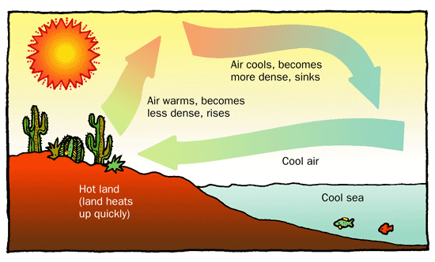
Transfer of heat WITHIN the atmosphere
Convection
  Differences in air density cause differences in air pressure → causing CONVECTION CURRENTS.
Notes:
Winds

Slide 6
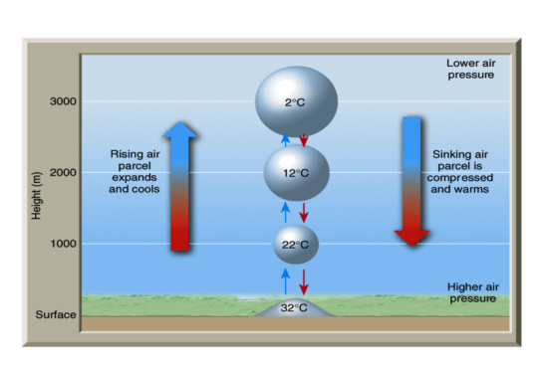
Heating and Cooling of Air by Expansion and Compression
When a gas EXPANDS, temp DECREASES
When a gas COMPRESSES, temp INCREASES
Notes:
Temp generally decreases with increasing altitude bc as air rises there is less air above it → less air pressure → expands and cools.

Slide 7
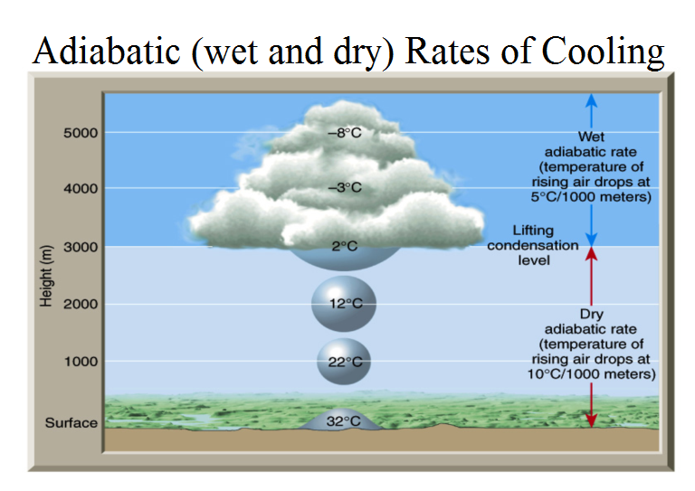

Slide 8
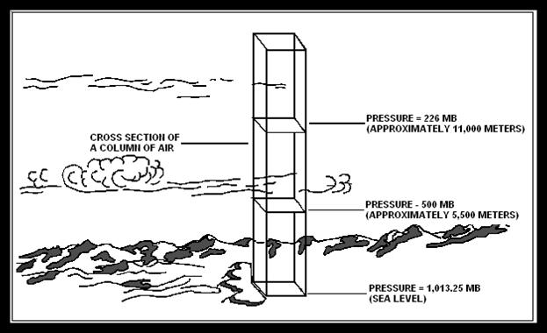
Atmospheric Pressure and Density
Directly related
Atmospheric Pressure: the pressure due to the weight of the overlying atmosphere pushing down on an area.
Notes:
Barometric Pressure or Air pressure

Slide 9
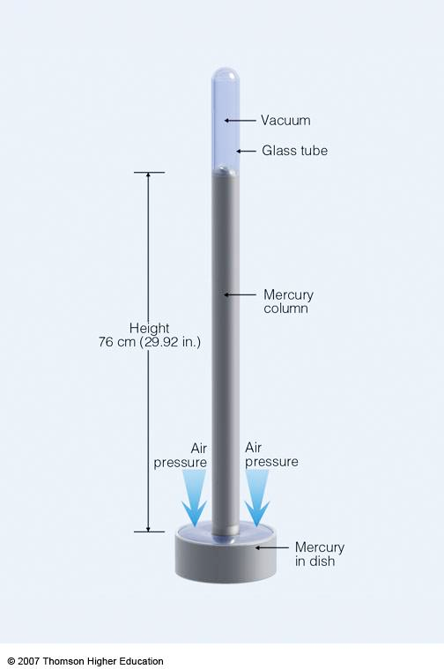
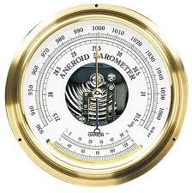
Measuring Air Pressure
Barometer: instrument used to measure air pressure.
Mercury Barometer
Aneroid Barometer
Notes:
Mercury Barometer: tube with a closed top placed in a container of mercury. When air pushes down on mercury, it rises in the tube.
Aneroid Barometer: metal can contains a partial vacuum that expands and contracts with changes in air pressure. Mechanical parts display a reading on a dial.

Slide 10
Standard air pressure at sea level (1 atmosphere):
  14.7 pounds per square inch
  29.92 inches of mercury
  1013.2 millibars
Notes:
Page 13 ESRT

Slide 11
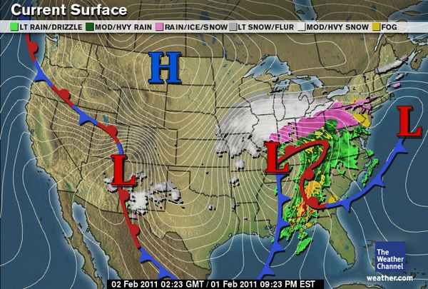
Air pressure is shown on weather maps with ISOBARS

Slide 12
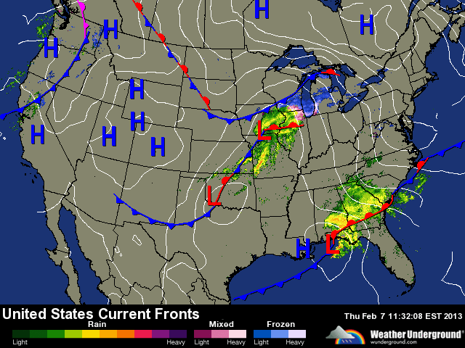

Slide 13
More Effects on Air Pressure
Temperature
Water Vapor
Altitude
**AS any of these 3 factors INCREASE, air pressure and air density DECREASE.
Notes:
TEMP:
As temperature INCREASES, air expands and pressure decreases.
As temperature DECREASES, air compresses and pressure increases.
Water Vapor:
More vapor = less density and less pressure. Water molecules replace air molecules (O or N) – Weighs less.
As elevation increases, density and pressure DECREASE. Less oxygen available.

