Slide 1
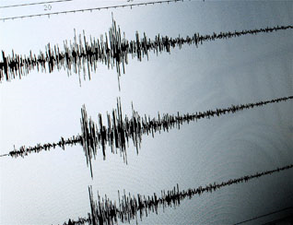
Earthquakes and Volcanoes
AIM: Why do earthquakes and volcanoes occur on Earth?

Slide 2
What are Earthquakes?
An earthquake is the shaking and trembling that results from the movement of rock beneath Earth’s surface.
  There are several THOUSAND earthquakes every day, but most are too small to notice.
Plate movements create stress in Earth’s crust, creating faults.
  Stress increases along a fault until the rock breaks, causing an earthquake.
  Earthquakes release enormous amounts of stored energy.

Slide 3
Focus: the area beneath Earth’s surface where an earthquake originates.
Epicenter: the place on Earth’s surface lying DIRECTLY ABOVE the focus.

Slide 4
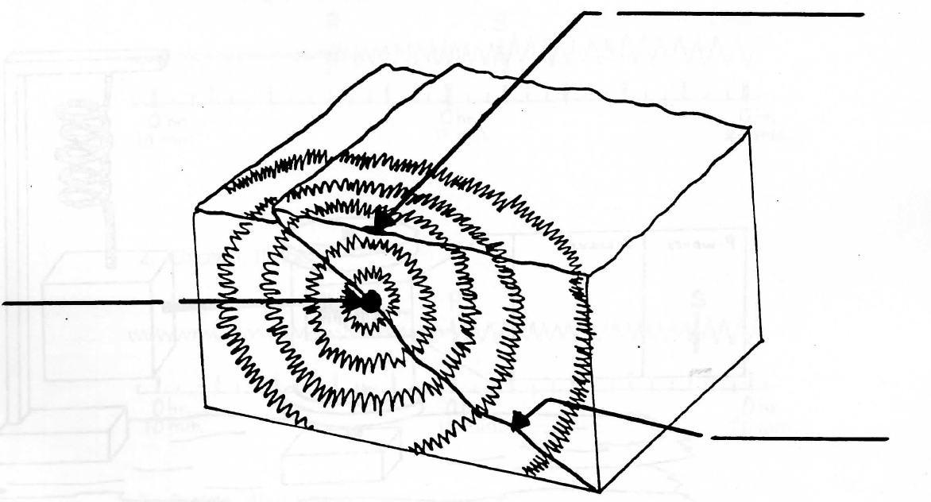
Epicenter
Focus
Fault

Slide 5
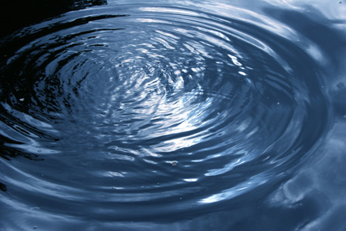
Types of Seismic Waves
An earthquake produces vibrations called waves.
  Beginning at the focus, waves carry energy outward in all directions.

Slide 6
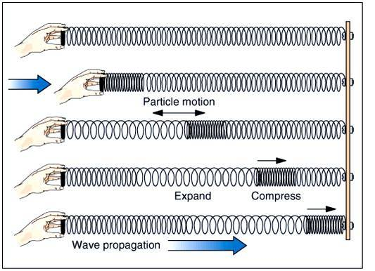
PRIMARY WAVES
Also called P-Waves.
Compress and expand like a slinky.
Can travel through solids, liquids, and gases.

Slide 7
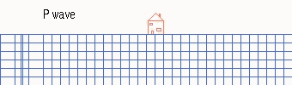

Slide 8
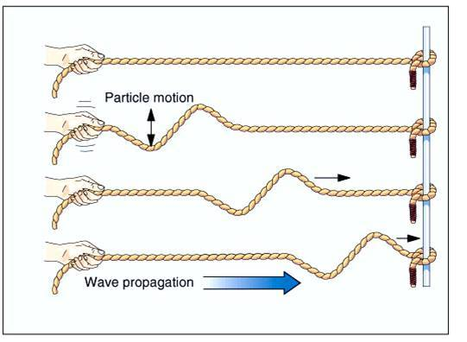
2. SECONDARY WAVES
Also called S-Waves.
Vibrate up and down as they move forward.
Can ONLY travel through SOLIDS.

Slide 9
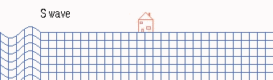

Slide 10
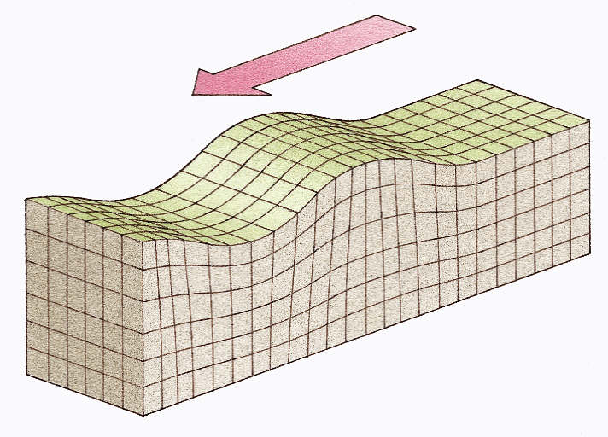
3. SURFACE WAVES
When some P and S waves reach the surface, they can become surface waves.
Can make the ground roll like ocean waves.

Slide 11
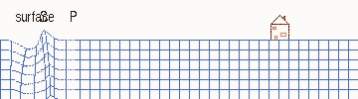

Slide 12
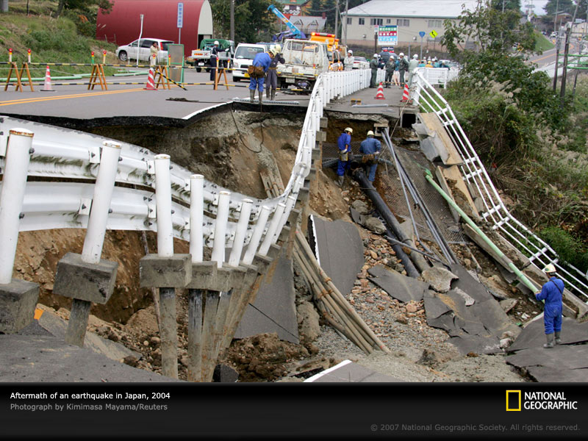

Slide 13
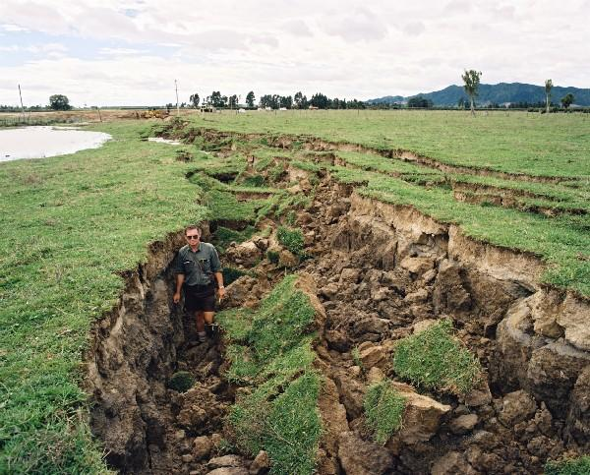

Slide 14
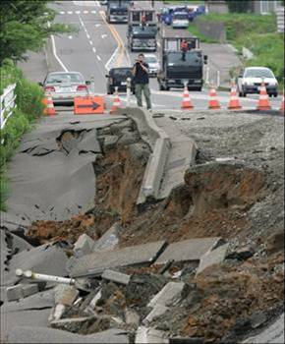

Slide 15
What can people do to protect themselves during an earthquake?
Drop down under a strong object (desk, table, etc.)
Turn away from windows
Do not go very far (only 10-30 seconds long)

Slide 16
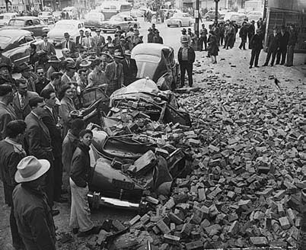
During the April 1949 earthquake near Tacoma, Washington, the owner of the Busy Bee Café barred the doors to keep panicking patrons from rushing outside. Seconds later, brick fell from the top of the Hotel Seattle, crushing several cars.

Slide 17
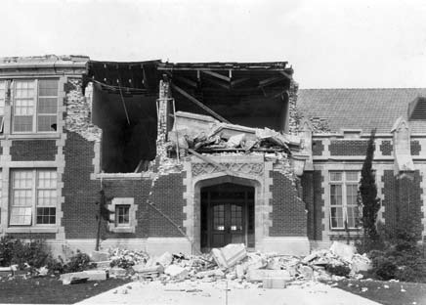
The Long Beach, California school above shows how dangerous old, brick
buildings can be. In the 1949 Olympia earthquake, the Senior Class President
of Castle Rock High School was killed by falling bricks. The gable on the school collapsed, even though the structure was more than 50 miles (80 kilometers) from the epicenter.

Slide 18
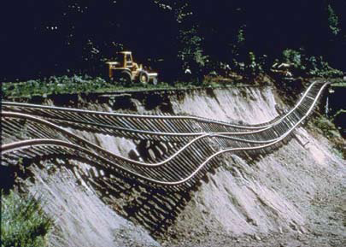
Landslides are an often-overlooked danger of earthquakes. They are particularly likely during rainy, water-soaked winter months in Cascadia. Almost 40 miles (60 kilometers) from the epicenter, this section of the Union Pacific Railway was left dangling after the hillside fill beneath it slid away in the 1965 earthquake.

Slide 19
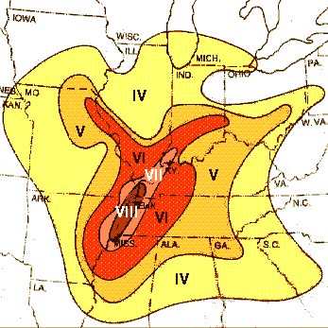
How can we Measure Earthquakes?
The 3 most commonly used methods are:
Mercalli Scale: rates earthquakes according to level of damage.
Depending on your location, the same earthquake can have many different ratings.

Slide 20
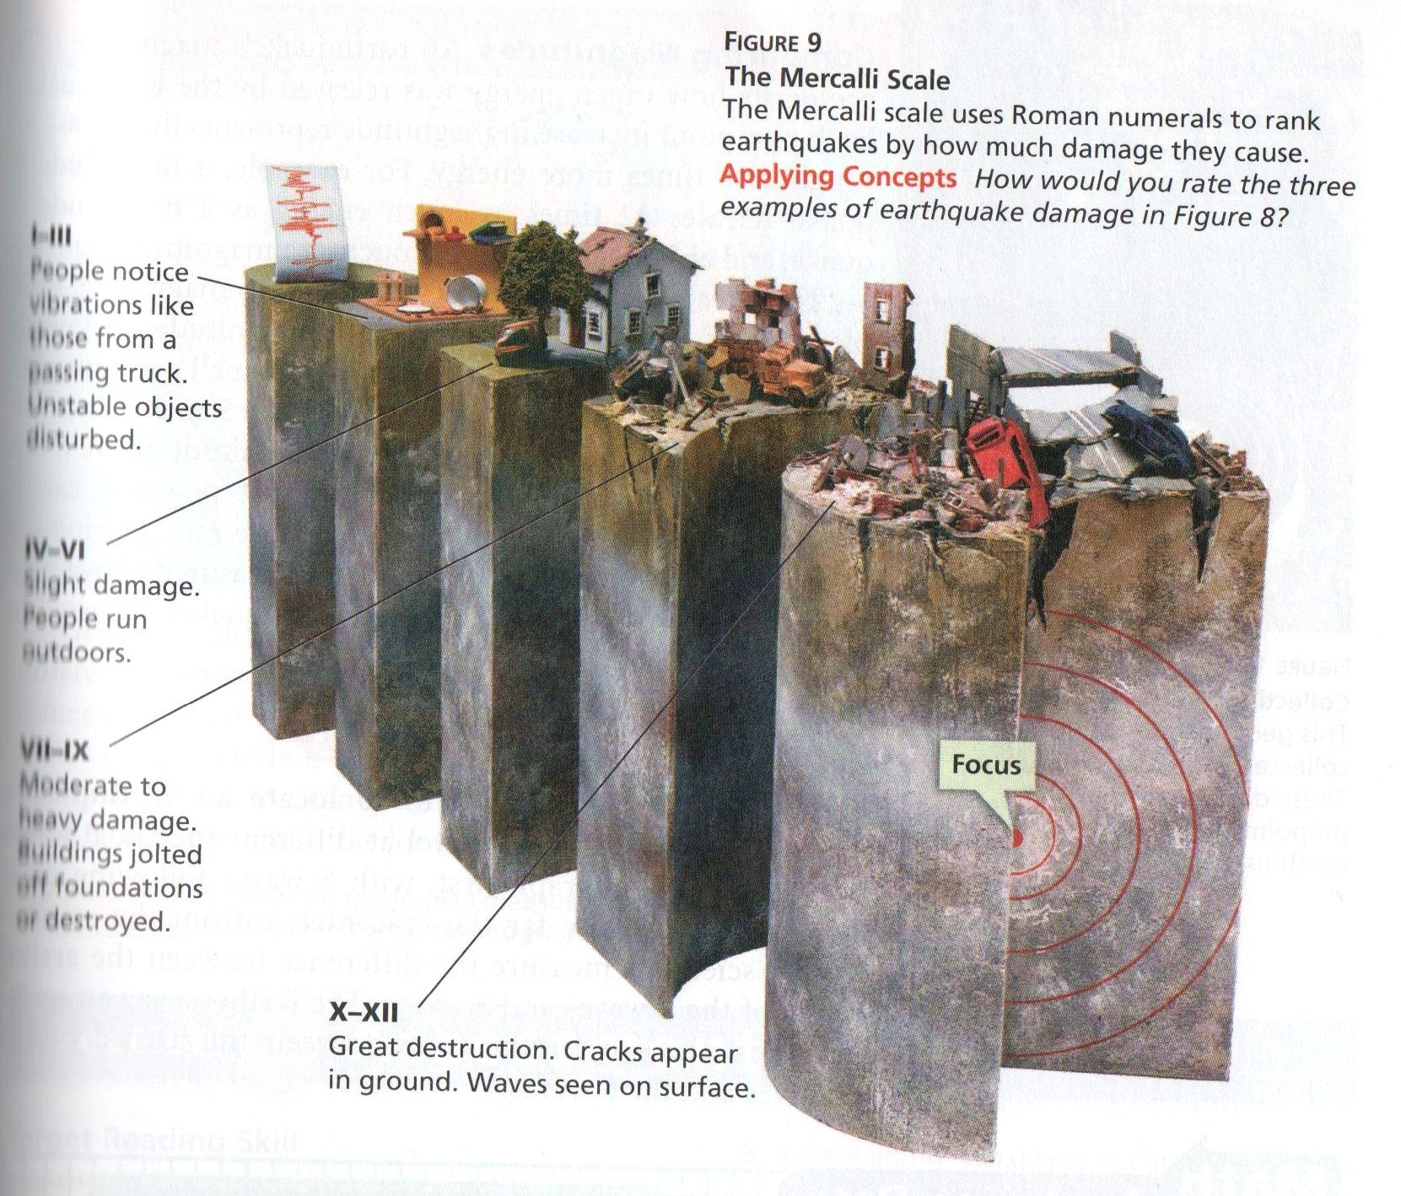

Slide 21
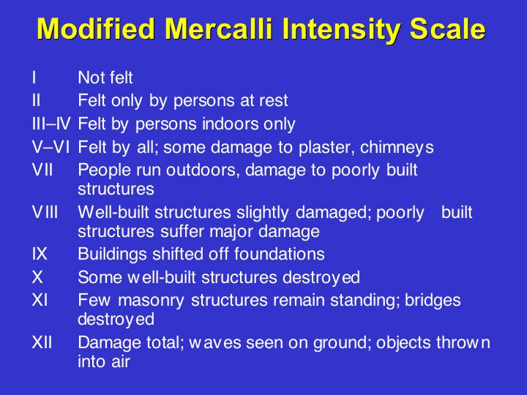

Slide 22
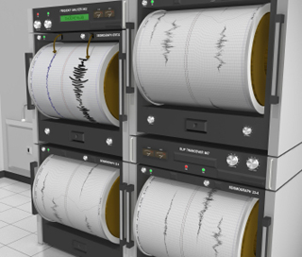
2. Richter Scale: rates an earthquake based on the size of its seismic waves.
Magnitude: number given to an earthquake based on its size.
Seismic waves are measured using a seismograph.
Does not work well for large or distant earthquakes.

Slide 23
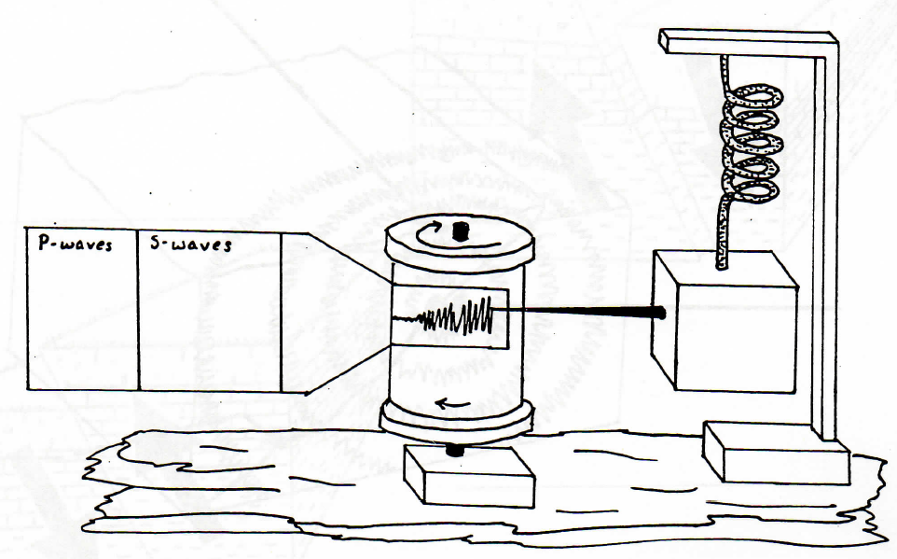
Spring
Rotating drum
marker
weight
Bedrock

Slide 24
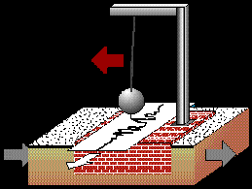

Slide 25
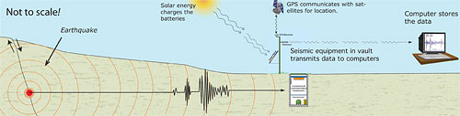
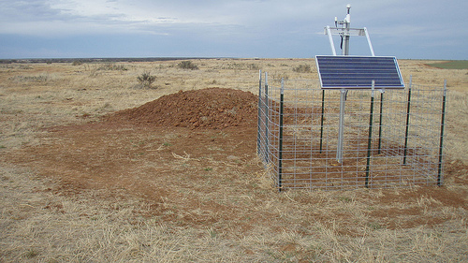

Slide 26
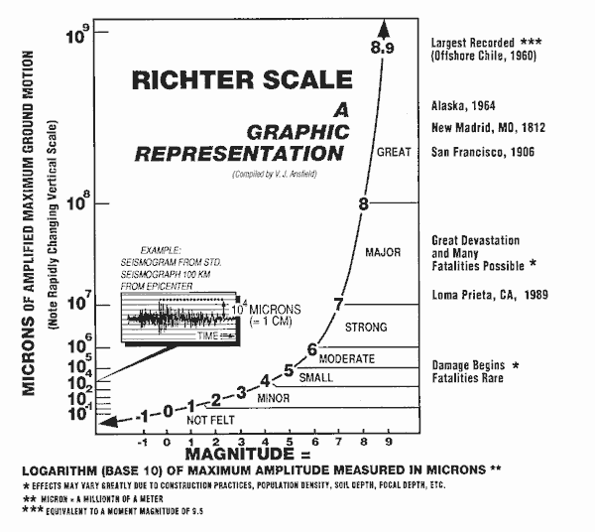

Slide 27
3. The Moment Magnitude Scale: estimates the total energy released by an earthquake.
Most often used by geologists today.
Can be used for near and distant earthquakes.
Data used from:
  seismographs
  wave types and strength
  movement along fault
  strength of rocks that broke

Slide 28
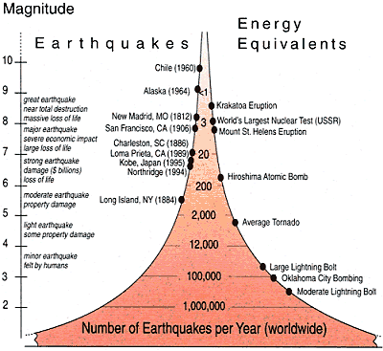

Slide 29
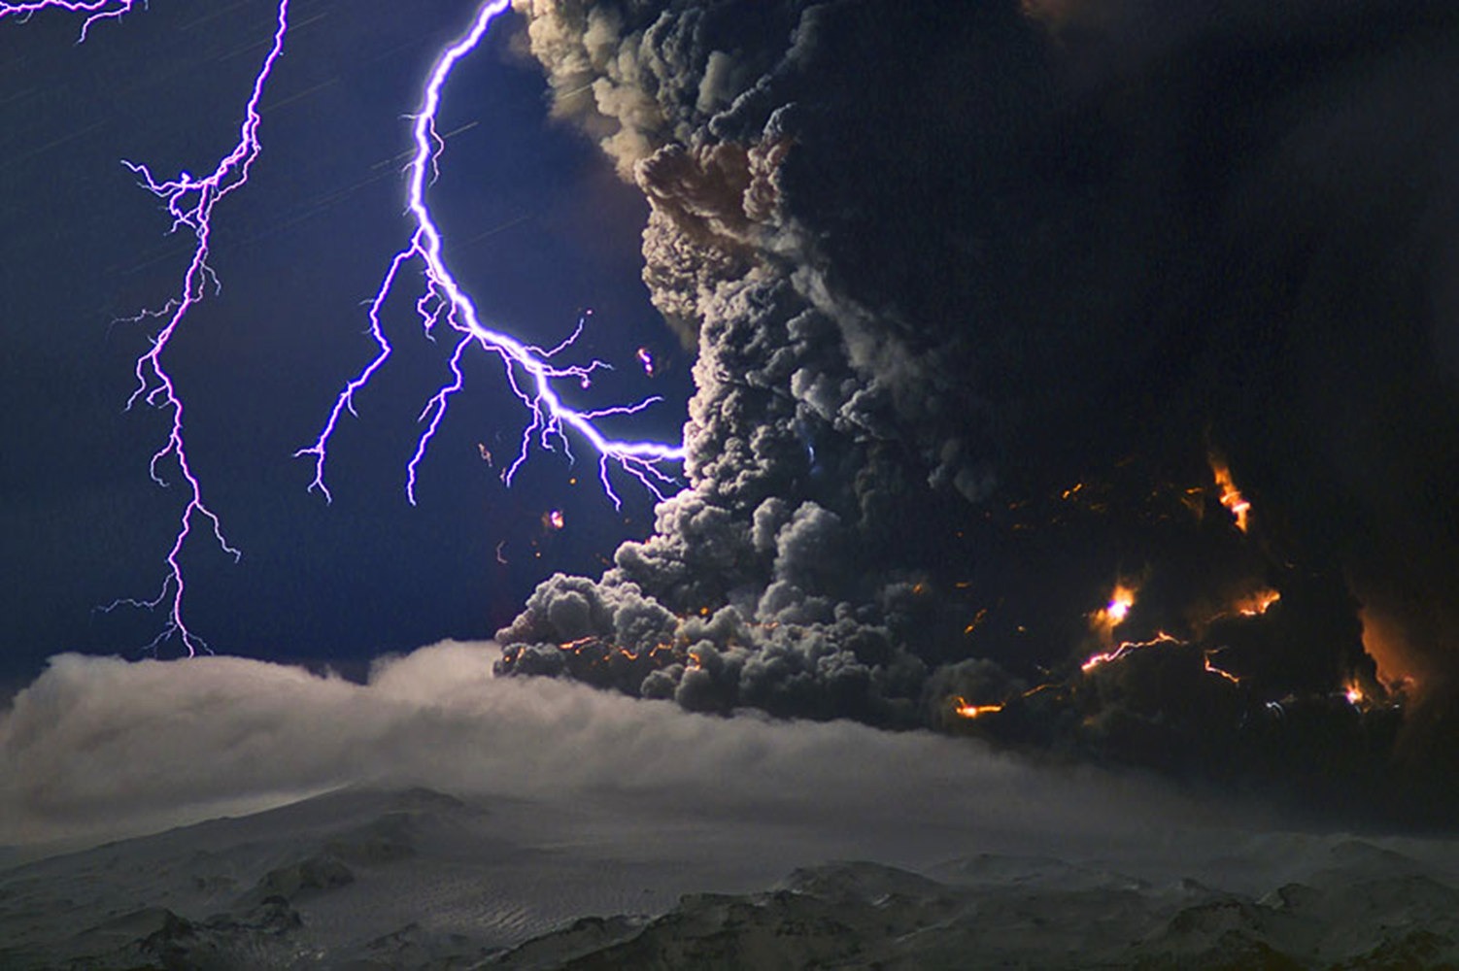
VOLCANOES

Slide 30
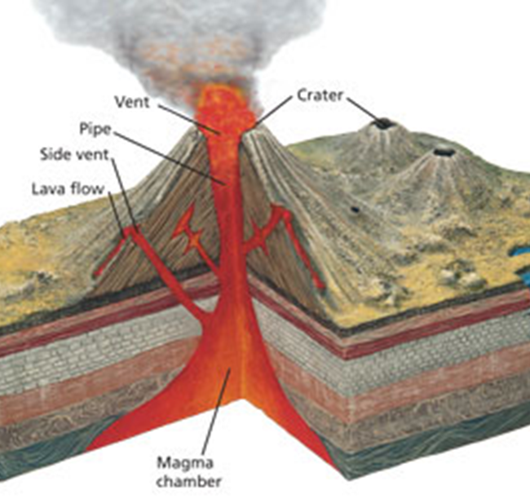
Volcanoes and Plate Boundaries
A volcano is a weak spot in the crust where magma comes to the surface.
Magma that reaches the surface is called lava.

Slide 31
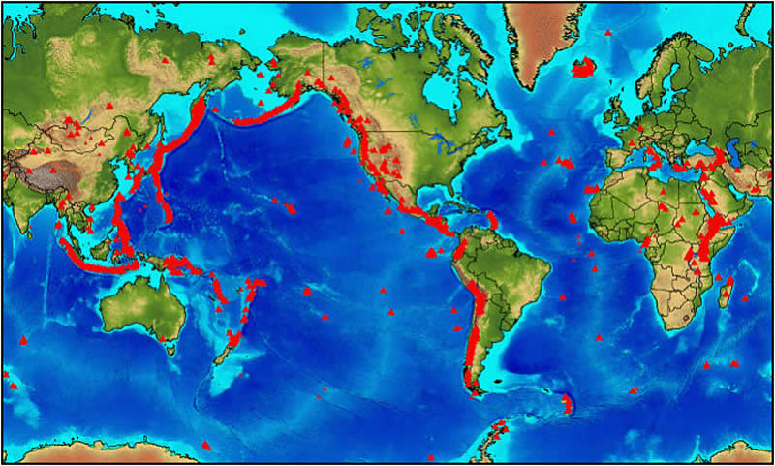

Slide 32
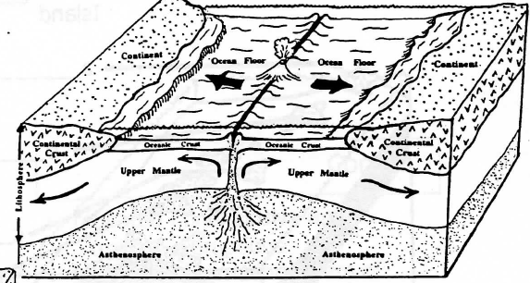
Volcanoes can be found at:
  1. Divergent Boundaries

Slide 33
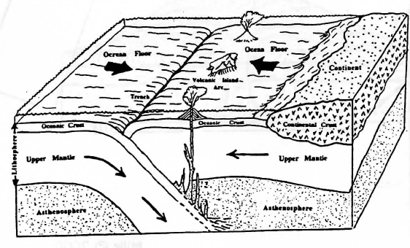
2. Convergent Boundaries
  Ocean-Ocean: Volcanoes occur on the ocean floor near the subduction zone, forming islands if they rise above sea level.

Slide 34
Iceland Photos (Video)
Underwater eruption, 2009
Volcano webcams

Slide 35
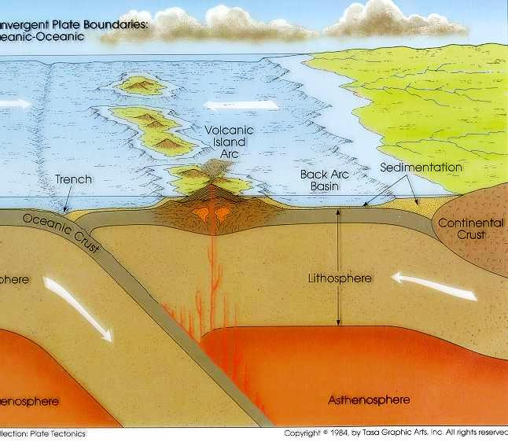

Slide 36
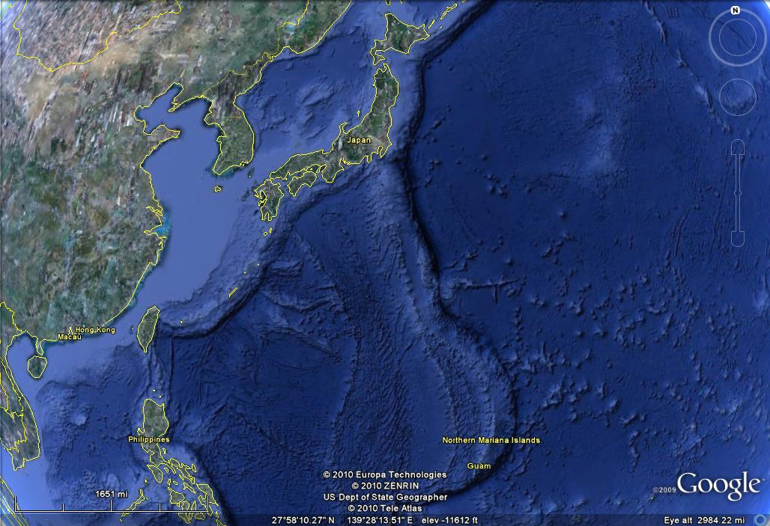

Slide 37
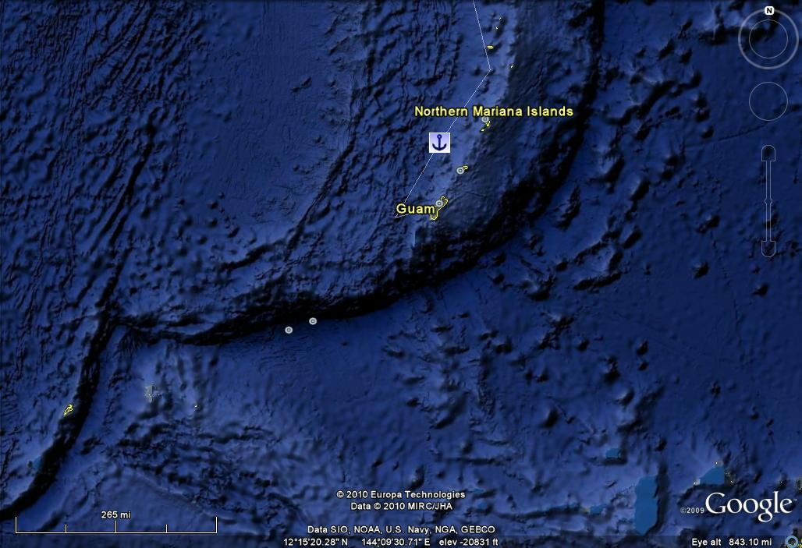
Mariana’s Trench = deepest point on Earth (35,814 feet deep)

Slide 38
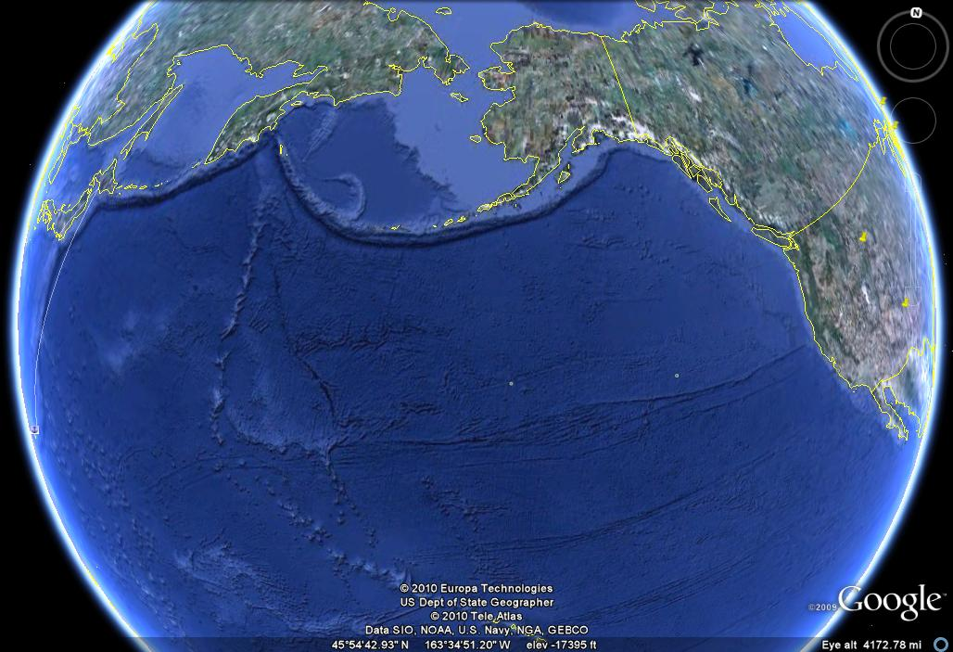
Aleutian Trench

Slide 39
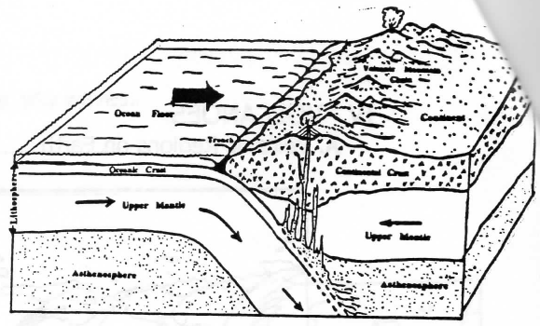
  Ocean-Continental: Volcanoes occur near the coast of the continental plate.

Slide 40
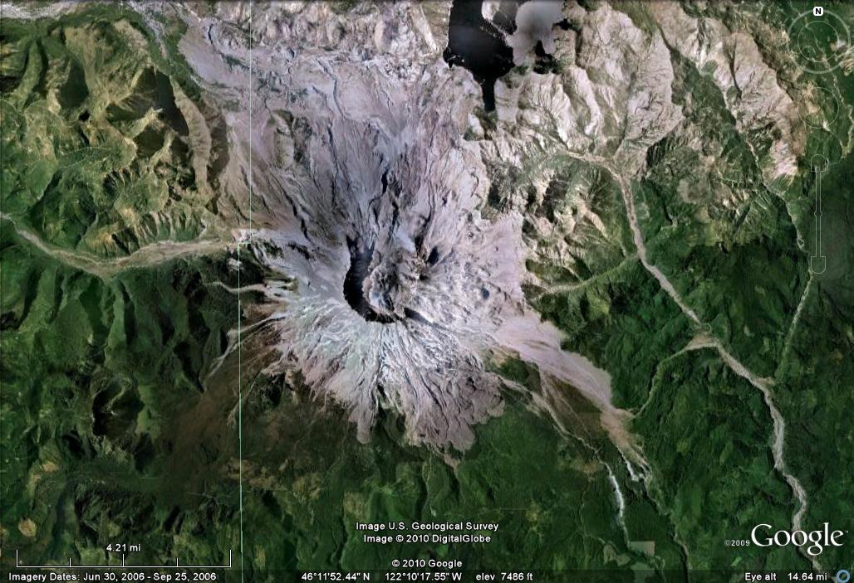
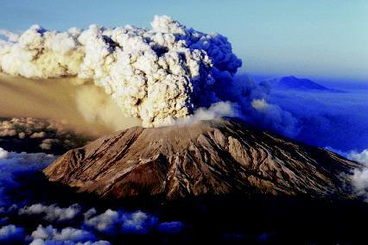
Mount St. Helens, Washington

Slide 41
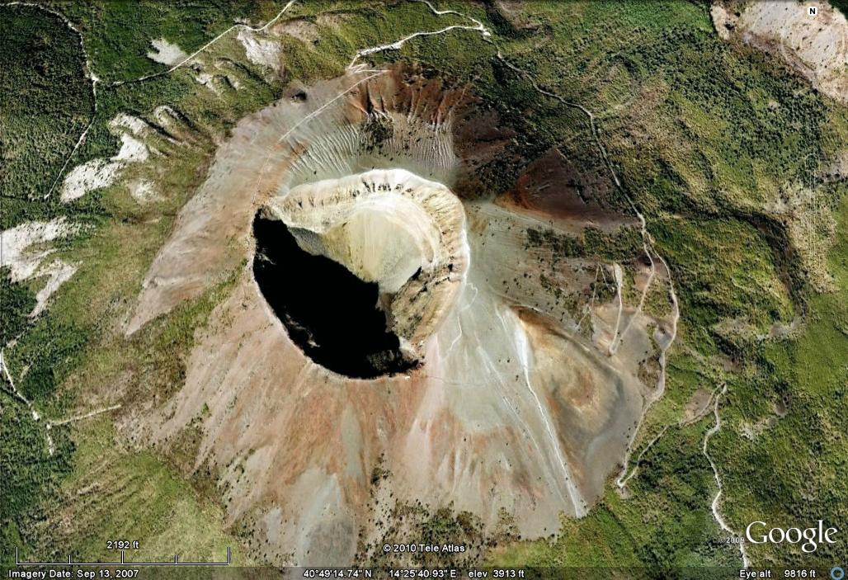
Pompeii, Italy

Slide 42
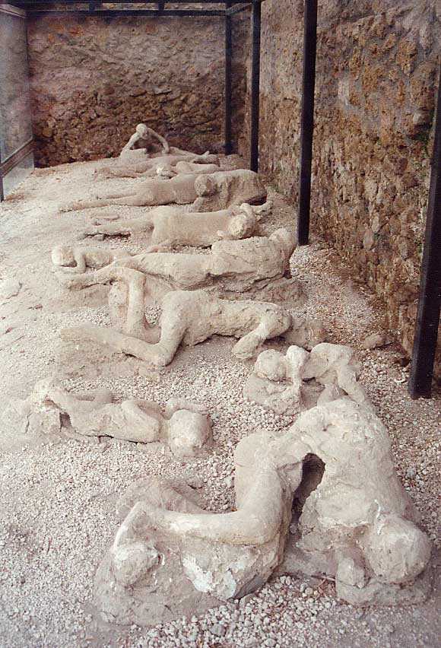
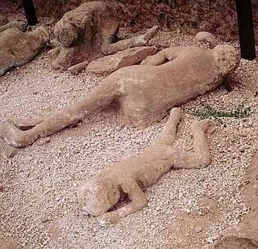

Slide 43
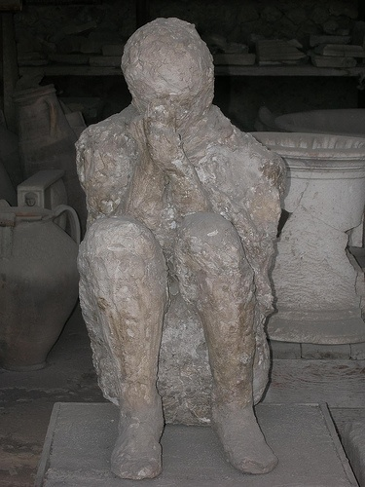
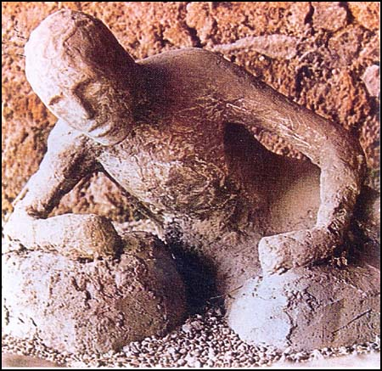

Slide 44
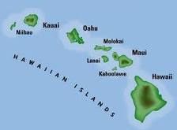
Hotspot Volcanoes
A hotspot volcano forms when material from deep inside the mantle rises and then melts. The magma breaks through the crust and reaches the surface.
  NOT at a plate boundary.
  Examples: Hawaiian Islands
  Yellowstone, Wyoming
Animation

Slide 45
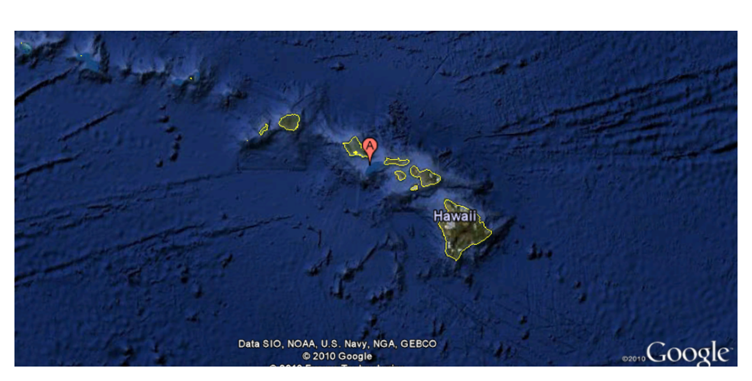
Molokai
1.5 my old
Maui
1.2 my old
Hawaii
0 my old
Kauai
4 my old
Oahu
2.5 my old

Slide 46
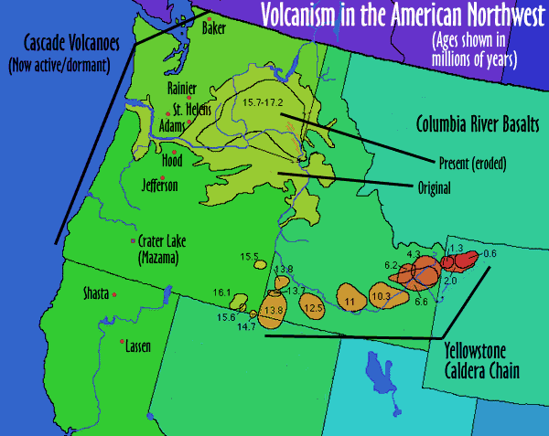

Slide 47
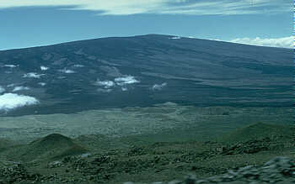
What types of volcanoes are there?
There are 3 main types of volcanoes
Shield Volcano: a wide, gently sloping mountain built by thin layers of lava.
    Ex: Hawaii
View of the NNW flank of Mauna Loa Volcano from the south side of Mauna Kea Volcano, Hawai`i; both are shield volcanoes.

Slide 48
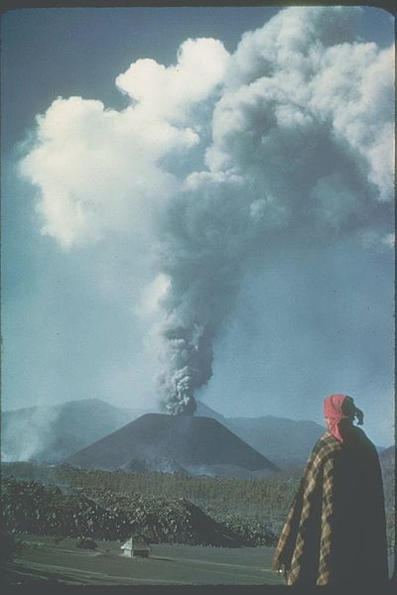
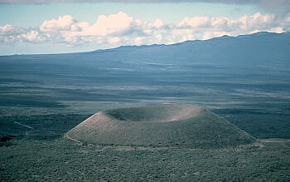
What types of volcanoes are there?
2. Cinder Cone Volcano: a steep, cone-shaped hill or mountain of ash and volcanic fragments.
This cinder cone (Pu`u ka Pele) was erupted low on the southeast flank of Mauna Kea Volcano. The cone is 95 m in height, and the diameter of the crater at the top is 400 m. Hualalai Volcano in background.
Parícutin: The volcano began as a fissure in a cornfield on February 20, 1943. Pulido, his wife, and their son all witnessed the initial eruption of ash and stones first-hand as they plowed the field. The volcano grew quickly, reaching five stories tall in just a week. The nearby villages were both buried in lava and ash; the residents relocated to vacant land nearby.

Slide 49
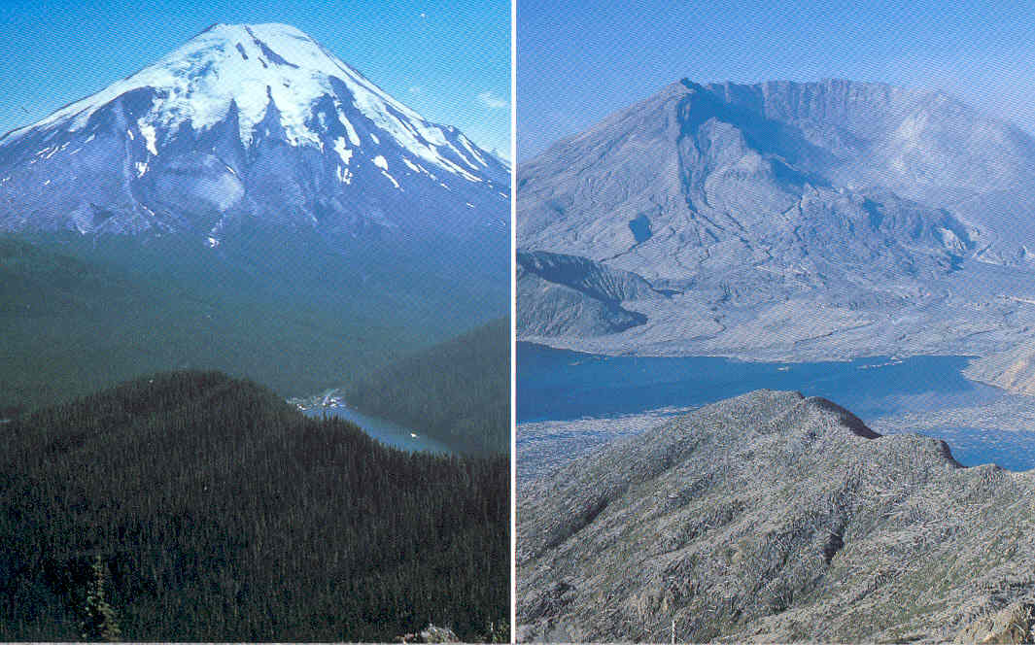
What types of volcanoes are there?
3. Composite Volcano: a tall, cone-shaped mountain with alternating layers of lava and ash.
    Ex: Mount. St. Helens (Washington State)

Slide 50
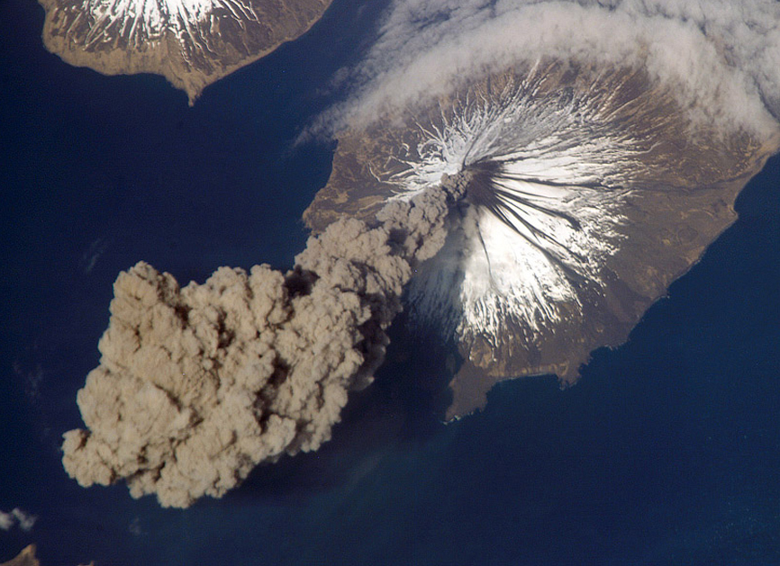
An image of a composite volcano, Cleveland Volcano, located in Alaska. On May 23rd, 2006, Flight Engineer Jeff Williams flying to the international space station noticed the gigantic plume shooting into the sky. He took this photograph of the plume of volcanic ash. The eruption lasted only 2 hours. The ash cloud height was estimated to be as high as 20,000 feet in the air.

Slide 51
Animation

