Slide 1
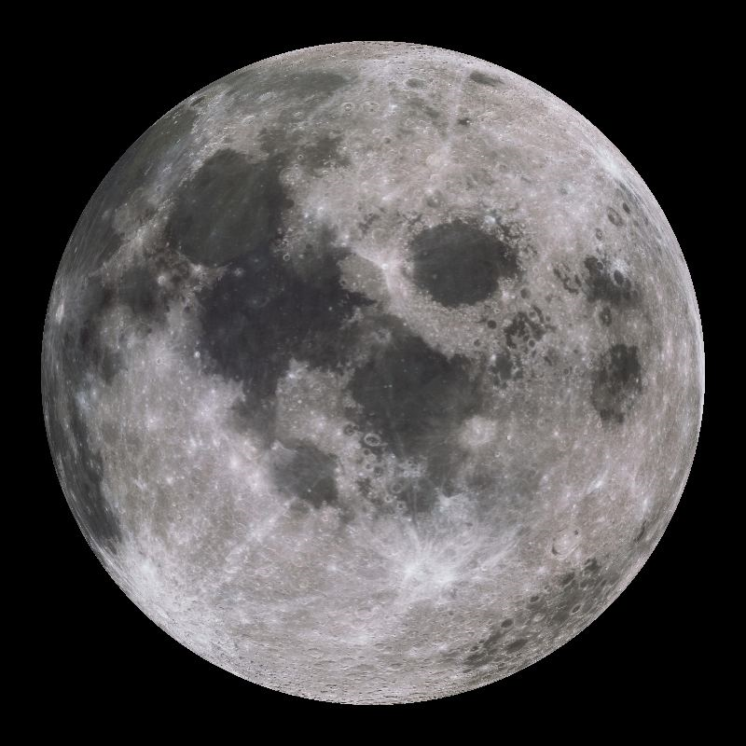
AIM: Why do we see different phases of the Moon?

Slide 2
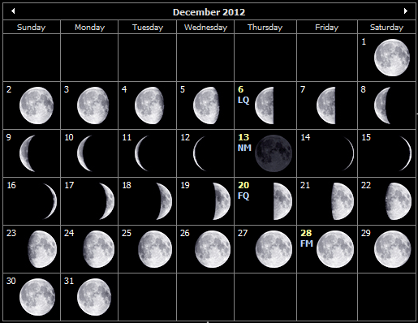
Moon Phases

Slide 3
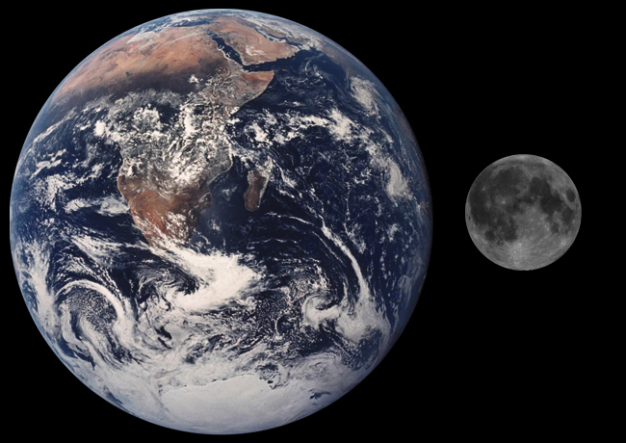
Motions of the Moon
As Earth revolves around the Sun, the moon revolves around Earth once every 27-1/3 days.
The Moon also rotates on its axis once every 27-1/3 days.
The same side of the Moon always faces the Earth.

Slide 4
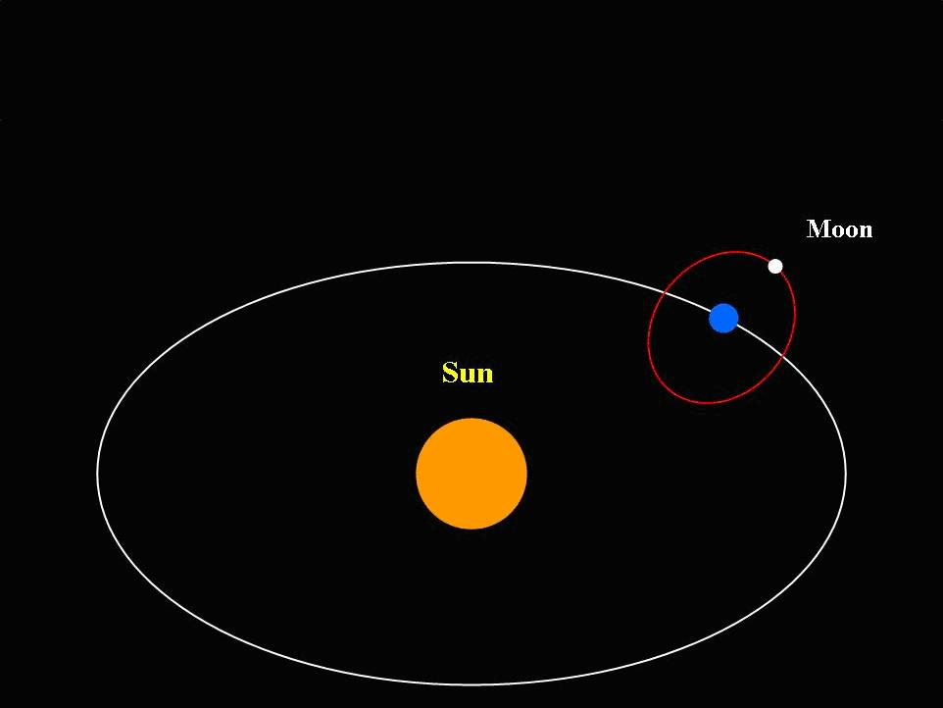

Slide 5
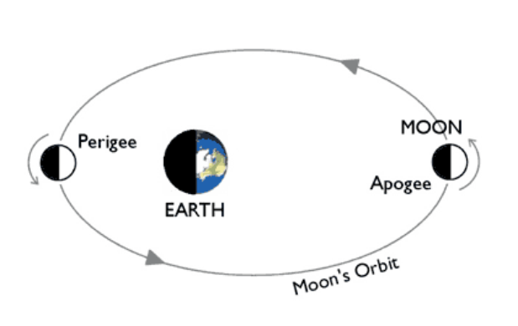
Why does the Moon shine?
The moon does NOT produce its own light.
The moon’s surface REFLECTS the light from the Sun.
One half is always lit up, one half is always dark.

Slide 6
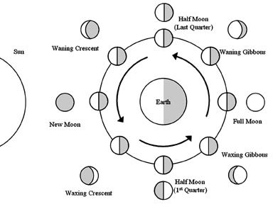
Phases of the Moon
As the moon revolves around Earth, we see varying amounts of the lighted half of the moon.
The varying amounts of the lighted moon seen from Earth are called phases of the moon.

Slide 7
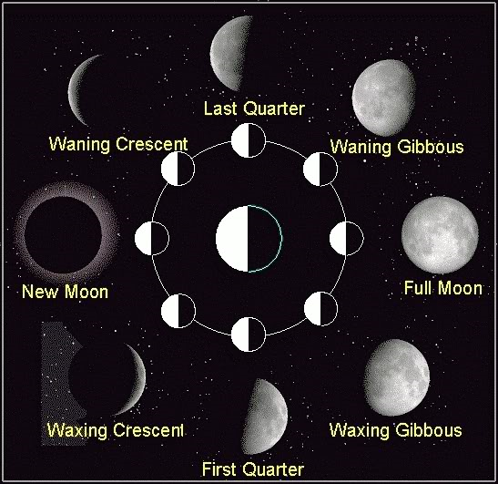

Slide 8
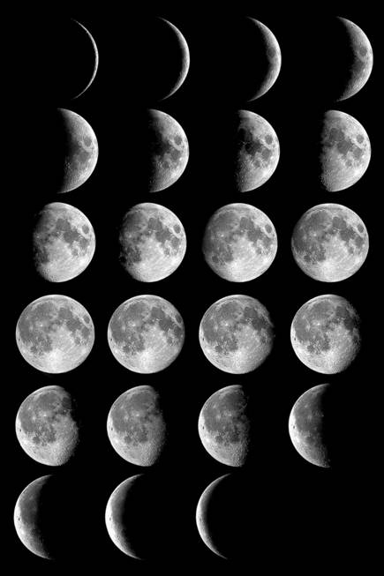
New Moon: the side of the Moon facing the Earth is completely dark.
Full Moon: the side of the Moon facing the Earth is completely lit.
Period of one full moon to the next is 29-1/2 days--this extra time is needed for the moon to catch up with the Earth as it revolves around the Sun.

Slide 9
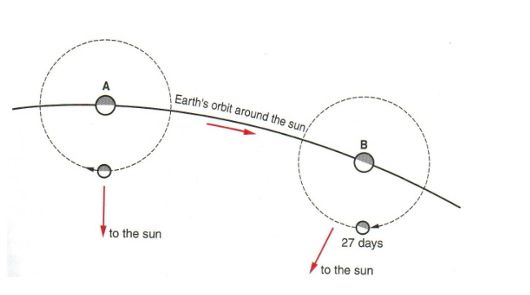

Slide 10
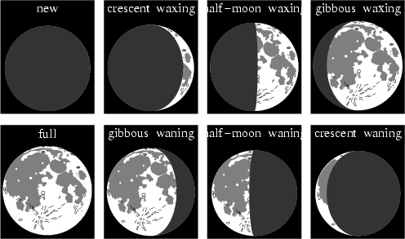
Waxing: the sunlit part of the Moon grows LARGER.
Waning: the sunlit part of the Moon gets SMALLER.

Slide 11
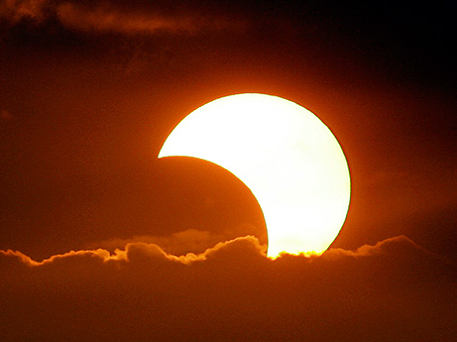
What is an Eclipse?
When an object in space comes between the Sun and another object, it casts a shadow on that object and an eclipse occurs.
The eclipse is named for the object that gets blocked.
Two types:
Solar Eclipse
Lunar Eclipse

Slide 12
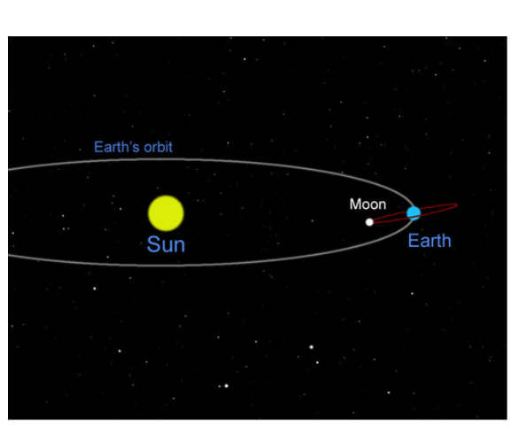
The moon's orbit is tilted about 5 degrees from Earth’s orbit

Slide 13
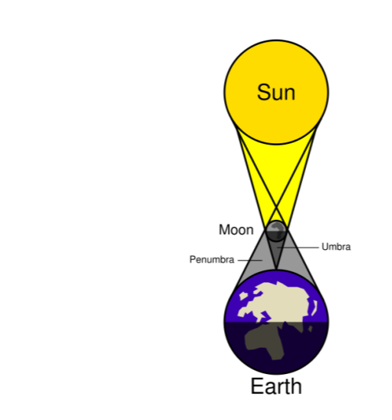
Solar Eclipse
Only during the NEW MOON phase
The moon gets in between the Earth and the Sun, casting a shadow on Earth.
Total solar eclipses are rare and brief
Last in continental US was in 1979
Next in continental US will be on 8/21/2017.

Slide 14
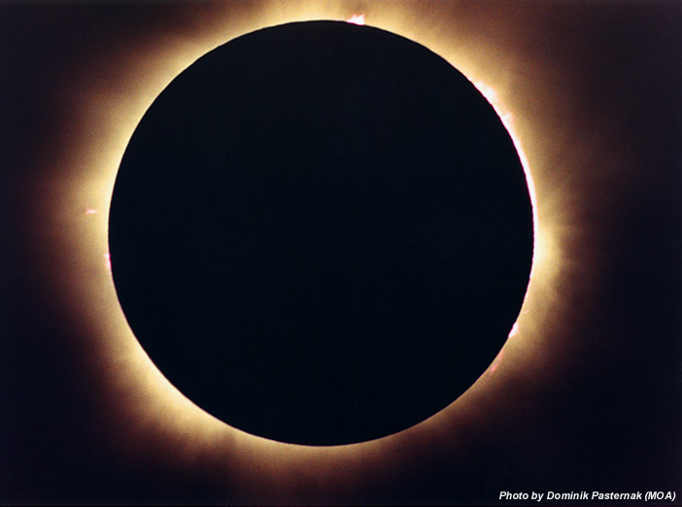

Slide 15
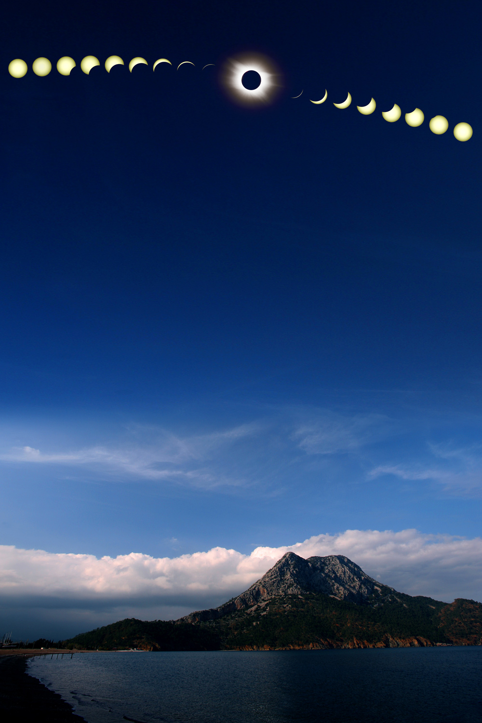
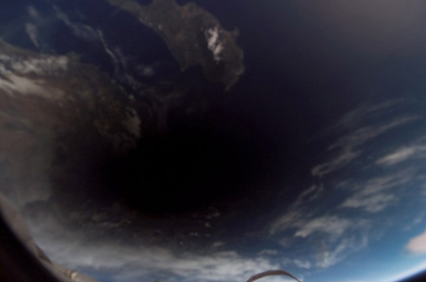
A total solar eclipse over Turkey in 2006.

Slide 16
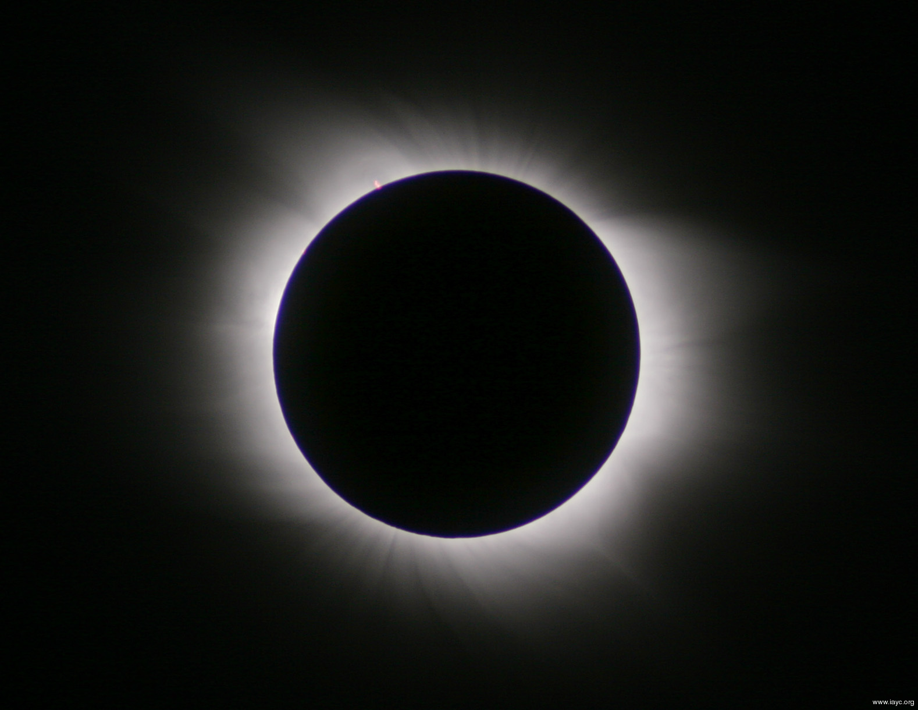
Observe a Solar Eclipse

Slide 18
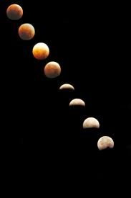
Lunar Eclipse
Only during FULL MOON phase
The Earth gets in between the Sun and the Moon, casting a shadow on the Moon.
Total lunar eclipses are more common and last longer
Average of 2 per year

Slide 19
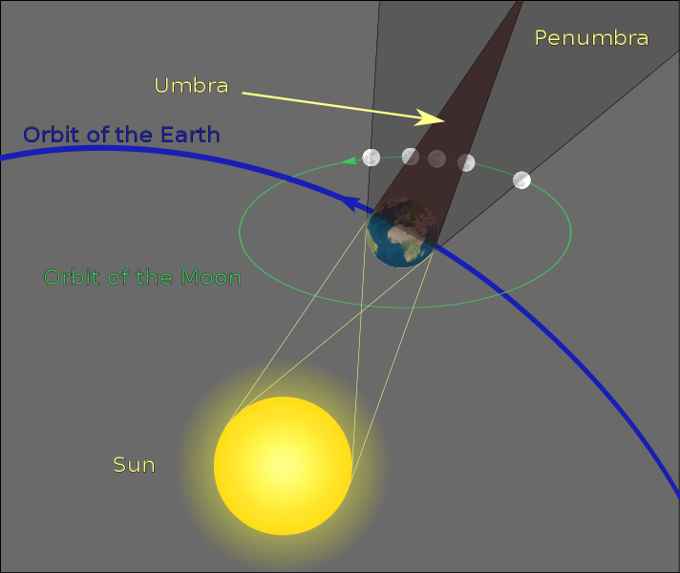

Slide 20
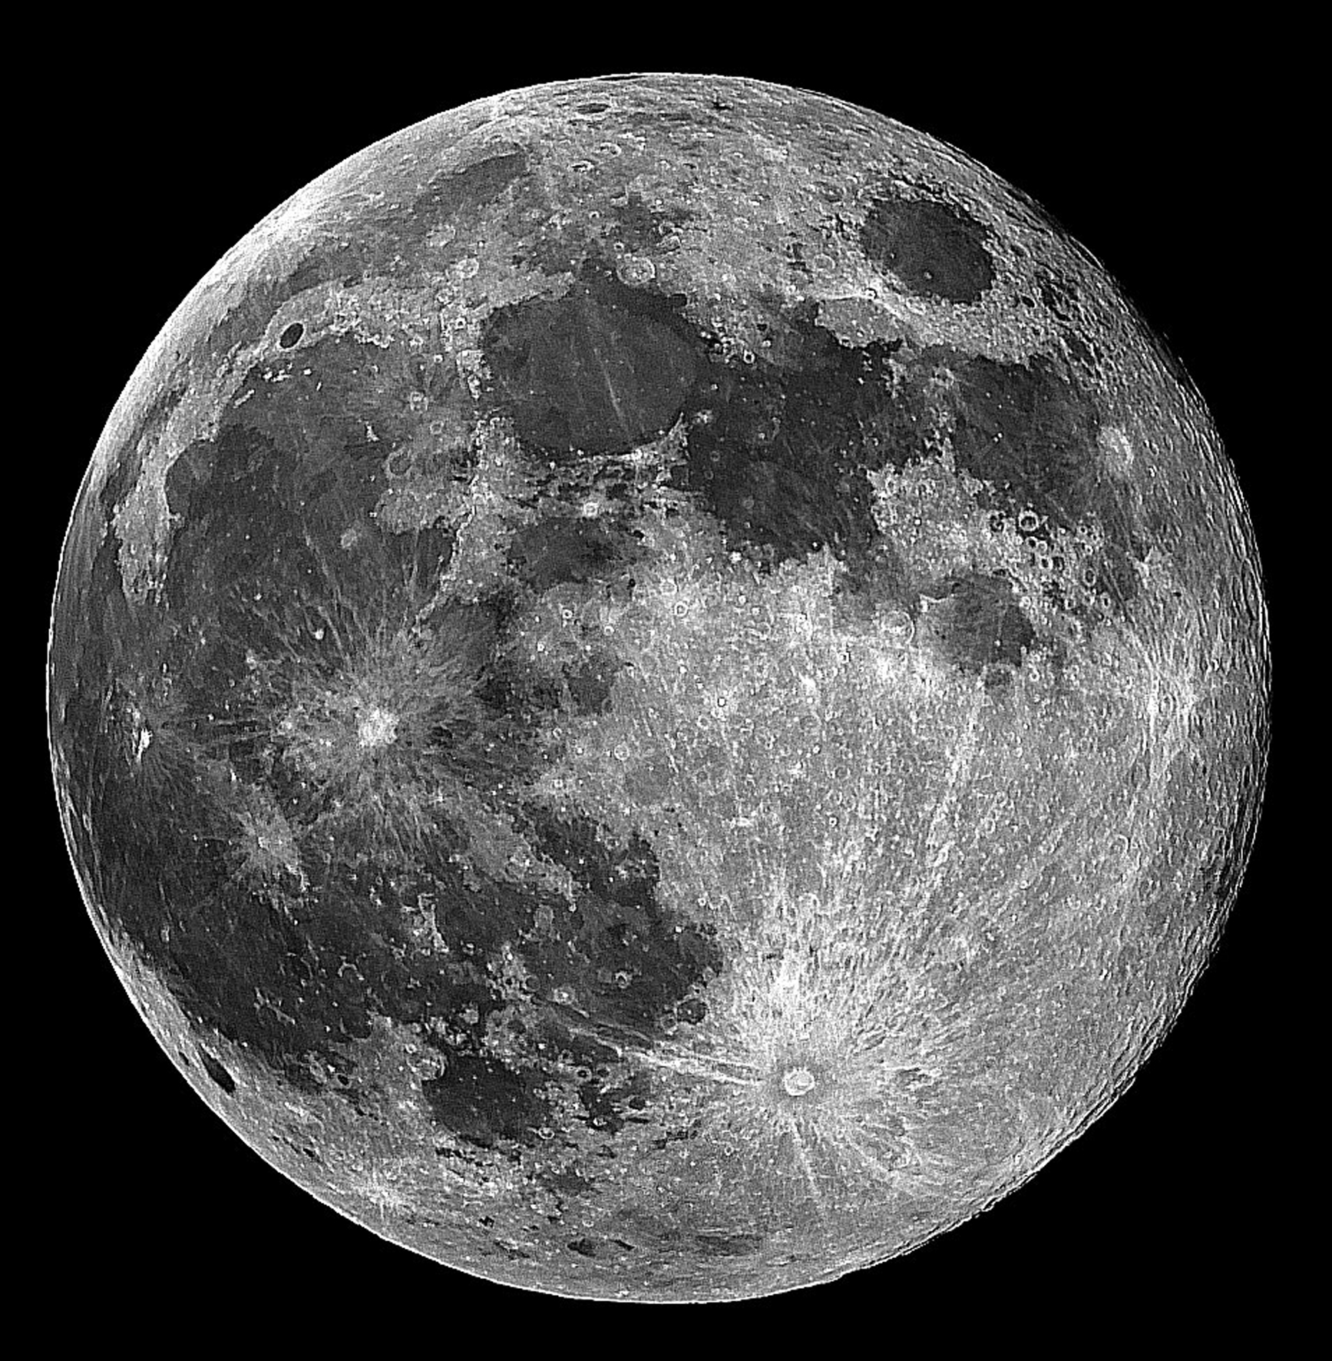
Observe a Lunar Eclipse

Slide 21
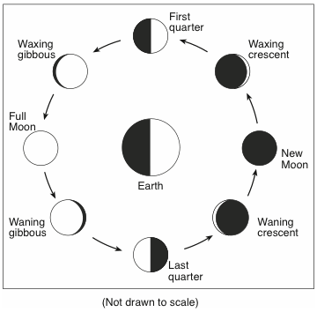
Which statement best explains why the same side of the Moon is viewed from Earth as the Moon goes through its phases?
The Moon does not rotate as it revolves around Earth.
The Moon’s period of rotation equals Earth’s period of rotation.
The Moon’s period of rotation equals Earth’s period of revolution around the Sun.
The Moon’s period of rotation equals the Moon’s period of revolution around Earth.
Which statement best explains why the same side of the Moon is viewed from Earth as the Moon goes through its phases?
The Moon does not rotate as it revolves around Earth.
The Moon’s period of rotation equals Earth’s period of rotation.
The Moon’s period of rotation equals Earth’s period of revolution around the Sun.
The Moon’s period of rotation equals the Moon’s period of revolution around Earth.

Slide 22
One complete cycle of the phases of the Moon takes approximately one
day
week
month
year

Slide 23
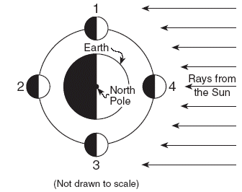
The diagram below shows the Moon at four positions in its orbit around Earth.
An observer on Earth could see a solar eclipse when the Moon is at position
1
2
3
4
An observer on Earth could see a solar eclipse when the Moon is at position
1
2
3
4

Slide 24
Which statement correctly describes the type of eclipse that was occurring and the position on Earth where this eclipse was observed?
A lunar eclipse was observed from position A.
A lunar eclipse was observed from position B.
A solar eclipse was observed from position A.
A solar eclipse was observed from position B.

Slide 25
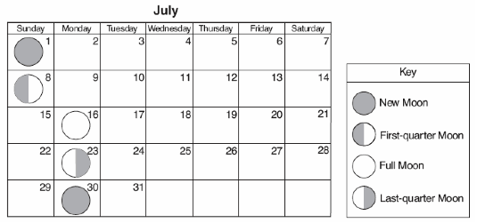
Eclipses do not occur every month because the Moon’s
rate of rotation is 15° each hour
orbit is inclined to Earth’s orbit
period of revolution is 27.3 days
period of rotation and period of revolution are the same
Eclipses do not occur every month because the Moon’s
rate of rotation is 15° each hour
orbit is tilted compared to Earth’s orbit
period of revolution is 27.3 days
period of rotation and period of revolution are the same

