Slide 1
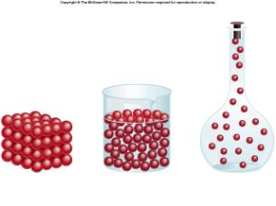
Aim: What is the difference between solids, liquids, and gases?

Slide 2
We’ve discussed how matter has specific PHYSICAL characteristics, but one of the most important physical characteristics is an object’s STATE OF MATTER at room temperature.
What is a state of matter?
Phase – solid, liquid, gas, and plasma.

Slide 3
SOLIDS
Has a mass
Definite shape
Definite volume
Densely packed
Particles cannot move far out of their places (vibration)

Slide 4
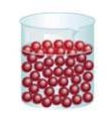
LIQUIDS
Has a mass
Definite volume
Takes shape of container
Particles flow easily around one another (fast)

Slide 5
GASES
Has a mass
NO definite volume
Takes shape of container
Particles usually very far apart
Particles move very fast

Slide 6
PLASMA
HIGH ENERGY
Most matter in the universe is in the form of plasma.
Ex:

Slide 7
Phase Changes
Change of State | Scientific Term | Heat Energy | Change in Temperature | What is happening to the molecules?
Solid → Liquid | Melting | Absorbed | Increases | Move faster; slip out of ordered arrangement
Liquid → Solid | Freezing | Released | Decreases | Slow down; form an ordered arrangement
Liquid → Gas | Vaporization | Absorbed | Increases | Move faster; spread apart
Gas → Liquid | Condensation | Released | Decreases | Slow down; move closer together
Solid → Gas | Sublimation | Absorbed | Increases | Move faster; slip out of ordered arrangement and spread apart

Slide 8
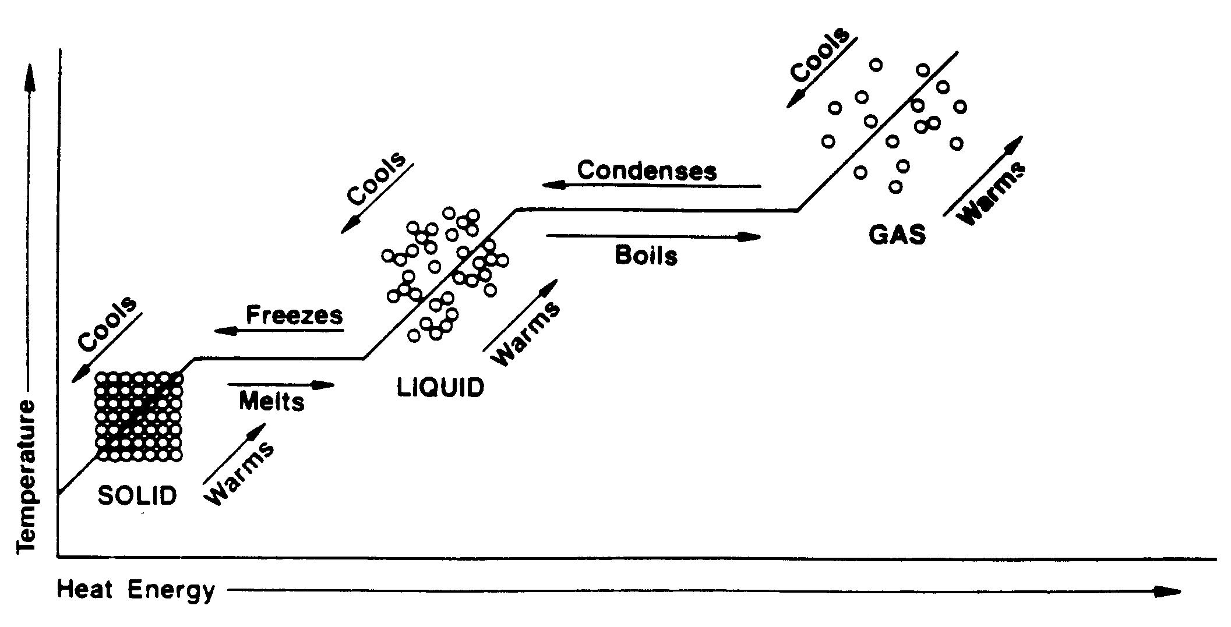
Phase Changes

