Slide 1
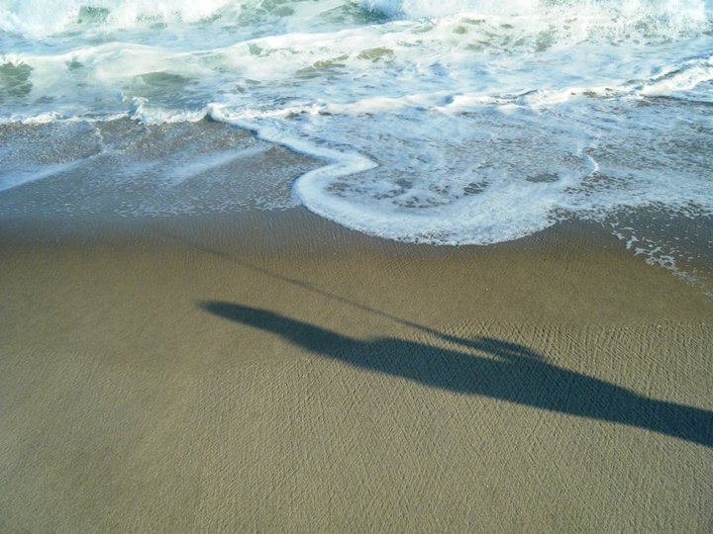
Reason for the Tides

Slide 2
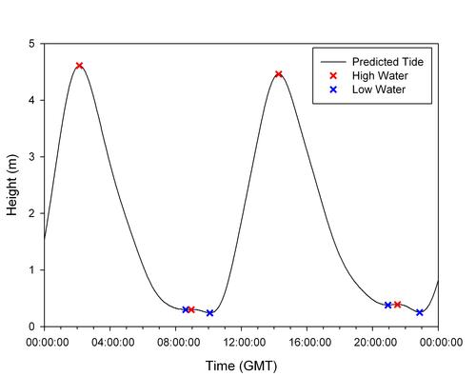
What are Tides?
Tides are the cyclic rise and fall of ocean waters.

Slide 3
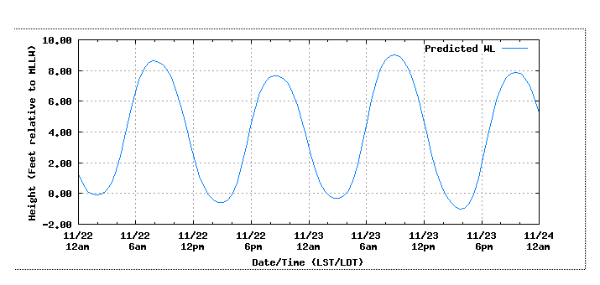
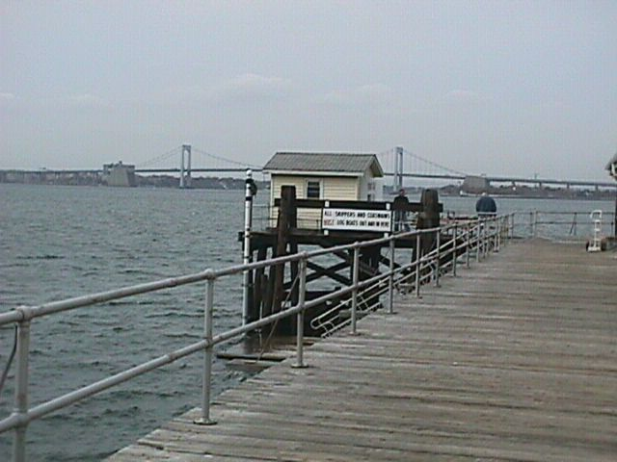
Local Tides for Kings Point, NY

Slide 4
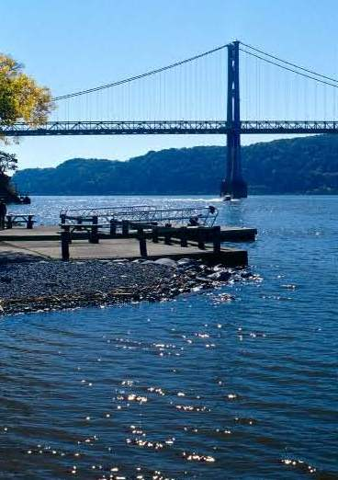
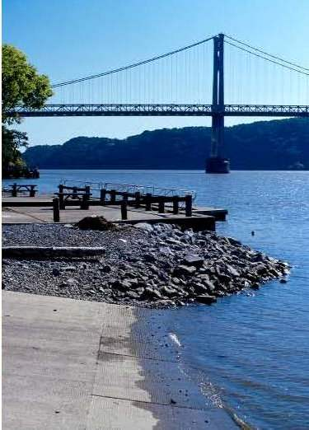

Slide 5
Why does Earth have Tides?
Tides are a result of the gravitational attraction between the Earth, the Moon, and the Sun.
The Moon has the greatest effect because it is about 400 times closer to us than the Sun.

Slide 6
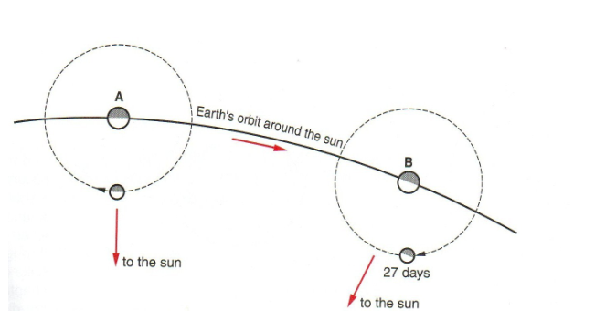
The Moon rises about 50 minutes LATER each day.
Has a period of 27-1/3 days.
Notes:
Every 24 hrs the moon moves about 13 deg eastward in its orbit, thus Earth must rotate an extra 13 deg (beyond 360 deg) to see moonrise each night--this takes about 50 min.
Rotation AND Revolution

Slide 7
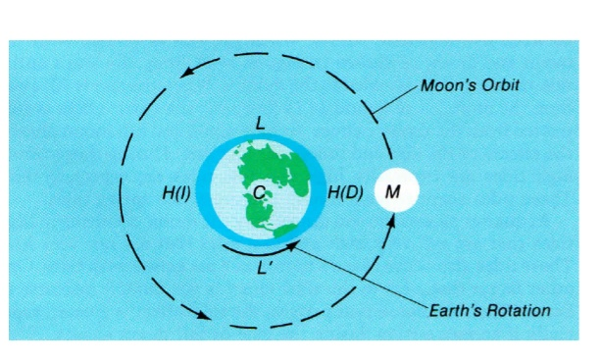
As Earth rotates, the low and high tides follow the alignment of Earth and the moon.
The time between two high (or two low) tides is ideally about 12 hours and 25 minutes.

Slide 8
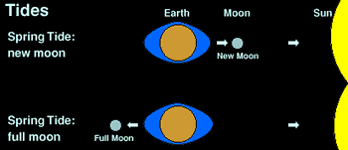
Spring Tides
When the moon is in NEW or FULL phase, the gravity of the moon and the Sun are in a straight line.
This creates spring tides (higher high tides and lower low tides).

Slide 9
Neap Tides
When the moon is in the QUARTER phase, the gravitational force of the Sun is at 90 degrees to the Moon's force.
This creates neap tides (low high tides, high low tides).

Slide 10
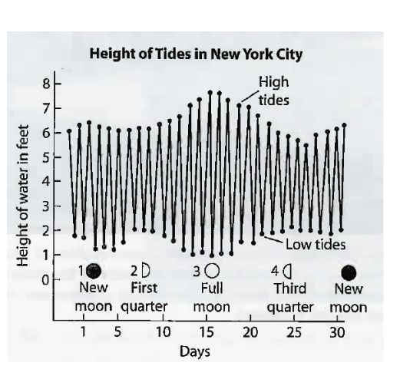

Slide 11
