Slide 1
Energy in Earth Processes: Transformation of Energy

Slide 2
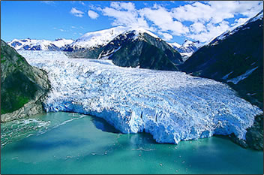
Transformation of Energy: the changing of one type of energy into another type of energy.
Heat Production: often occurs when there is friction
Notes:
As a glacier flows, some of its kinetic energy is transformed into heat energy at the interface between glacier and valley walls
Occurs bc of friction between the moving glacier and the rock of the valley walls.

Slide 3
Transformations of Mechanical Energy
Mechanical Energy: the sum of the potential energy and kinetic energy of an object.
Kinetic Energy: the energy of motion
Potential Energy: energy related to position or phase (“stored” energy)
Notes:
Mechanical energy is the energy that is possessed by an object due to its motion or due to its position. Mechanical energy can be either kinetic energy (energy of motion) or potential energy (stored energy of position).
The faster something moves and the more mass it has, the greater the K.E.
The higher an object is above the center of the Earth, the greater its potential to fall (P.E.)

Slide 4
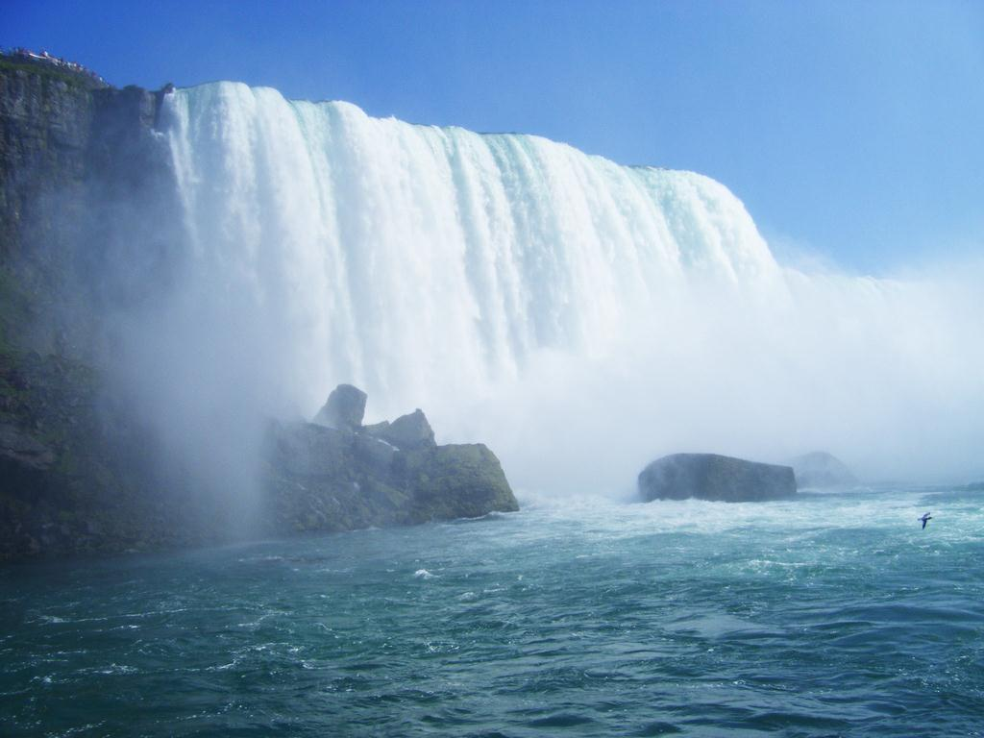
Niagara Falls, August 2008
Notes:
K.E. or P.E. can be transformed into the other.
At top of waterfall, high P.E. bc of position relative to Earth’s center.
As water falls to a lower level, some P.E. is transformed into K.E., resulting in an increase in speed.

Slide 5
Transformation of Electromagnetic Wavelength
Hotter objects (source) emit shorter wavelengths than cooler objects (sink).
When electromagnetic energy from the Sun is absorbed by Earth’s cooler surface, it is reradiated at longer wavelengths.

Slide 6
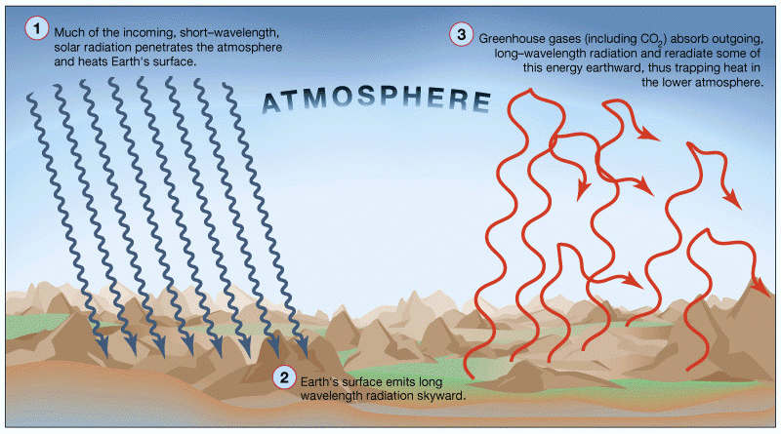

Slide 7
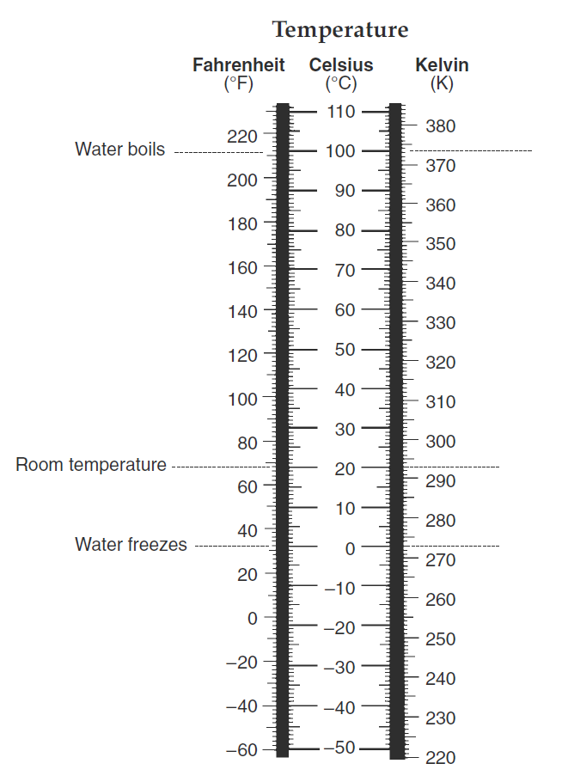
Temperature and Heat
Temperature: a measure of the average kinetic energy of the particles of an object.
We use thermometers to accurately measure temperature.
Celsius, Fahrenheit, and Kevin
Notes:
The greater the average kinetic energy of the particles of matter, the higher the temperature.
Page 13 ESRT

Slide 8
Temperature and Heat
When measuring the transfer of heat energy from one object to another, we use the unit joules (a metric unit).
Specific Heat: the quantity of heat needed to raise the temperature of 1 gram of any substance by 1 degree Celsius.
It takes 4.18 joules to raise the temperature of 1g of liquid water by 1 degree Celsius
Notes:
Specific Heat: the resistance of a material to heat up or cool off.
Liquid water has the highest specific heat of naturally occurring substances (why large bodies of water have a major moderating effect on weather and climate)

Slide 9
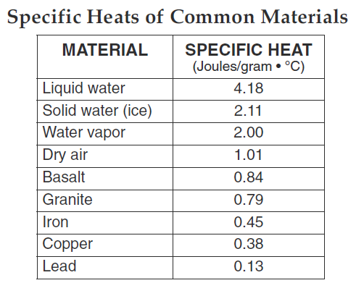
Notes:
Page 1 ESRT

