Slide 1
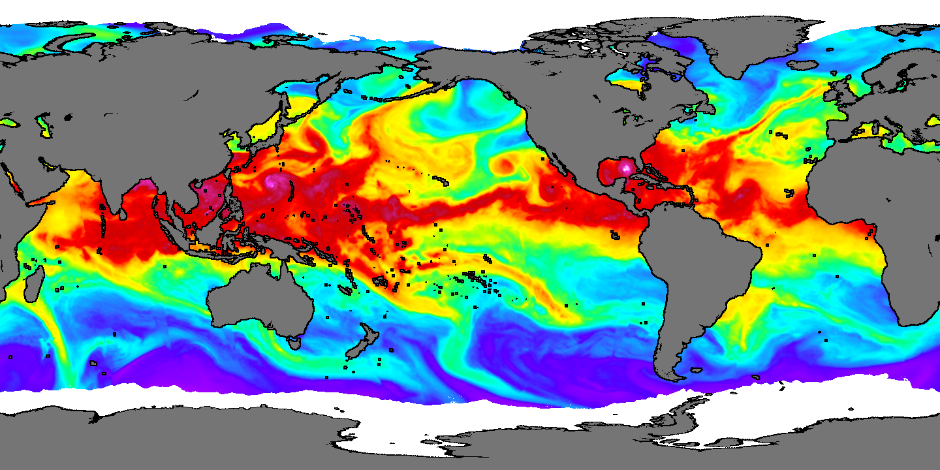
Atmospheric Moisture

Slide 2
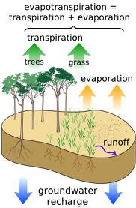
Water in the atmosphere can be solid, liquid, or gas.
Oceans supply most atmospheric moisture.
Water enters the atmosphere through evapotranspiration and sublimation.
Notes:
Gas = WATER VAPOR
Oceans = 70% of surface
Evapotranspiration = evaporation and transpiration collectively

Slide 3
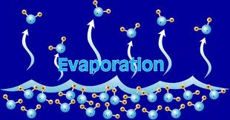
Energy of Evapotranspiration
Large amounts of energy are required to change liquid water into water vapor.
The most energetic molecules will leave the liquid during evaporation.
Temperature of the remaining liquid is somewhat lower than its surroundings.
Notes:
2260 joules/gram
Since the molecules LEAVING the liquid are more energetic, the average K.E. of the molecules remaining in the liquid decreases.
Ex: When you step out of the shower and feel chilled.

Slide 4
Hot
Warm
Cold

Slide 7
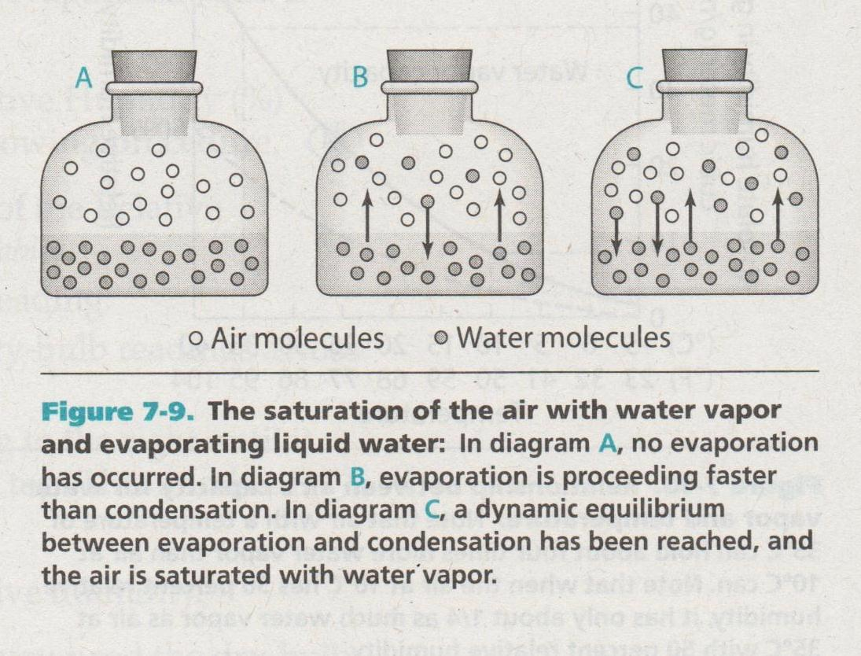
Process of Evaporation
Notes:
C = DYNAMIC EQUILIBRIUM = the rate at which the water is evaporating equals the rate at which the water is condensing.

Slide 8

What factors affect the rate at which water evaporates?
Temperature
Surface area of the water
How saturated the air is
Wind speed
Notes:
More energy available = higher temp = faster evaporation
More spread out = faster evaporation
The closer the air is to being saturated, the slower water will evaporate.
Wind moves air at the air/water interface that is high in water vapor and replaces it with air that is less saturated. Faster wind = faster evap

Slide 9
What is Humidity?
Humidity: the water vapor in the atmosphere
Absolute humidity: the amount(mass) of water vapor in each unit volume of air.
Hotter air can hold MORE water vapor than colder air.
Relative humidity: tells us “how full” the air is with water
Notes:
Abs humidity: grams/m3
Relative Humidity: expressed as a PERCENT; at 100%, its full and cant hold anymore (SATURATED)

Slide 10
Relative Humidity and Temperature
At any given time and place, the air has a certain amount of water vapor (absolute humidity).
If temperature changes, but amount of water vapor remains the same, the relative humidity will change.
If temperature stays constant, but more water vapor is added to the air, absolute humidity AND relative humidity will increase.
Notes:
If temperature increases, R.H. will decrease
If temperature decreases, R.H. will increase.

Slide 11
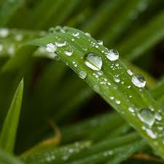
Dew Point
Dew Point: the temperature at which air is filled (saturated) with water vapor.
If air temperature drops BELOW the dew point, water vapor in the air will condense to liquid water or sublimate into solid water.
Notes:
If air temperature decreases but absolute humidity stays the same

Slide 12
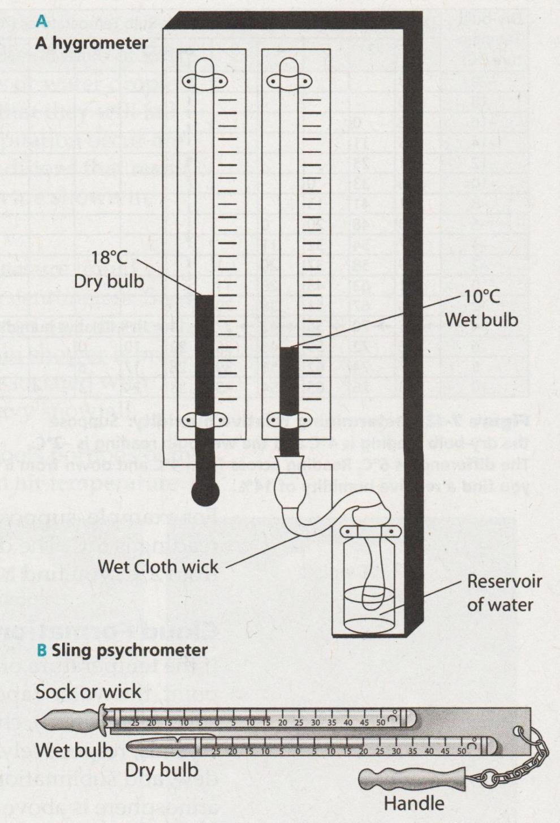
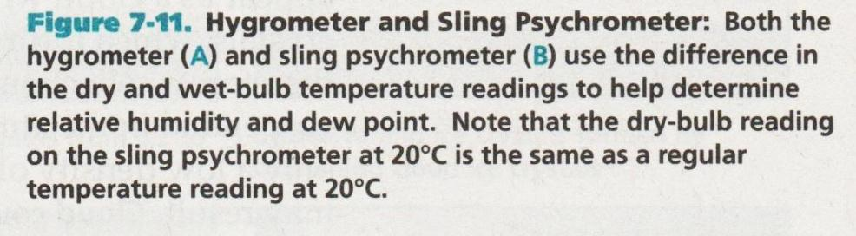
How can we MEASURE relative humidity?
Sling psychrometer
Hygrometer
Both use 2 thermometers: wet bulb and dry bulb
Notes:
Sling psychrometer: amount of cooling depends on the rate of evaporation, and is related to relative humidity.

Slide 13
Notes:
Sling psychrometer: amount of cooling depends on the rate of evaporation, and is related to relative humidity.

Slide 15

Cloud Formation
A cloud is a collection of liquid water droplets and/or ice crystals suspended in the atmosphere and dense enough to be visible.
Clouds form when the temperature cools below the dew point
Notes:
If dew point is above 0 degrees celsius, condensation produces water droplets
If dew point is below 0 degrees celsius, sublimation produces ice crystals.
Factors causing air to rise and cool include:
rising air at fronts
air blowing against a mountain
portions of air selectively heated at Earth’s surface, such as over a dark road

Slide 16
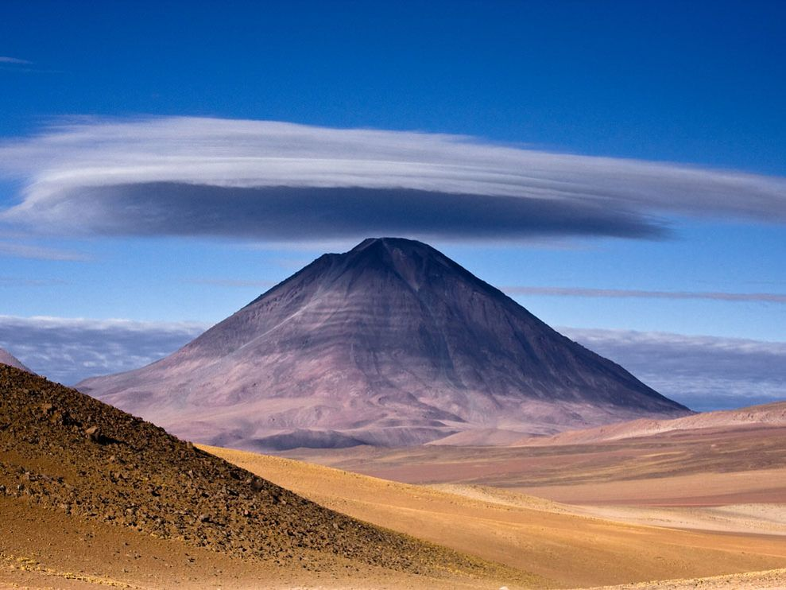
Licancabur Volcano is located on the border between Chile and Bolivia.

Slide 17
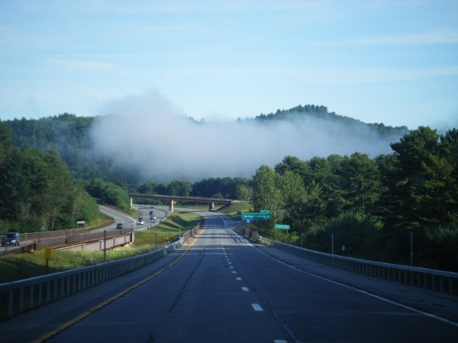
If a cloud is on, or just above, Earth’s surface, it is called FOG.

Slide 18
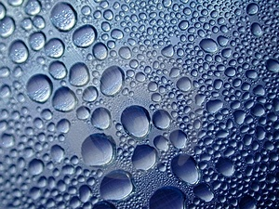
Cloud Formation
In addition to saturated air, clouds need a condensation surface.
Notes:
Surfaces = aerosols = dust, bacteria, volcanic ash.
Dew = features on Earth’s surface, such as grass and leaves.

Slide 19
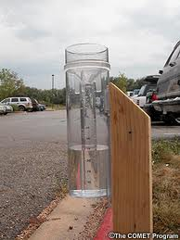
Precipitation
Precipitation: the falling of liquid or solid water from clouds toward the surface of Earth.
  Ice crystals or water droplets must become big enough that they fall due to gravity.
Rain Gauge: measures liquid precipitation
Notes:
Rain, drizzle, snow, sleet, freezing rain, hail.

Slide 20
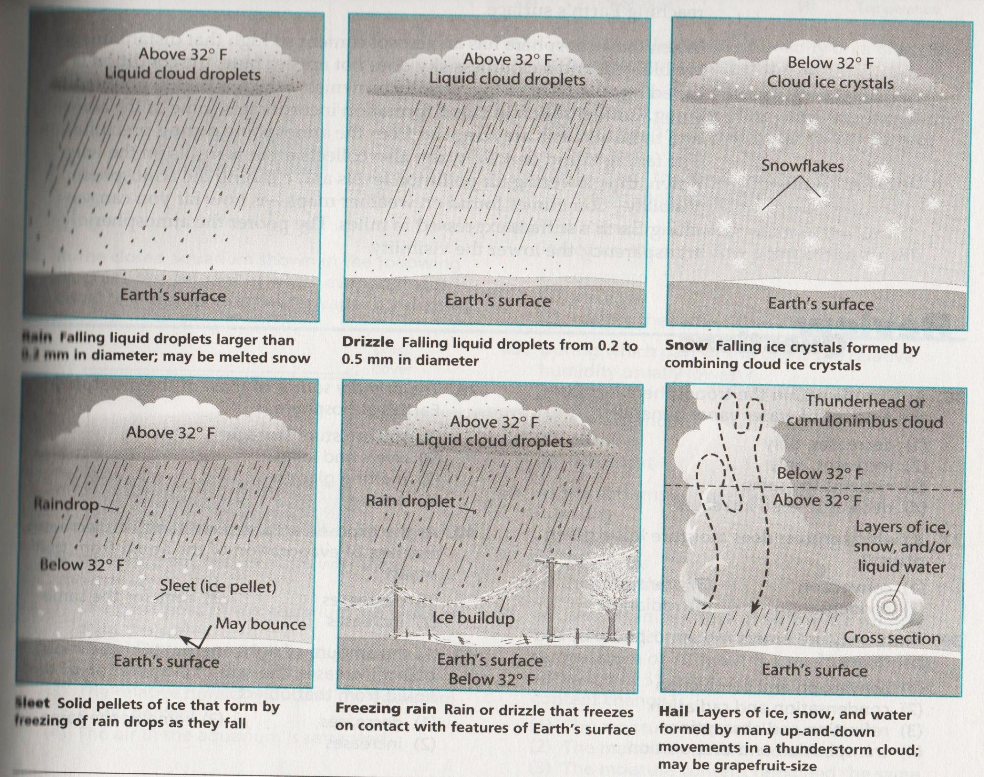

Slide 21
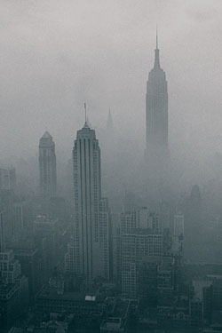
Atmospheric Transparency
Atmospheric transparency: how transparent the atmosphere is to insolation from the Sun.
Haze: when the atmosphere has a very HIGH aerosol content (cloudless sky does not appear blue)
  Smog: a haze that is highly polluted; usually brownish
Precipitation can clean the atmosphere
Notes:
Atm transparency = more aerosols in the air = less transparent
Precip can remove aerosols from air

Slide 22
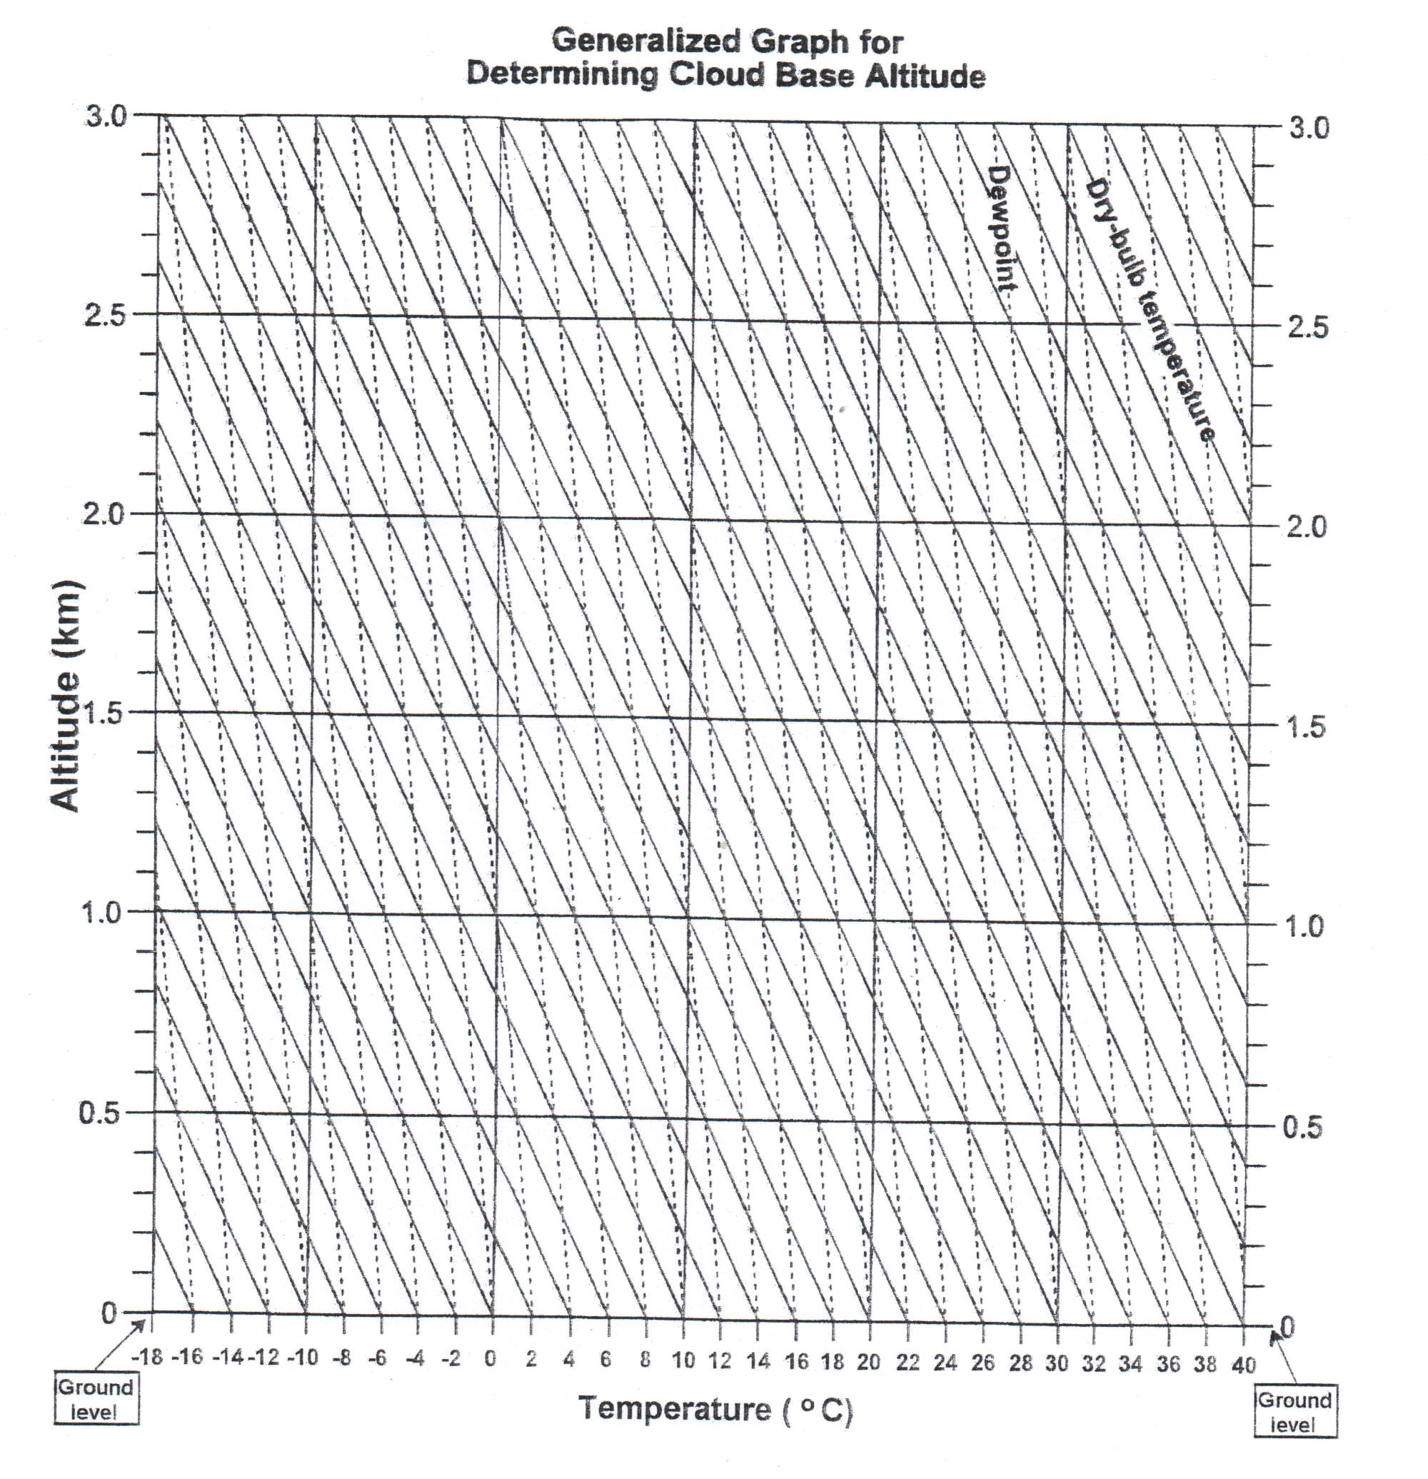

Slide 23
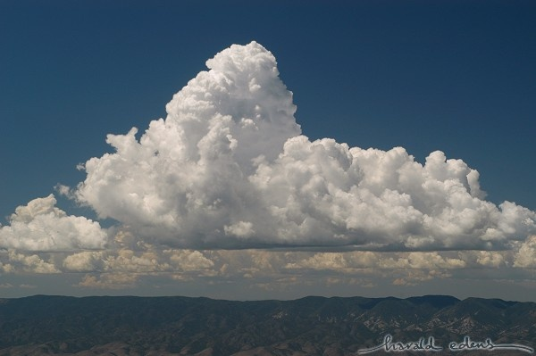

Slide 24
