Slide 1
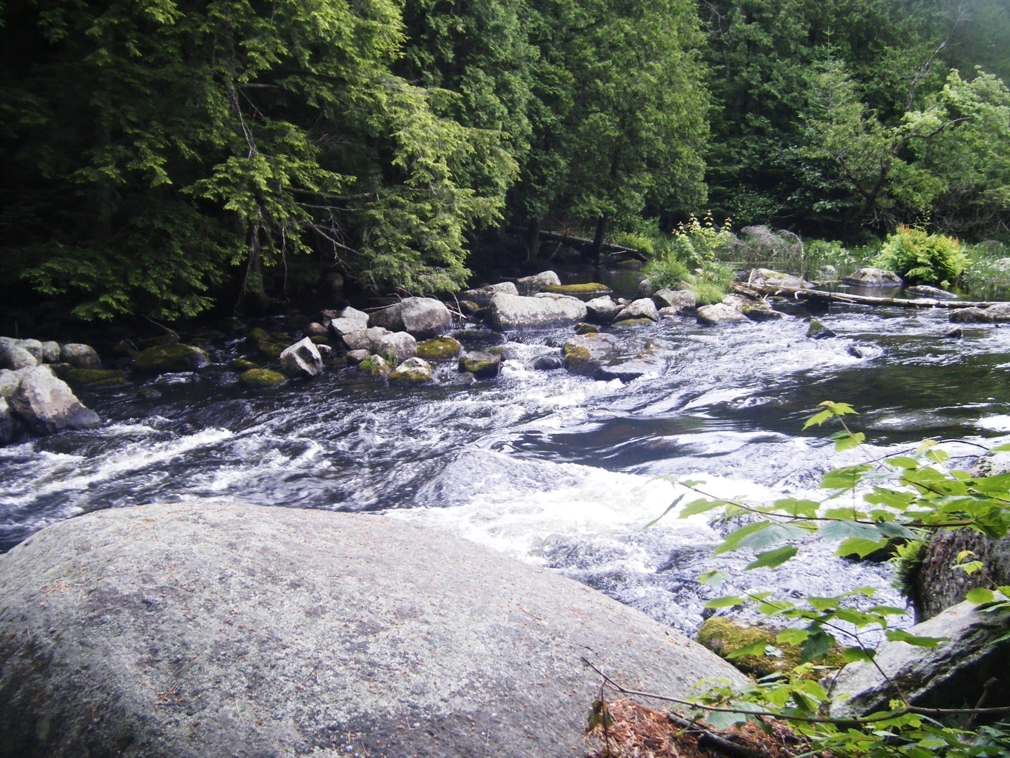
AIM: After weathering, what processes move the sediment?

Slide 2
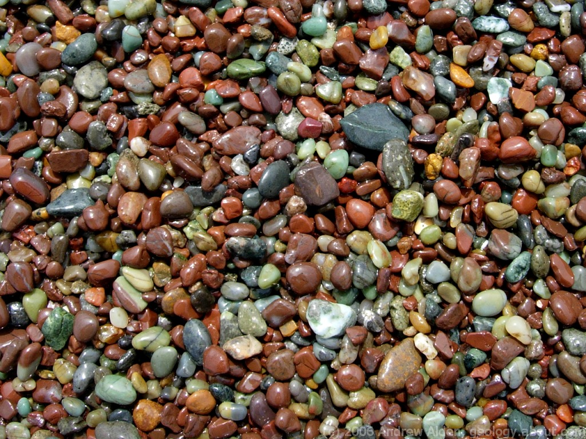
What is Erosion? Erosion is the process by which weathered sediments are transported/carried.
An agent of erosion is a material or a force that moves sediments from one place to another place.
Agents of erosion include:
Running water
Wind
Glaciers
Waves
Gravity

Slide 3
Stream Erosion at Natural Bridge, Virginia

Slide 4
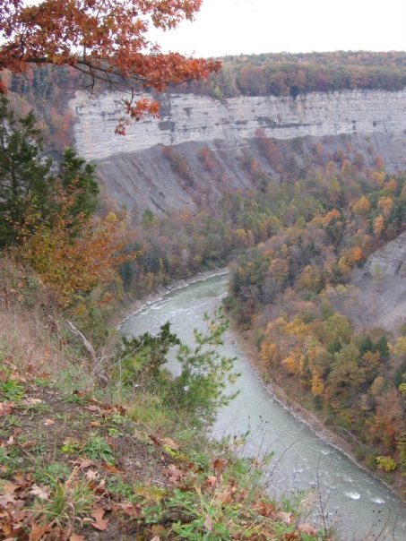
Stream erosion at Letchworth State Park, NY

Slide 5
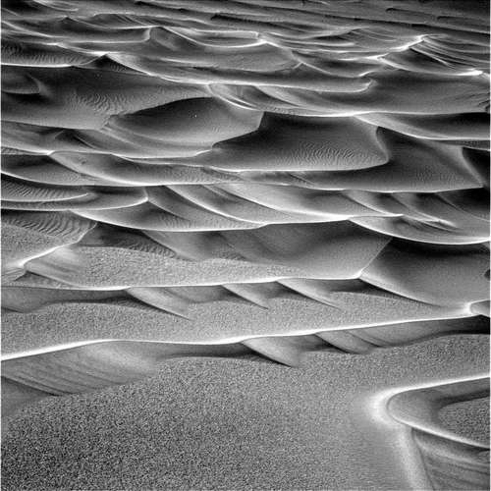
Sand dunes on Mars formed by wind erosion

Slide 6
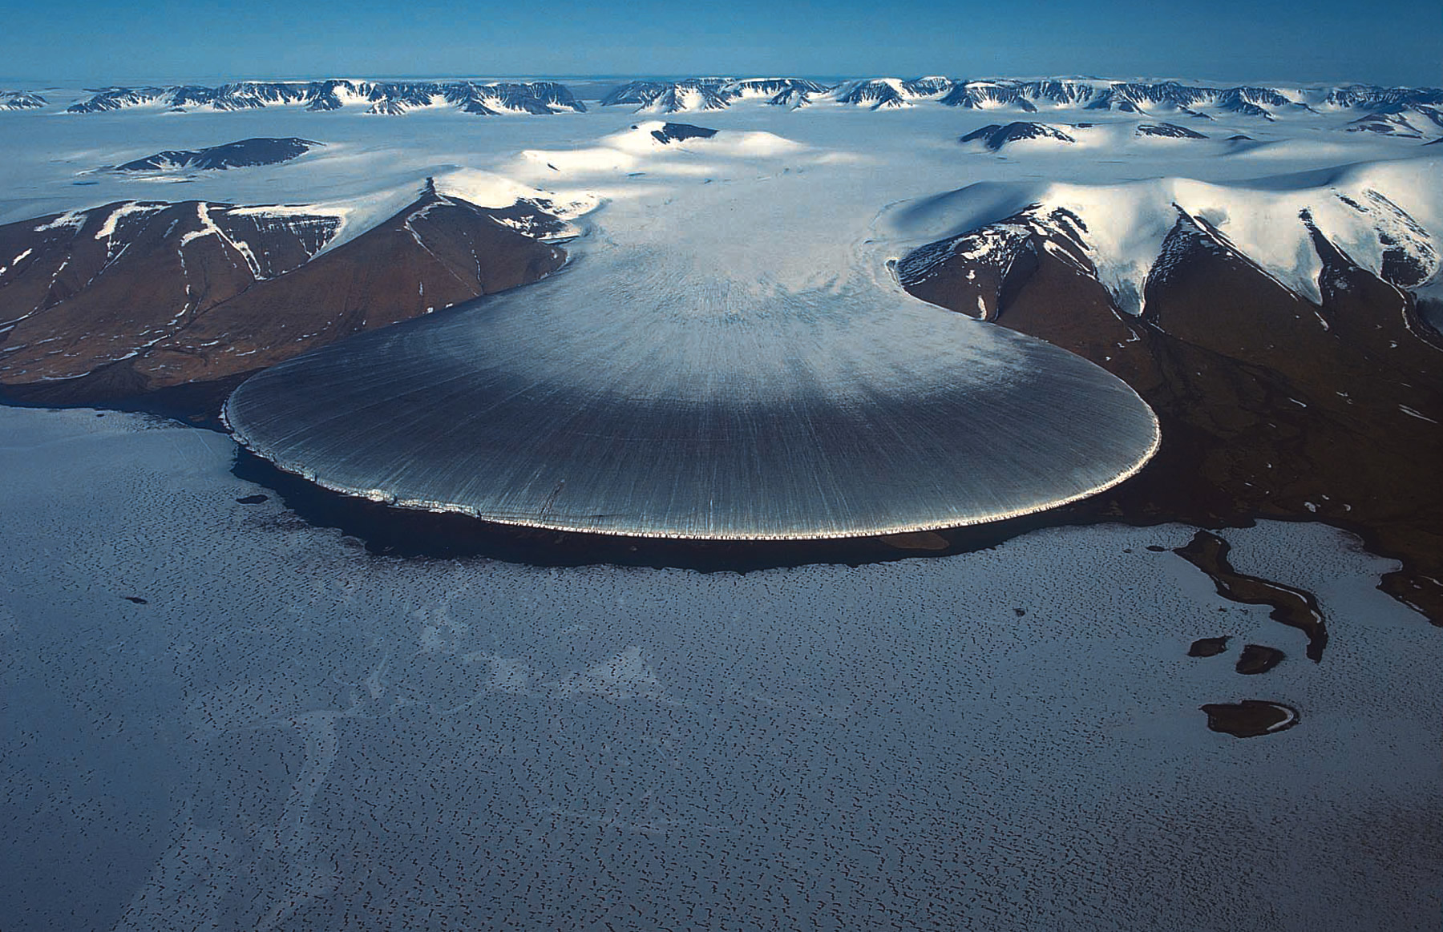

Slide 7
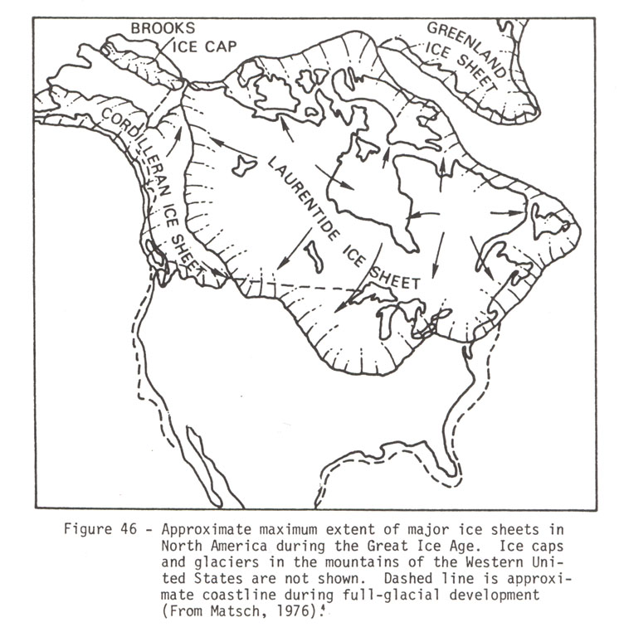

Slide 8
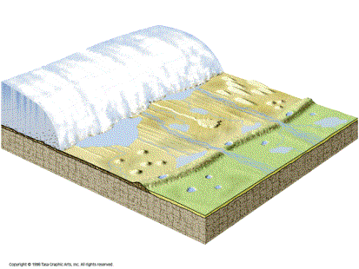

Slide 9
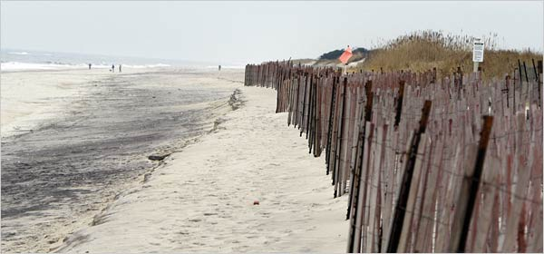
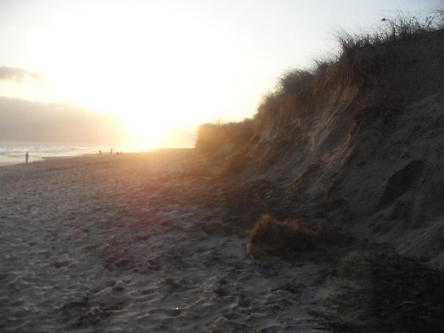
Beach Erosion at
Smith Point Park, NY

Slide 10
Montauk Point in 1838 (vertical section, west to east). The lighthouse is 220' from the bluff.
Montauk Point in 1990 (vertical section, west to east). The lighthouse is 100' from the bluff.

Slide 11
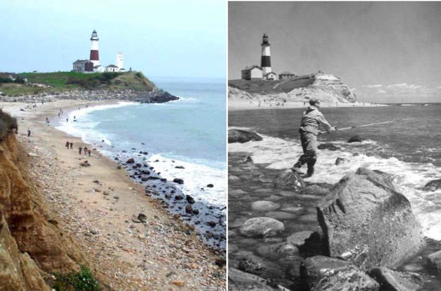
Present-Day Montauk Point
1939 Montauk Point

Slide 12
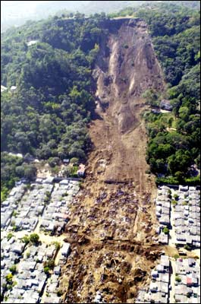

Slide 13
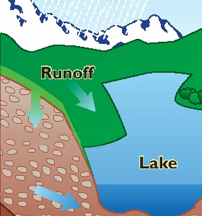
What force is mainly responsible for Erosion?
Water
Raindrops loosen soil & pick up particles
Runoff
Water moves over land
Also carries soil particles
Amount of Runoff depends on:
Rain amount, vegetation, soil type, land shape, land use

Slide 14
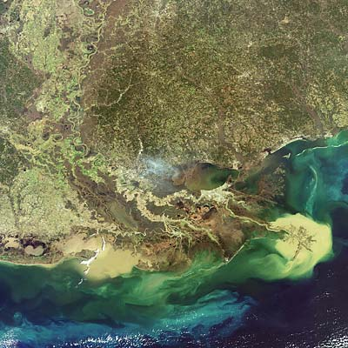
What is Deposition? Deposition is the process by which sediment is dropped or settles.
Deposition occurs when the velocity (speed) of running water or wind decreases, and/or when the discharge (volume of water) decreases.
Mississippi River Delta
decreases
decreases

Slide 15
Factors that affect the deposition of sediment:
Size: As the size of sediment increases, the rate (speed) of deposition increases.
RATE
of
Deposition
Size of Sediment

Slide 16
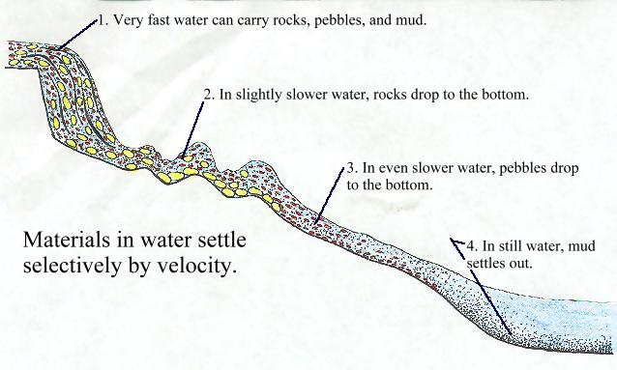

Slide 17
2. Density: As the density of sediment increases, the rate (speed) of deposition increases.
RATE
of
Deposition
Density of Sediments

Slide 18
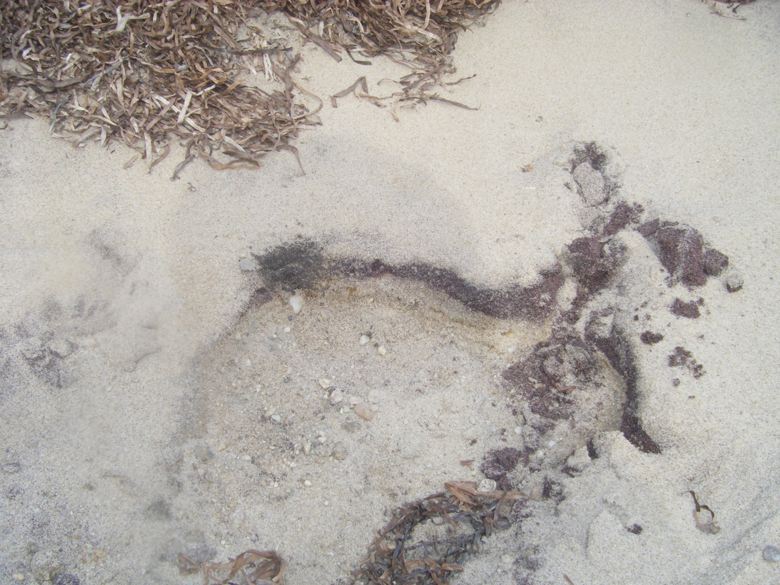
Darker, more dense sand particles

Slide 19
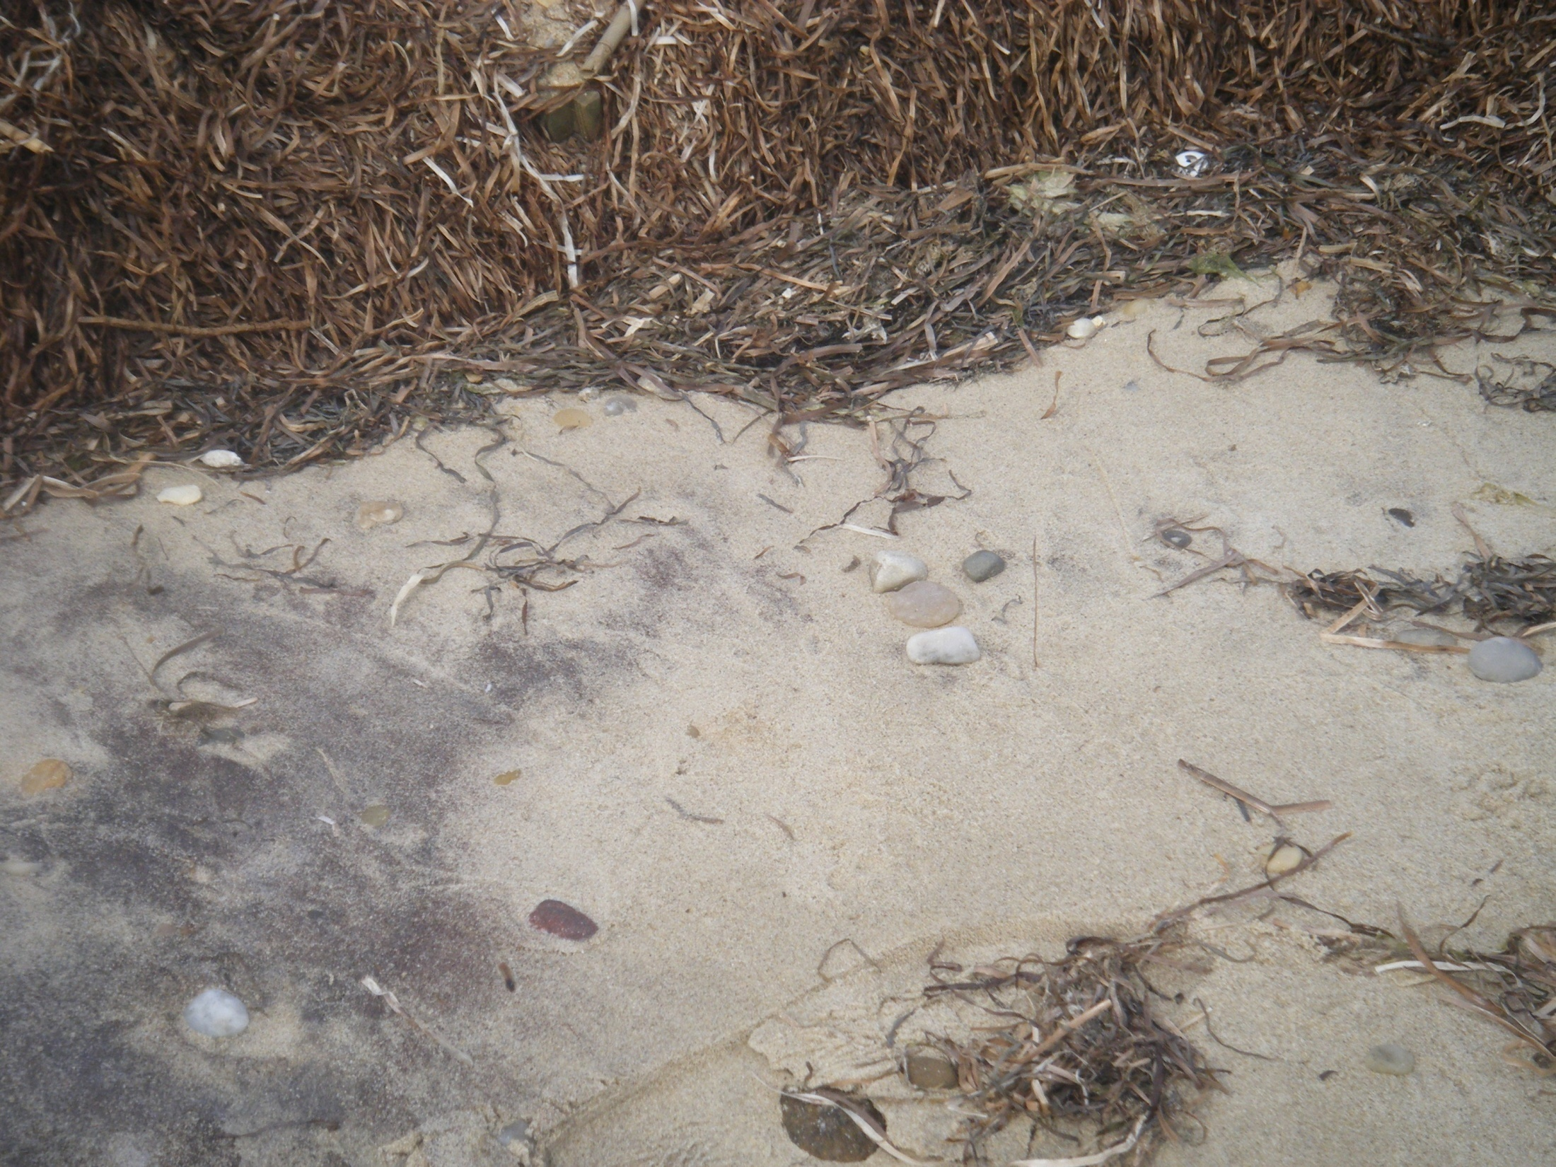

Slide 20
3. Shape: As the shape becomes more round, the rate (speed) of deposition of the sediment increases.
RATE
of
Deposition
Flat
Round
Shape of Sediments

Slide 21
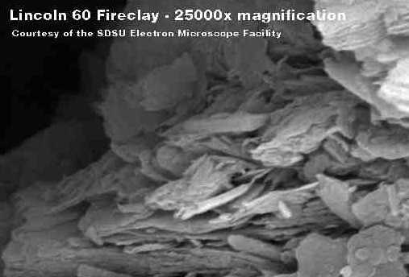

Slide 22
What CAUSES erosion and deposition?
Gravity causes water to flow downhill.
Gravity causes glaciers to flow down a valley or spread outward.
Gravity causes winds by pulling heavier (more dense) cold air down beneath the lighter (less dense) warm air.

Slide 23
4. Gravity pulls sediments down slopes.
The downhill movement of sediments by gravity is called mass wasting.
Types of mass wasting include:
Landslides (land moving down a slope)
Mudslides (quick saturation with water)

Slide 24
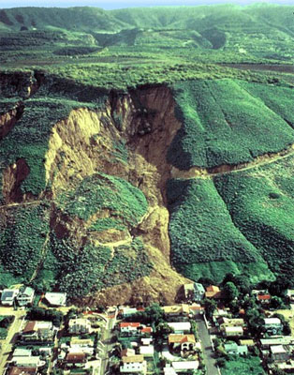
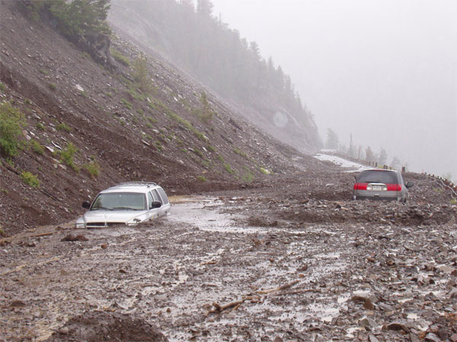
National Geographic Video - Landslides
Mudslide
Landslide
Deadly mudslide in Portugal, Feb 2010

Slide 25
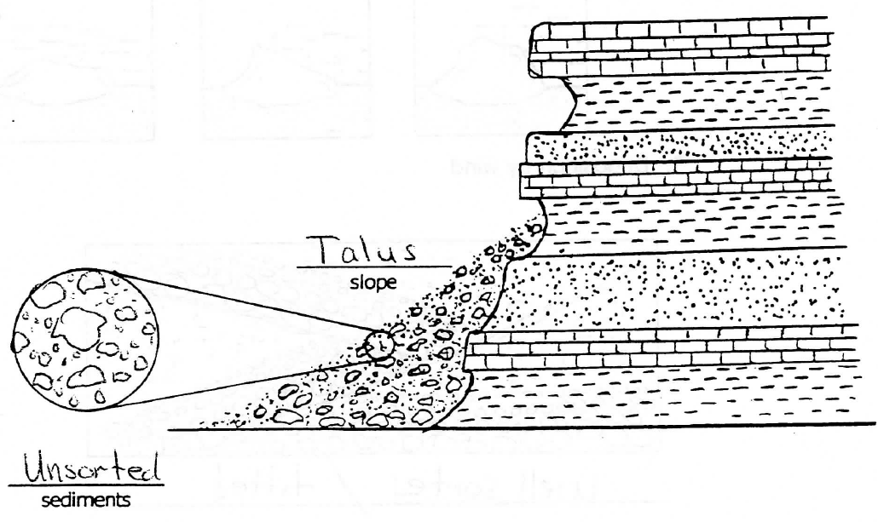
Deposition resulting from gravity
Talus
Unsorted

Slide 26
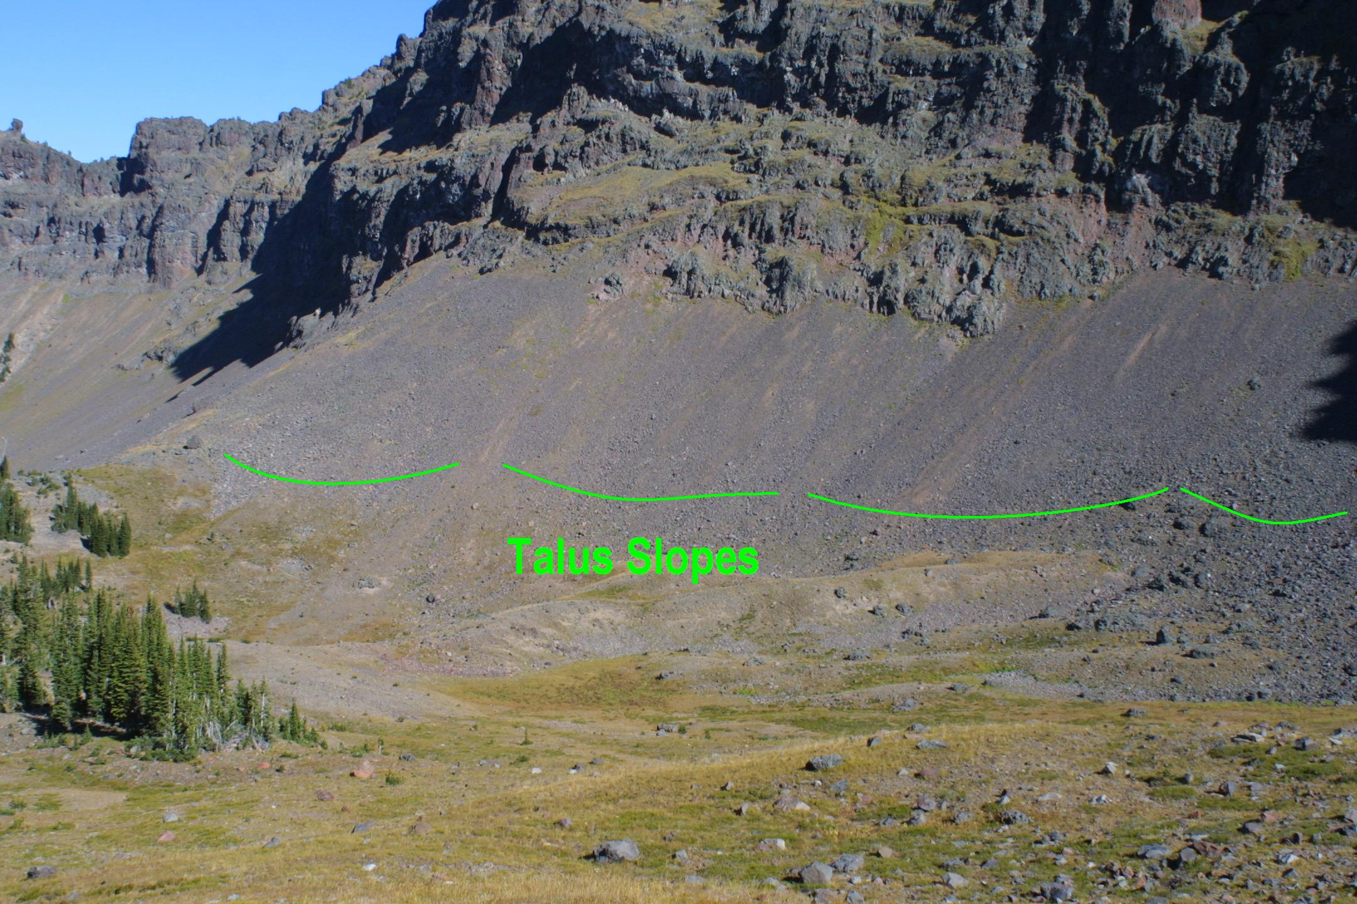
Hyalite Peak, Montana

Slide 27
