Slide 1
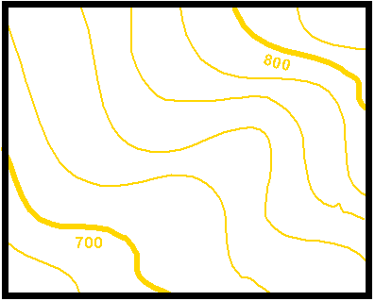
Aim: How can isolines help us understand data?

Slide 2
0 - no smell
1 - very slight smell
2 - slight smell
3 - strong smell
4 - very strong smell
Kitchen
Cafeteria

Slide 3
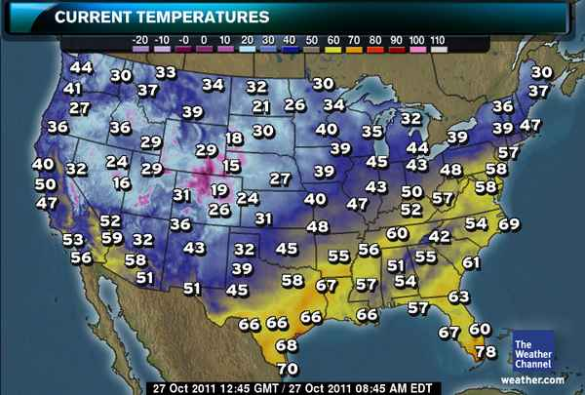
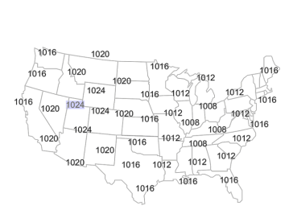
Fields
Field: Any area which has measurable value of a given quantity at every point
Field maps can show levels of:
- Atmospheric Pressure
- Temperature
- Elevation
- Pollutants

Slide 4
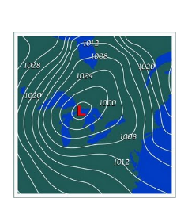
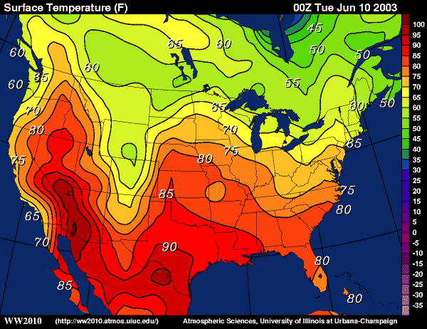
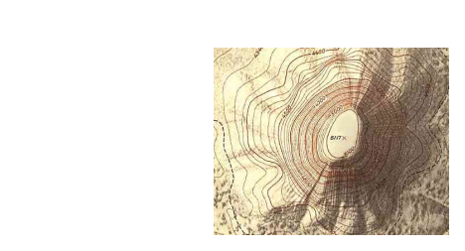
Isolines are lines that connect points of equal value.

Slide 5
Rules for Drawing Isolines:
1. Isolines connect points of equal value.
5
5
10
10
10
10
15
15

Slide 6
Rules for Drawing Isolines:
2. Isolines are gentle, curving lines- no sharp corners.
5
5
10
10
10
10
15
15

Slide 7
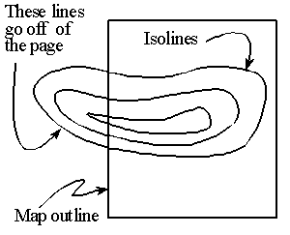
Rules for Drawing Isolines:
3. Isolines are always closed curves even though the map might only show part of it.

Slide 8
Rules for Drawing Isolines:
4. Isolines NEVER cross!!
This would mean that one point has two different values. Ex: one spot has two temperatures?
50 °
60 °
40 °
30 °
X
20°
Z
Y

Slide 9
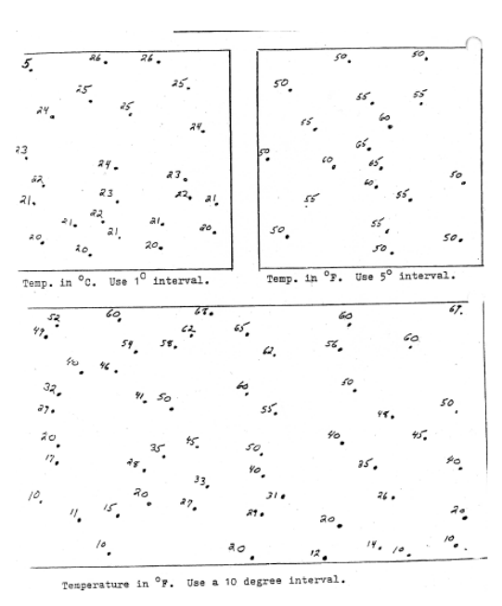

Slide 10
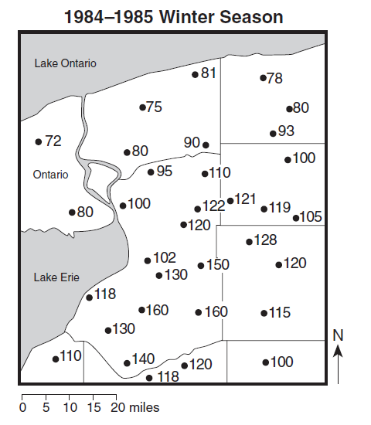

Slide 11
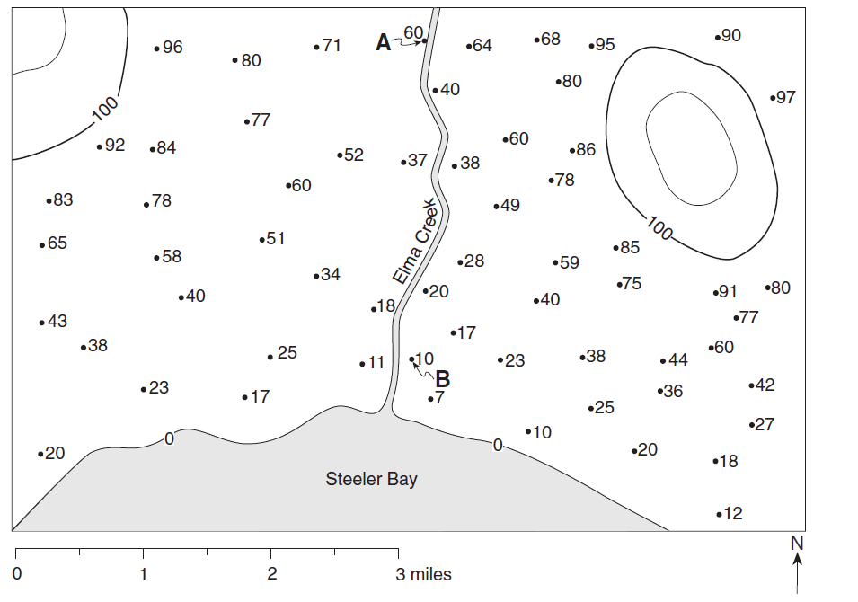

Slide 12
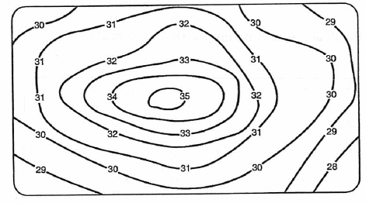
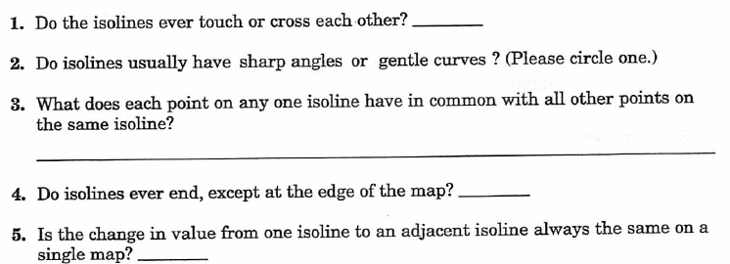

Slide 14
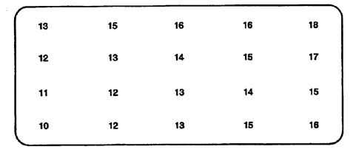

Slide 15
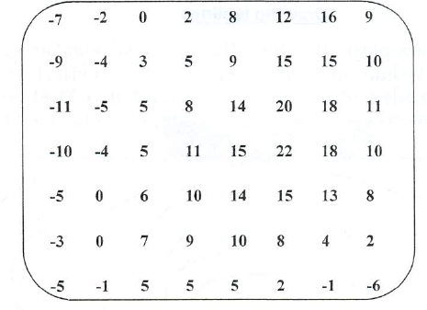

Slide 16
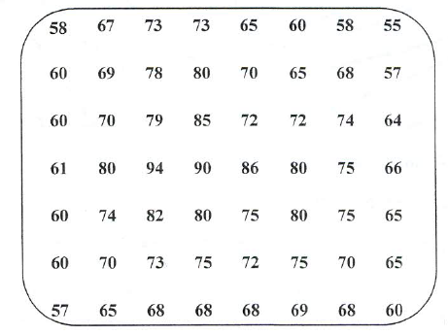

Slide 17
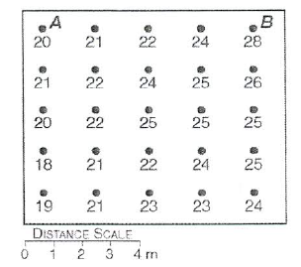

Slide 18
Gradient: Change in field value distance Example: 12ºC temperature change between two locations that are 3 km apart

Slide 19
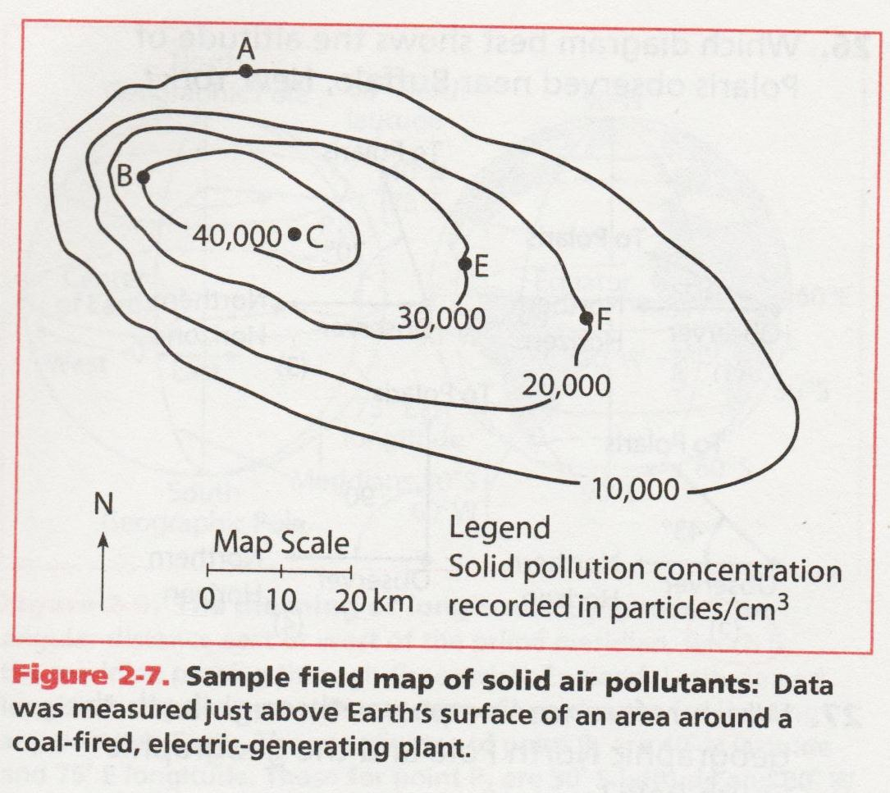
Compare the gradient between points A and B to the gradient between points E and F

Slide 20
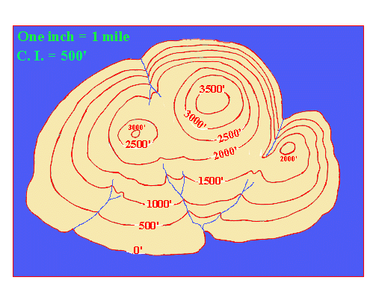
Contour Interval: difference between adjacent contour lines (how much lines go up by)

