Slide 1
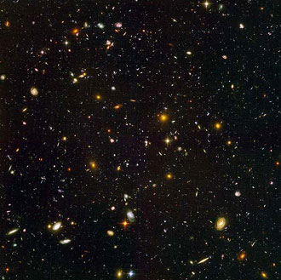
Our Solar System

Slide 2
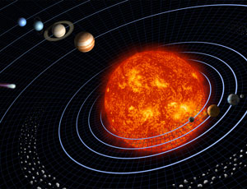
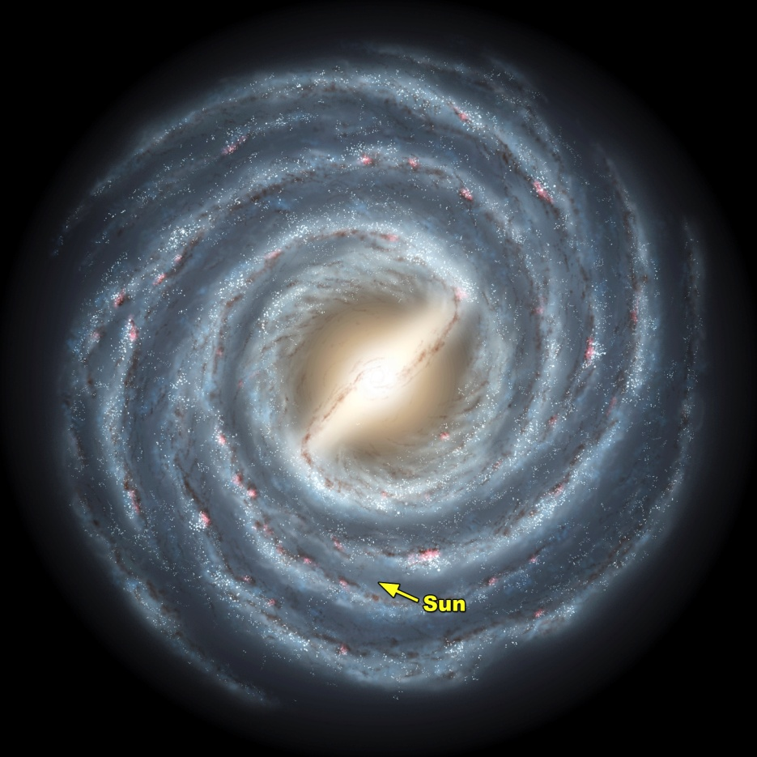

Slide 3
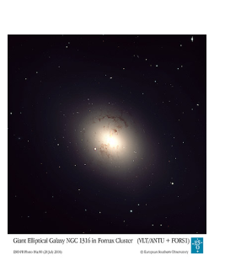
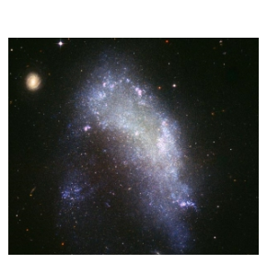
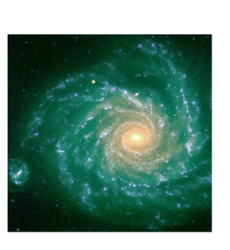
Stars and Galaxies
Galaxy - a collection of billions of stars, gas, and dust held together by GRAVITY
Galaxies are categorized by SHAPE:
Elliptical
Irregular
Spiral

Slide 4
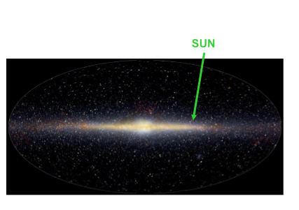
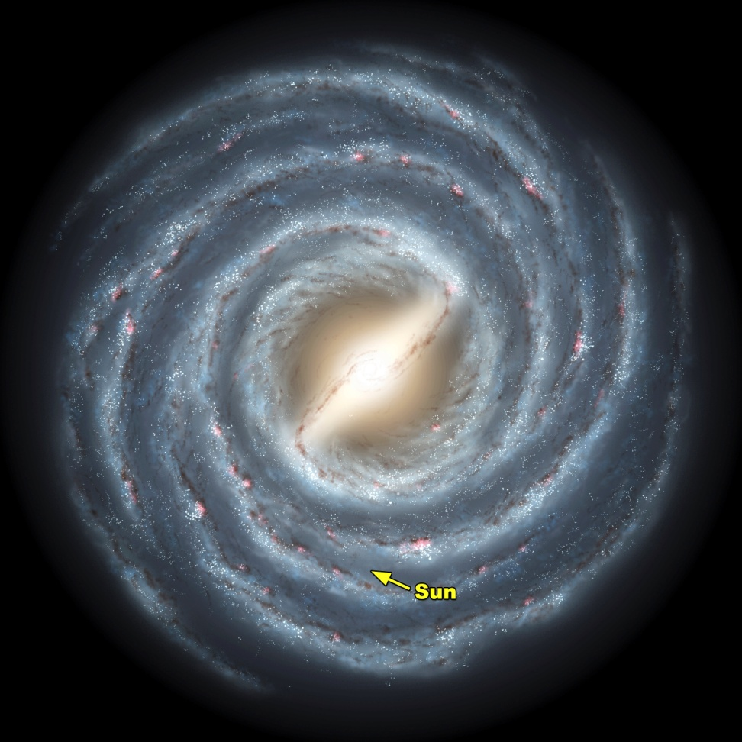
Our Milky Way Galaxy
Our own Milky Way Galaxy is spiral shaped and contains approximately 200 billion stars.
Our solar system is located between two spiral arms and about 2/3 of the way from the center of the galaxy.

Slide 5
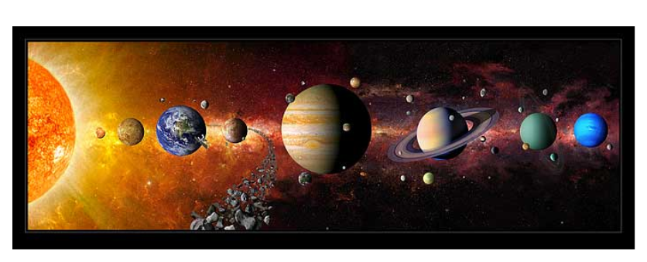
Our Solar System
Our solar system is made up of the Sun and all of the objects that orbit it under its gravitational influence.
Most of our solar system is relatively empty.
Notes:
The Sun contains about 99% of the mass that does exist in our solar system.

Slide 6
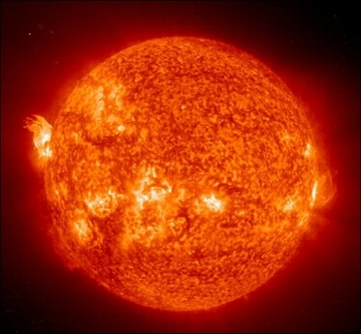
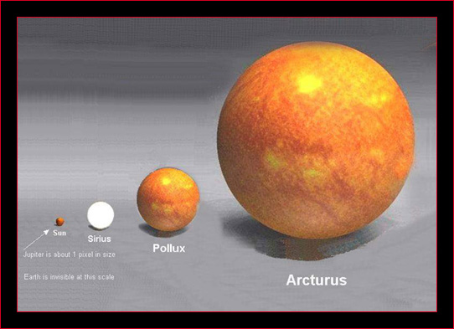
Parts of our Solar System
SUN
Largest object in our solar system
Temperature = 15 million K
70% H, 28% He, 2% Metals
Nuclear fusion creates Sun’s energy
Notes:
Nuclear fusion - joining nuclei of smaller elements (like H) to form nuclei of larger elements (like He) PLUS ENERGY.
- This occurs at extremely high temperature/pressure, and radiates electromagnetic energy into space.
- Our own Sun converts H --> He + energy

Slide 7
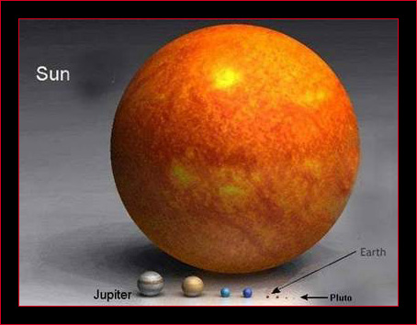

Slide 8
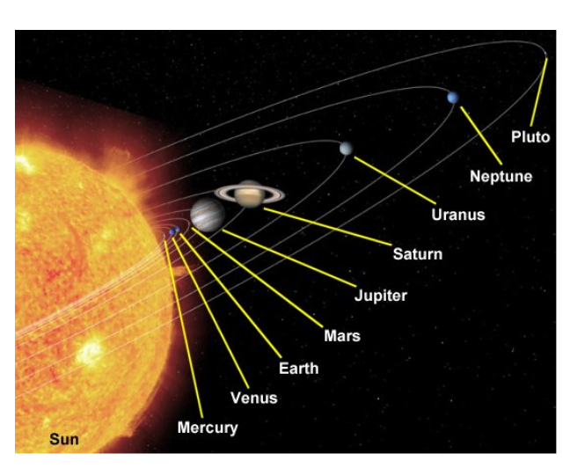
Parts of our Solar System
PLANETS - Our eight planets are the largest objects that independently orbit the Sun.

Slide 9
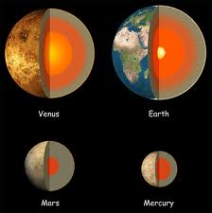
Terrestrial Planets
Inner Planets
Rocky Planets
Notes:
High density

Slide 10
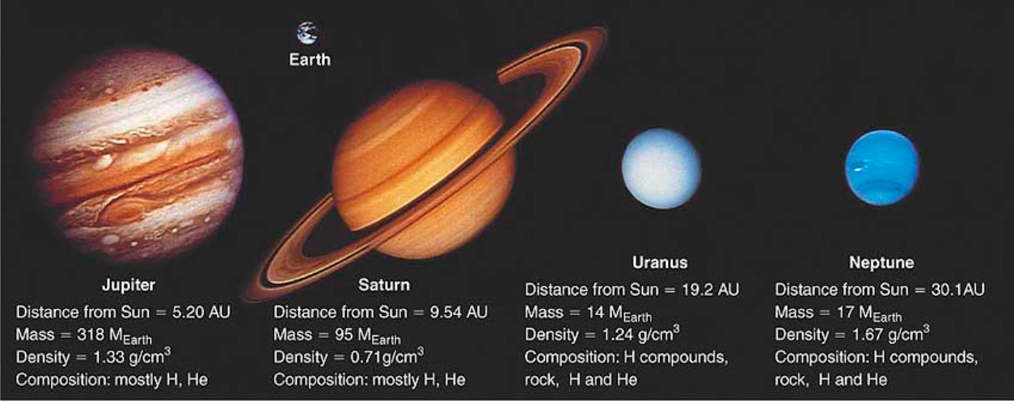
Jovian Planets
Outer Planets
Gaseous
Separated from the inner planets by the asteroid belt

Slide 11
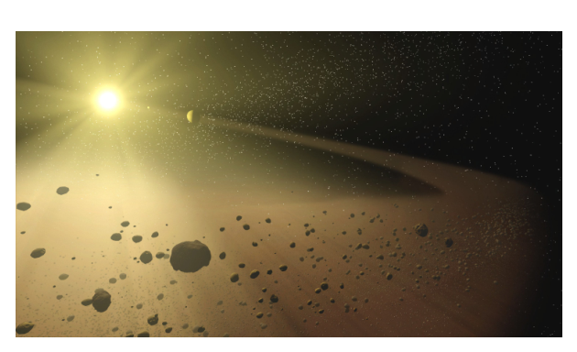
Parts of our Solar System
ASTEROIDS - solid rocky or metallic bodies that independently orbit the Sun.
Most of the known asteroids are in orbits between Mars and Jupiter.
Notes:
- Mostly irregular in shape, although the larger ones are spherical.
100 km to 1,000 km in diameter.
- Most of the known asteroids are in orbits between Mars and Jupiter

Slide 12
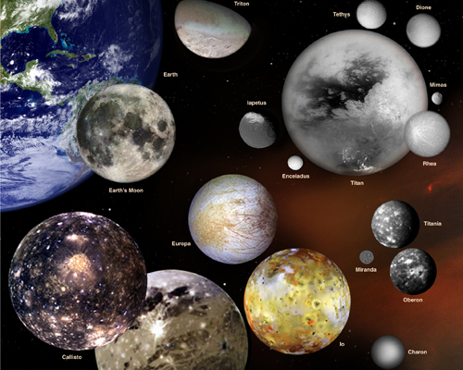
Parts of our Solar System
MOONS - bodies that orbit a planet or asteroid.
Vary in size from a few km to larger than the smallest planets

Slide 13
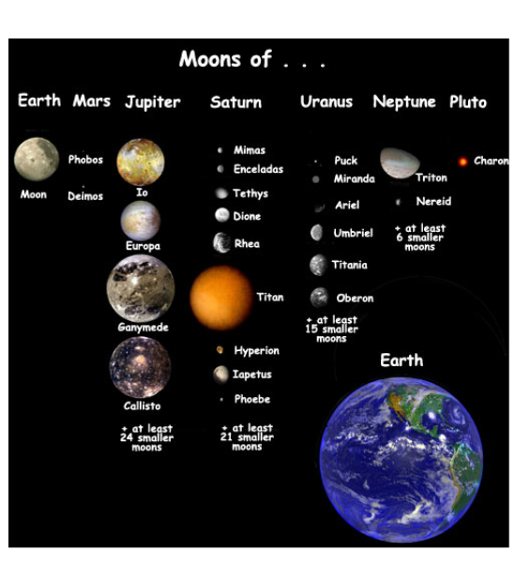

Slide 14
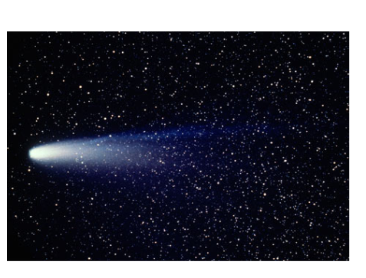
Parts of our Solar System
COMETS - ices of water and methane mixed with rocky or metallic solids
Ices turn to gases when they approach the Sun, forming spectacular tails.
Halley's Comet in 1986
Notes:
("dirty snowballs")
Most are 1 - 100 km in diameter

Slide 15
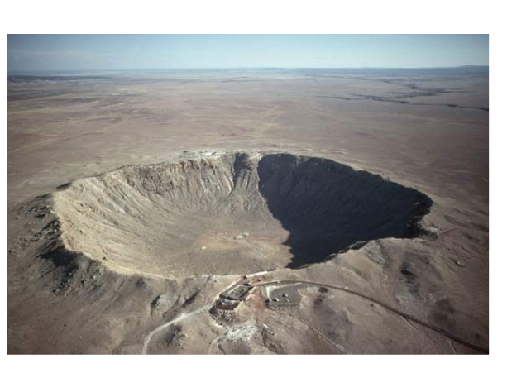
Parts of our Solar System
METEOROIDES - very small solid fragments that orbit the Sun.
As meteoroids enter our atmosphere, they burn up and leave a streak
If the meteoroid reaches Earth's surface it can create a depression (impact crater)

Slide 16
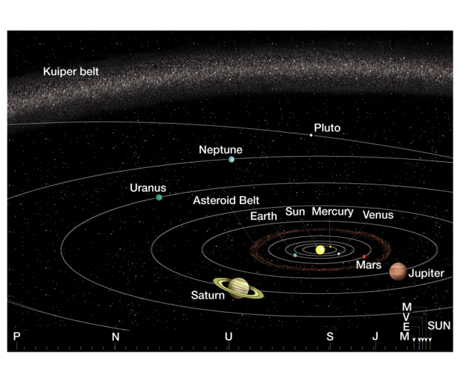

Slide 17
