Slide 1
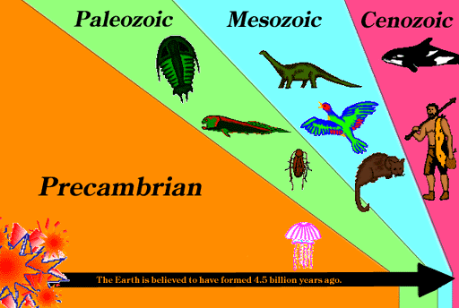
Evolution of Earth and Life

Slide 2
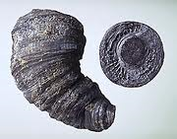
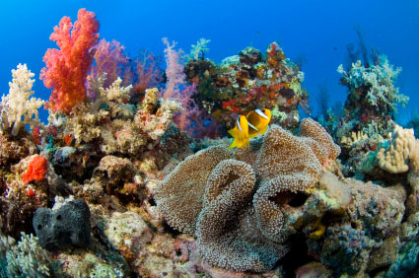
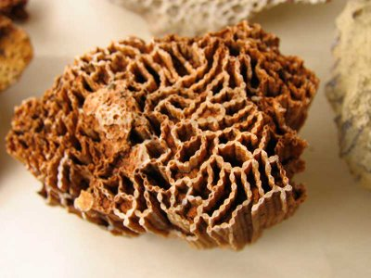
Variations in Fossils & Environments
A wide variety of life forms have lived on Earth.
Most probably haven’t been identified
We can compare fossils to similar life forms that exist today to infer information about Earth’s past environments.
Notes:
Most life forms now extinct – most forms probably havent been identified
Ex: today’s corals live in tropical, shallow ocean waters. It can be inferred past corals lived in similar environments.

Slide 3
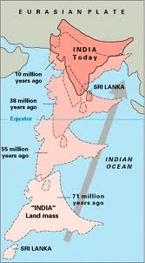
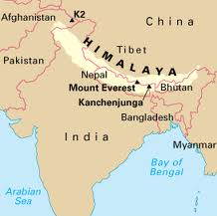
Environment Evolution & Plate Tectonics
The movement of plates can affect the climate of a landmass.
Latitude changes
Mountain ranges
Notes:
Move towards poles = colder. Move towards equator = warmer

Slide 4
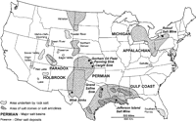
Environment Evolution & Rocks Types
Certain environmental conditions are related to the formation of rocks and minerals.
EX: Carboniferous Period had hot, humid conditions and an abundance of swamps = COAL.
EX: Silurian Period had hot, dry conditions and water in isolated oceans evaporated = HALITE, GYPSUM.

Slide 5
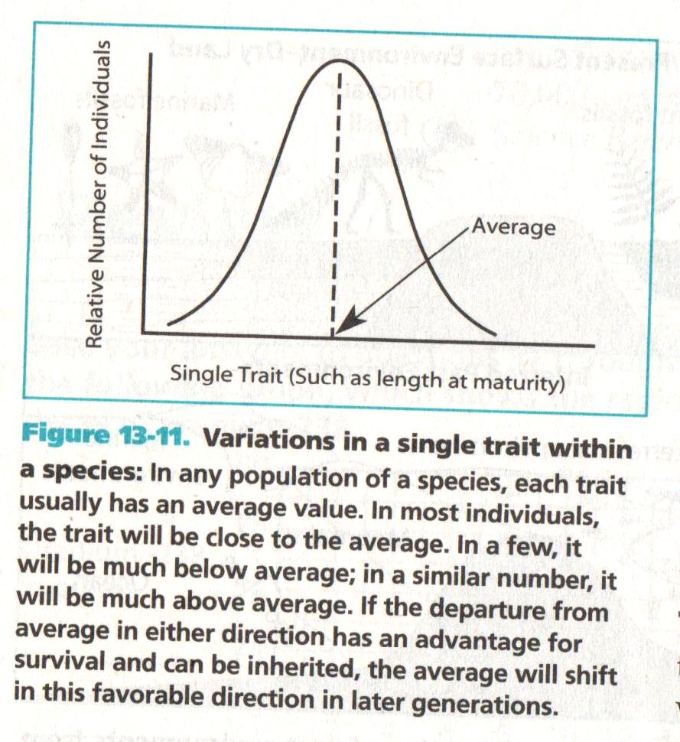
Fossils & the Evolution of Life
Species: a group of organisms that are similar enough to interbreed and produce fertile young.

Slide 6
Fossils & the Evolution of Life
Organic Evolution: life forms change through time.
As environments change, variations within a species give certain individuals a greater change of surviving and reproducing.
Favorable variations are preserved.
Over long periods of time, the individuals with the accumulated variations can lose the ability to interbreed with earlier varieties of the species = NEW SPECIES.
Notes:
Unfavorable variations die out/become extinct.

Slide 7
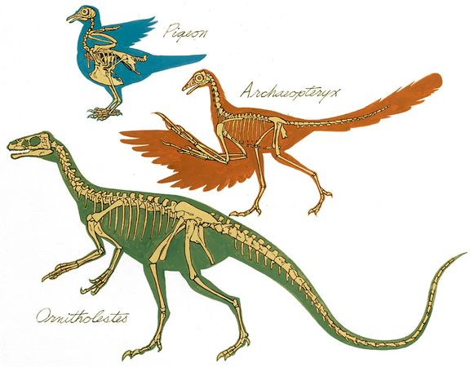
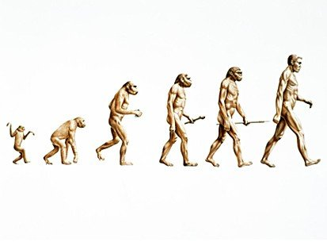
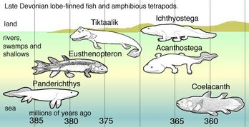
Fossils show a gradual transition from an older species to a newer one.

Slide 8
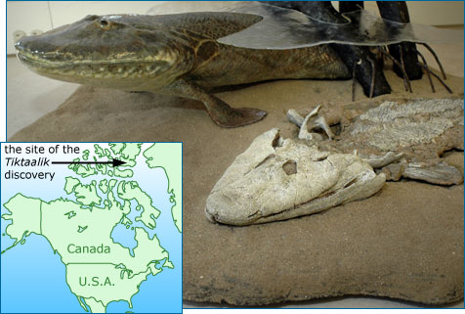

Slide 10
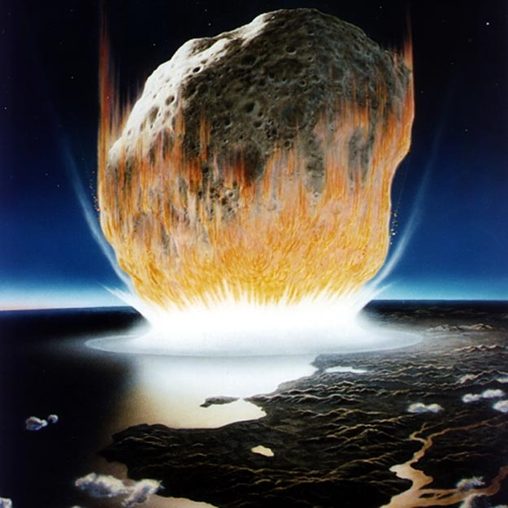
Rapid Evolution after an Impact Event
Impacts of comets or asteroids can cause catastrophic environmental changes.
Ex: 65 mya – 70% of species went extinct.
Huge tsunamis
Abundant vegetation burned up
Millions of tons of dust added to atmosphere
Notes:
Ex: 65 my impact – 70% of species went extinct, including many species of dinosaurs. Made way for mammal-dominated Earth.
Dust – atmosphere cooled, less solar energy reached Earth. Photosynthesis decreased, reducing the growth of plants and algae.

Slide 11
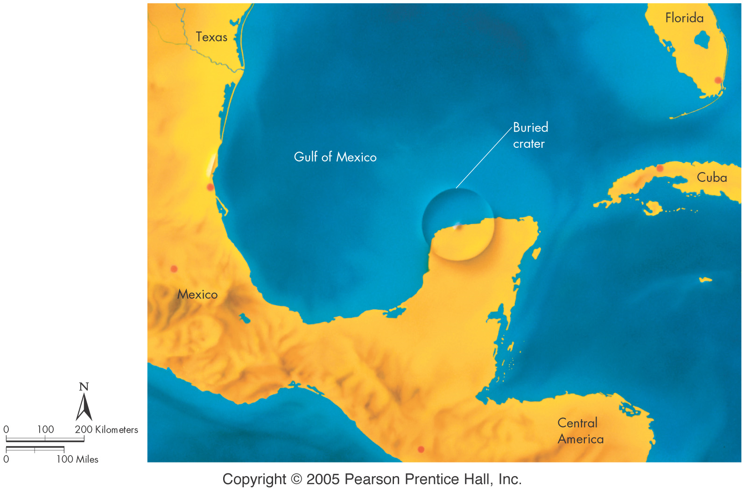

Slide 12
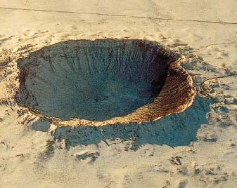
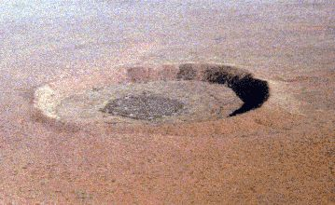
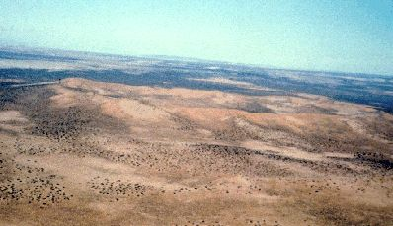
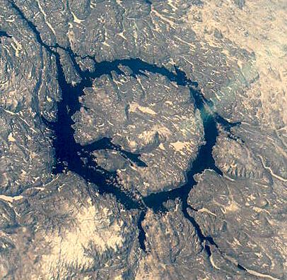
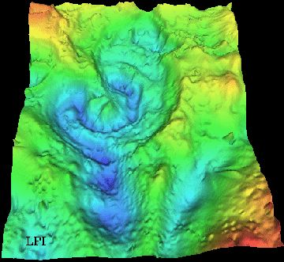
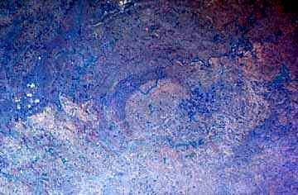
Roter Kamm Crater, Namibia (SW Africa)
5 mya
Wolfe Creek Crater in Australia,
300,000 yrs ago
Barrington Crater, Arizona, 49,000 yrs ago
Vredefort Crater in S. Africa
2 bya
Manicouagan Crater in Quebec, Canada
212 mya
Yucatan Peninsula, 65mya

Slide 13
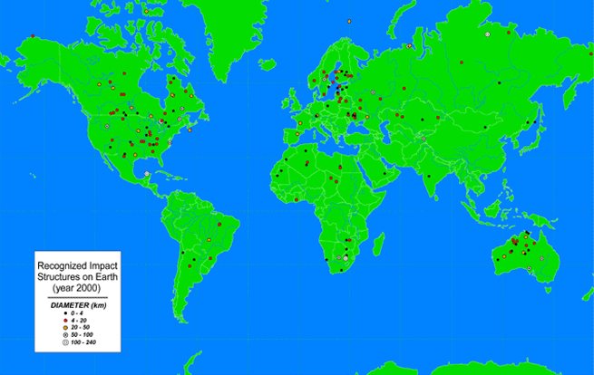
North American Impact Craters

Slide 14
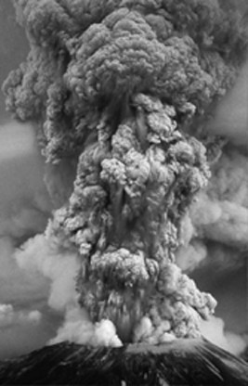
Early Evolution on Earth
4.6 BYA: Earth formed
Impacts and radioactive decay caused Earth to heat up and melt.
4.2 BYA: Solid crust has formed & plate tectonics began.
Outgassing of volcanoes and cracks in crust
Notes:
Earth formed – evidence from radioactive decay dates of Moon rocks and meteorites
Melting – dense materials sank to center (Fe, Ni), gases rose above surface
Outgassing –second atm formed – water vapor, co2, n2, other gases.

Slide 15
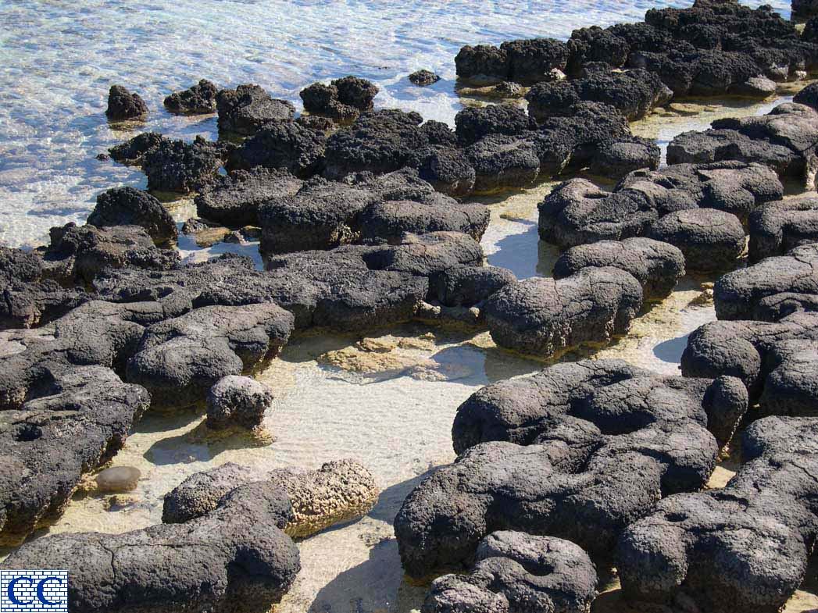
Early Evolution on Earth
By 4 BYA: Earth cooled, & water precipitated to form oceans.
3.8 BYA: Single-celled life forms present
3.5 BYA: Stromatolites evolve
Atmosphere becomes largely N₂ and O₂
Notes:
Stromatolites: bacteria/algae mats – convert CO2 to O2

Slide 16
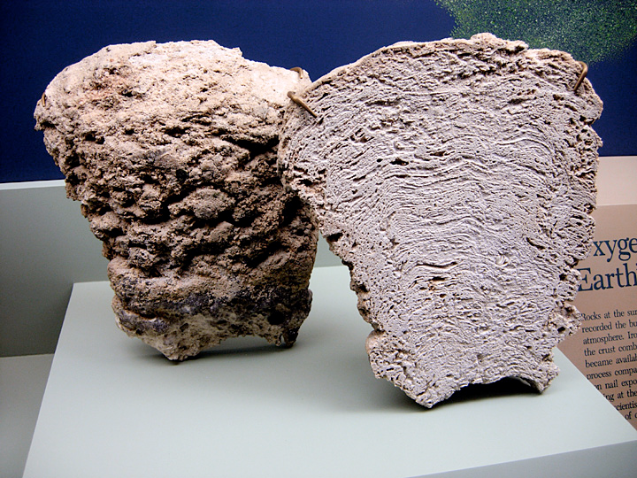
Fossil Stromatolite

Slide 17
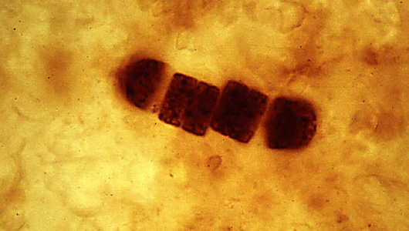
The oldest known fossils are very tiny ‘blue-green algae’ that can only be seen with a microscope. They are single-celled organisms called cyanobacteria and are found in rocks from Australia. Some of these blue-green algae cluster together to form groups called stromatolites.

Slide 18
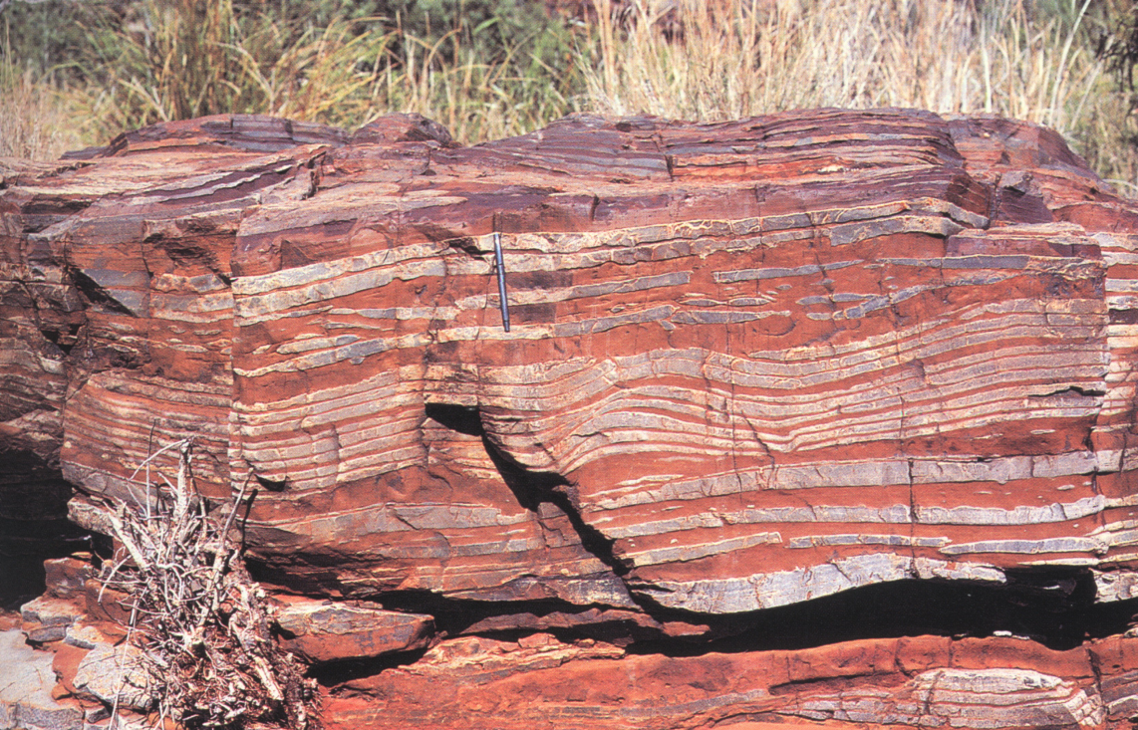
Early Evolution on Earth
3.5 - 2.8 BYA: Iron compounds reacted with oxygen in the atmosphere, forming iron oxide.
Millions of tons of iron oxide were deposited in the oceans
By 2.8 BYA: Most iron oxide finished reacting with oxygen, allowing O2 to build up in atmosphere
Early O-Zone layer forms
Banded Iron Formation from the Pre-Cambrian
Notes:
Iron oxide = rust
Early o-zone = protect life forms from deadly UV radiation.

Slide 19
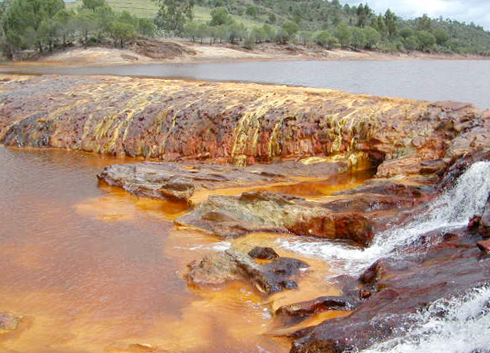
Water colored by iron, Rio Tinto, Spain.

Slide 20
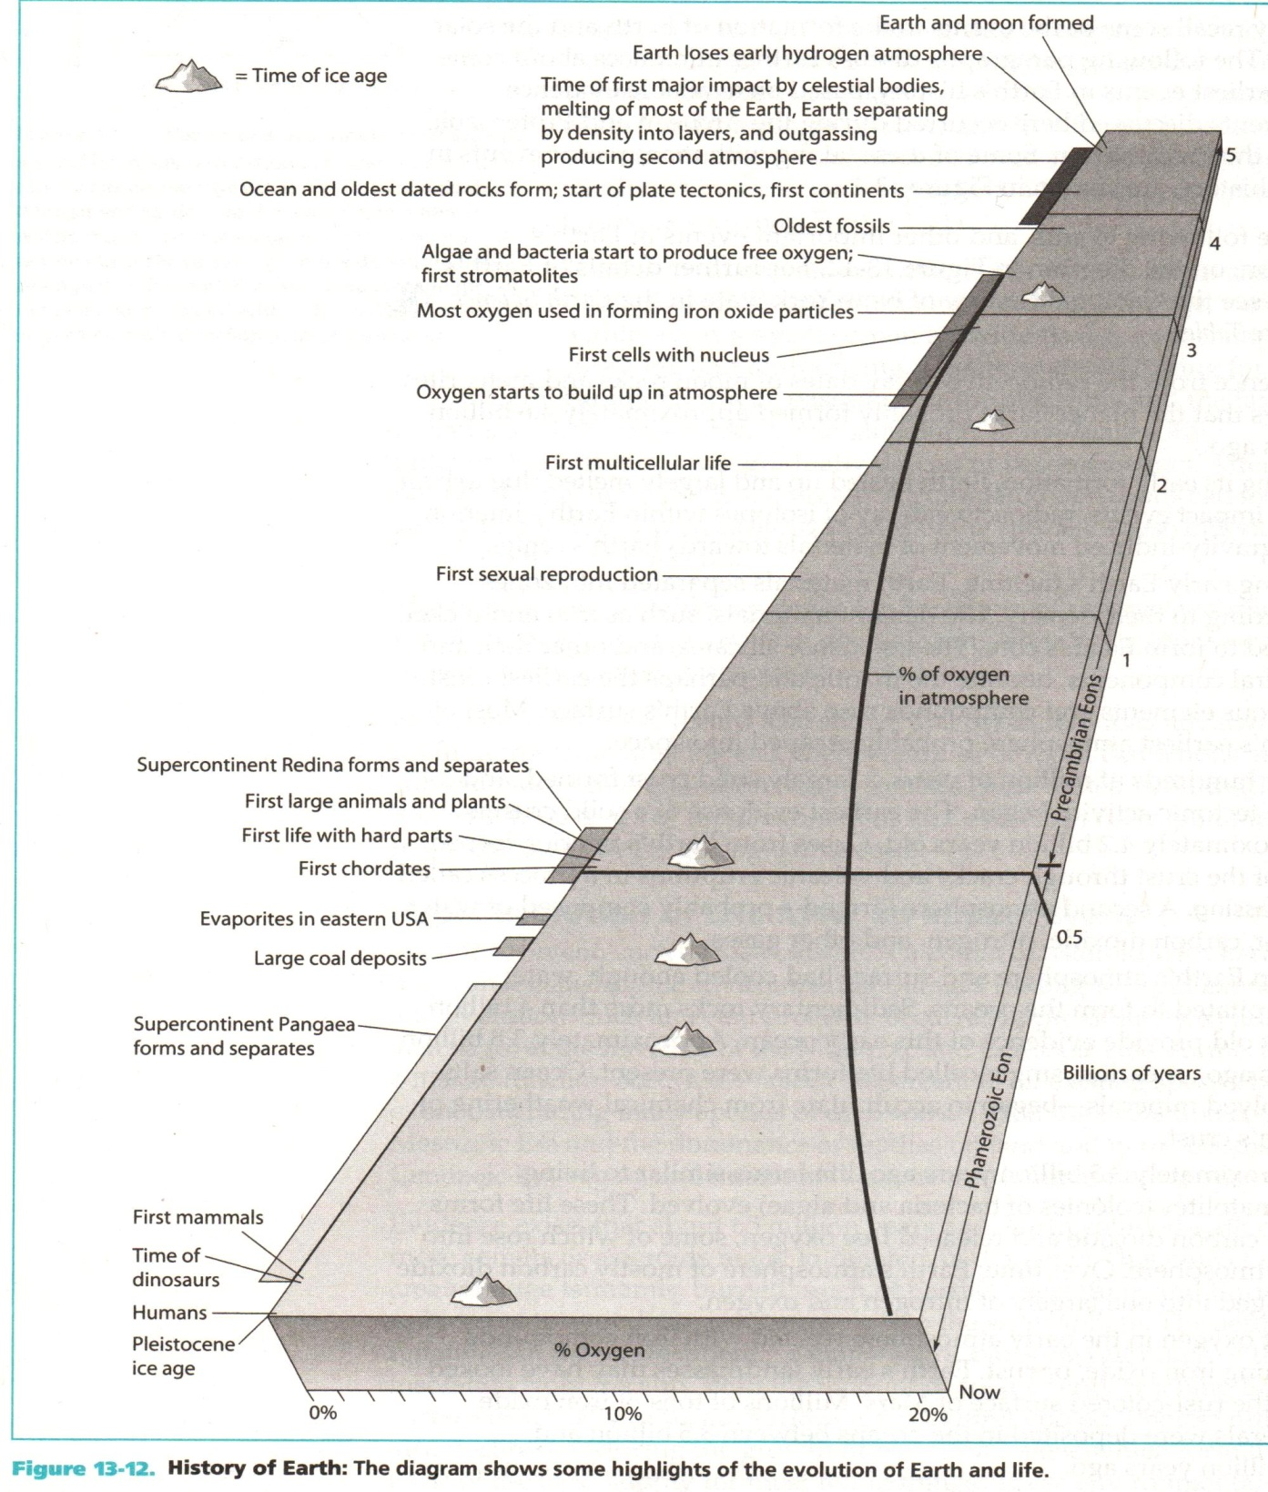
Notes:
Iron oxide = rust
Early o-zone = protect life forms from deadly UV radiation.

Slide 21
Evolution of Life in 60 Seconds

