Slide 1
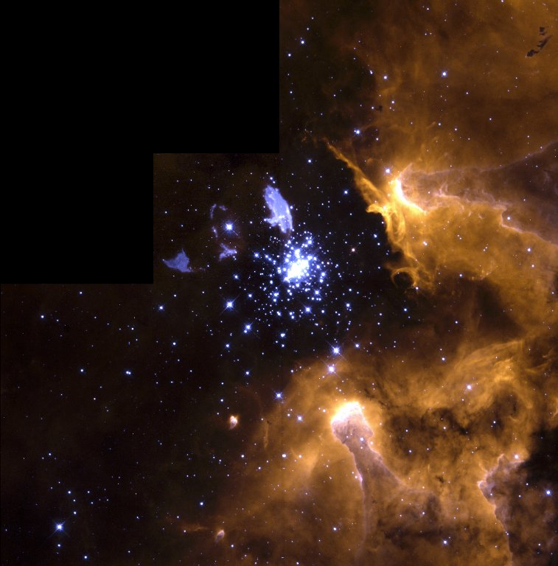
AIM: What is the Life Cycle of a Star?

Slide 2
If you were preparing a timeline of your life, what would you include?
Notes:
Stars also have "lives" and we can infer a star's life cycle based upon its mass.

Slide 3
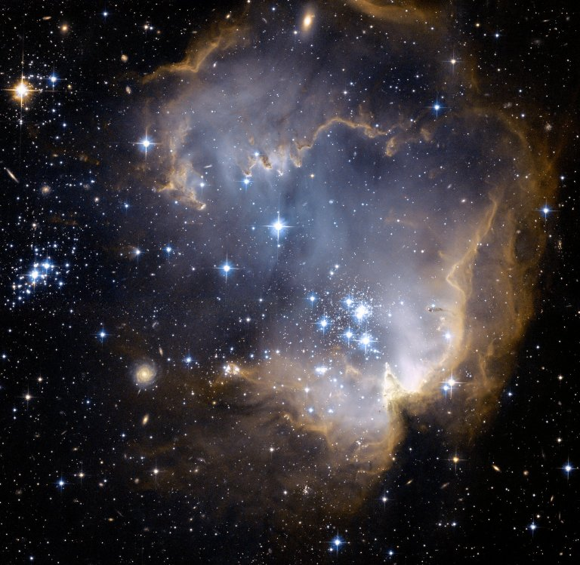
The Birth of a Star
Stars originate from nebulae (clouds of gas and dust molecules)
These clouds were created from the masses of:
1. The original Big Bang
and/or
2. Stars that have expanded or exploded
Notes:
Nebulae – clouds of gas an dust molecules
- EX: like cigarette smoke

Slide 4
Orion Nebula

Slide 5
The Birth of a Star
GRAVITY causes this gas and dust to come together, forming larger and larger balls of gas and dust molecules.
When the mass becomes large enough, gravitational contraction results in high pressure and temperature, and a protostar is formed.
Notes:
Larger than Jupiter

Slide 6
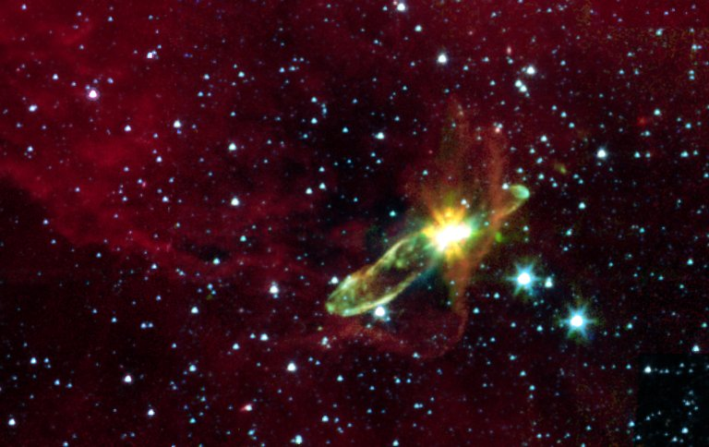
This protostar is located at a distance of 1140 light-years from Earth, and found in the constellation Vela.

Slide 7
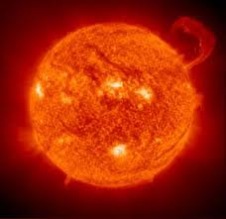
The Birth of a Star
A star is born when nuclear fusion begins .
H + H + H + H (4.030 amu) -----> He (4.003 amu)
+
extra energy leftover, that makes the star shine
Less massive elements combine to form more massive ones.
Notes:
This releases huge amounts of energy, and makes the star shine

Slide 8
Low and Medium Mass Stars
The life cycle of a star depends on its original mass.
Stars the size of our Sun (average mass) spend billions of years as main sequence stars
Expand to become RED GIANTS
Use up most of their fuel, blow away outer atmosphere
(planetary nebula), and remaining core becomes WHITE DWARFS
Cool down to become BLACK DWARFS

Slide 9
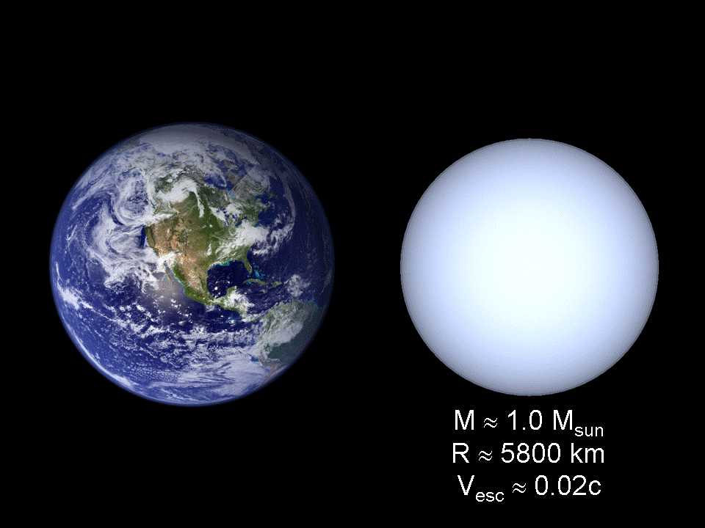

Slide 10
Low and Medium Mass Stars

Slide 11
High Mass Stars
Star remnants that are over 1.5 times the mass of our Sun exist for a SHORTER time (100,000,000 years) as MAIN SEQUENCE stars
Expand to become RED SUPERGIANTS
Explode as SUPERNOVA
High mass star remnant (1.5 to 2 times bigger than our Sun) become NEUTRON stars, and very high mass star remnant (3 times bigger than our Sun) become BLACK HOLES
Black hole formation
Notes:
*GIANTS - diameter of 10 x - 100 x of our Sun
SUPERGIANTS - diameter of 100 x - 1,000 x of our SUN

Slide 12
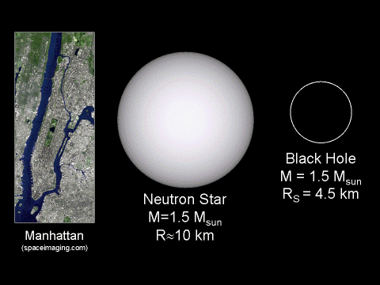

Slide 13
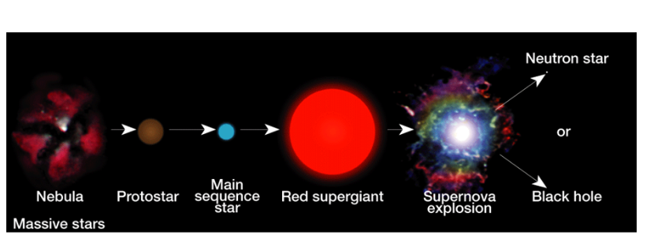
High Mass Stars
Explosion of star at various wavelengths

Slide 14
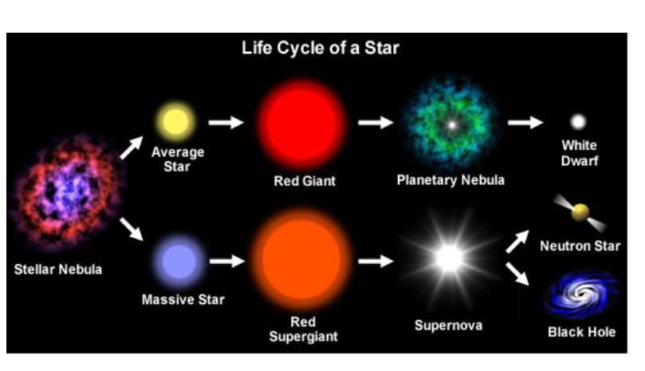

Slide 15
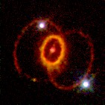
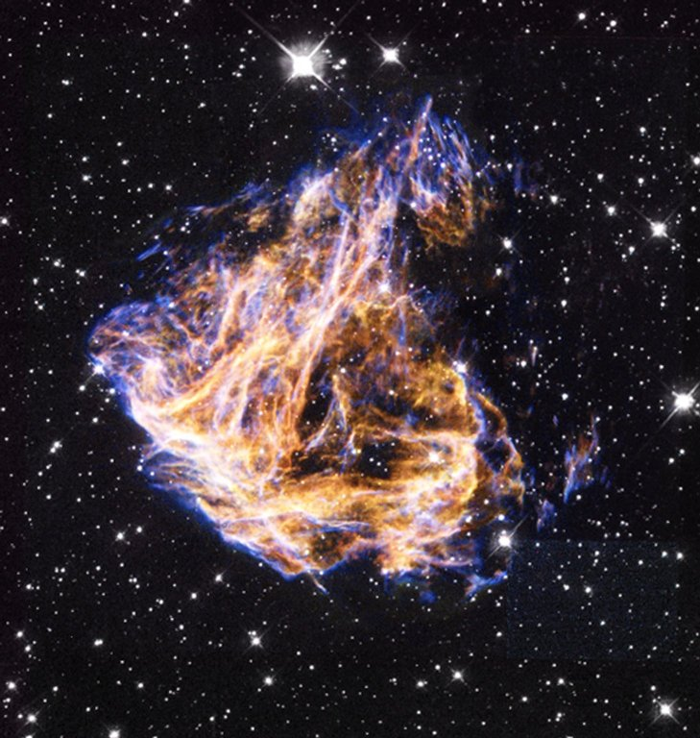
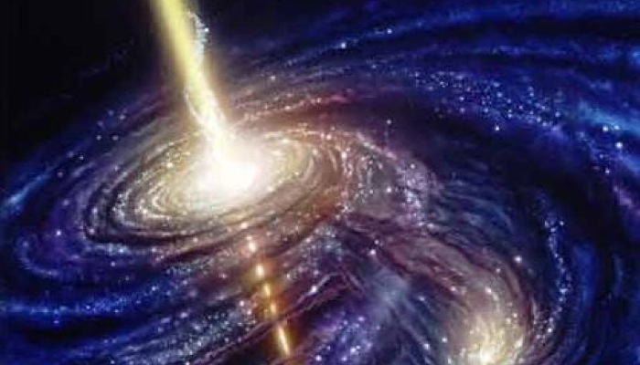

Slide 16
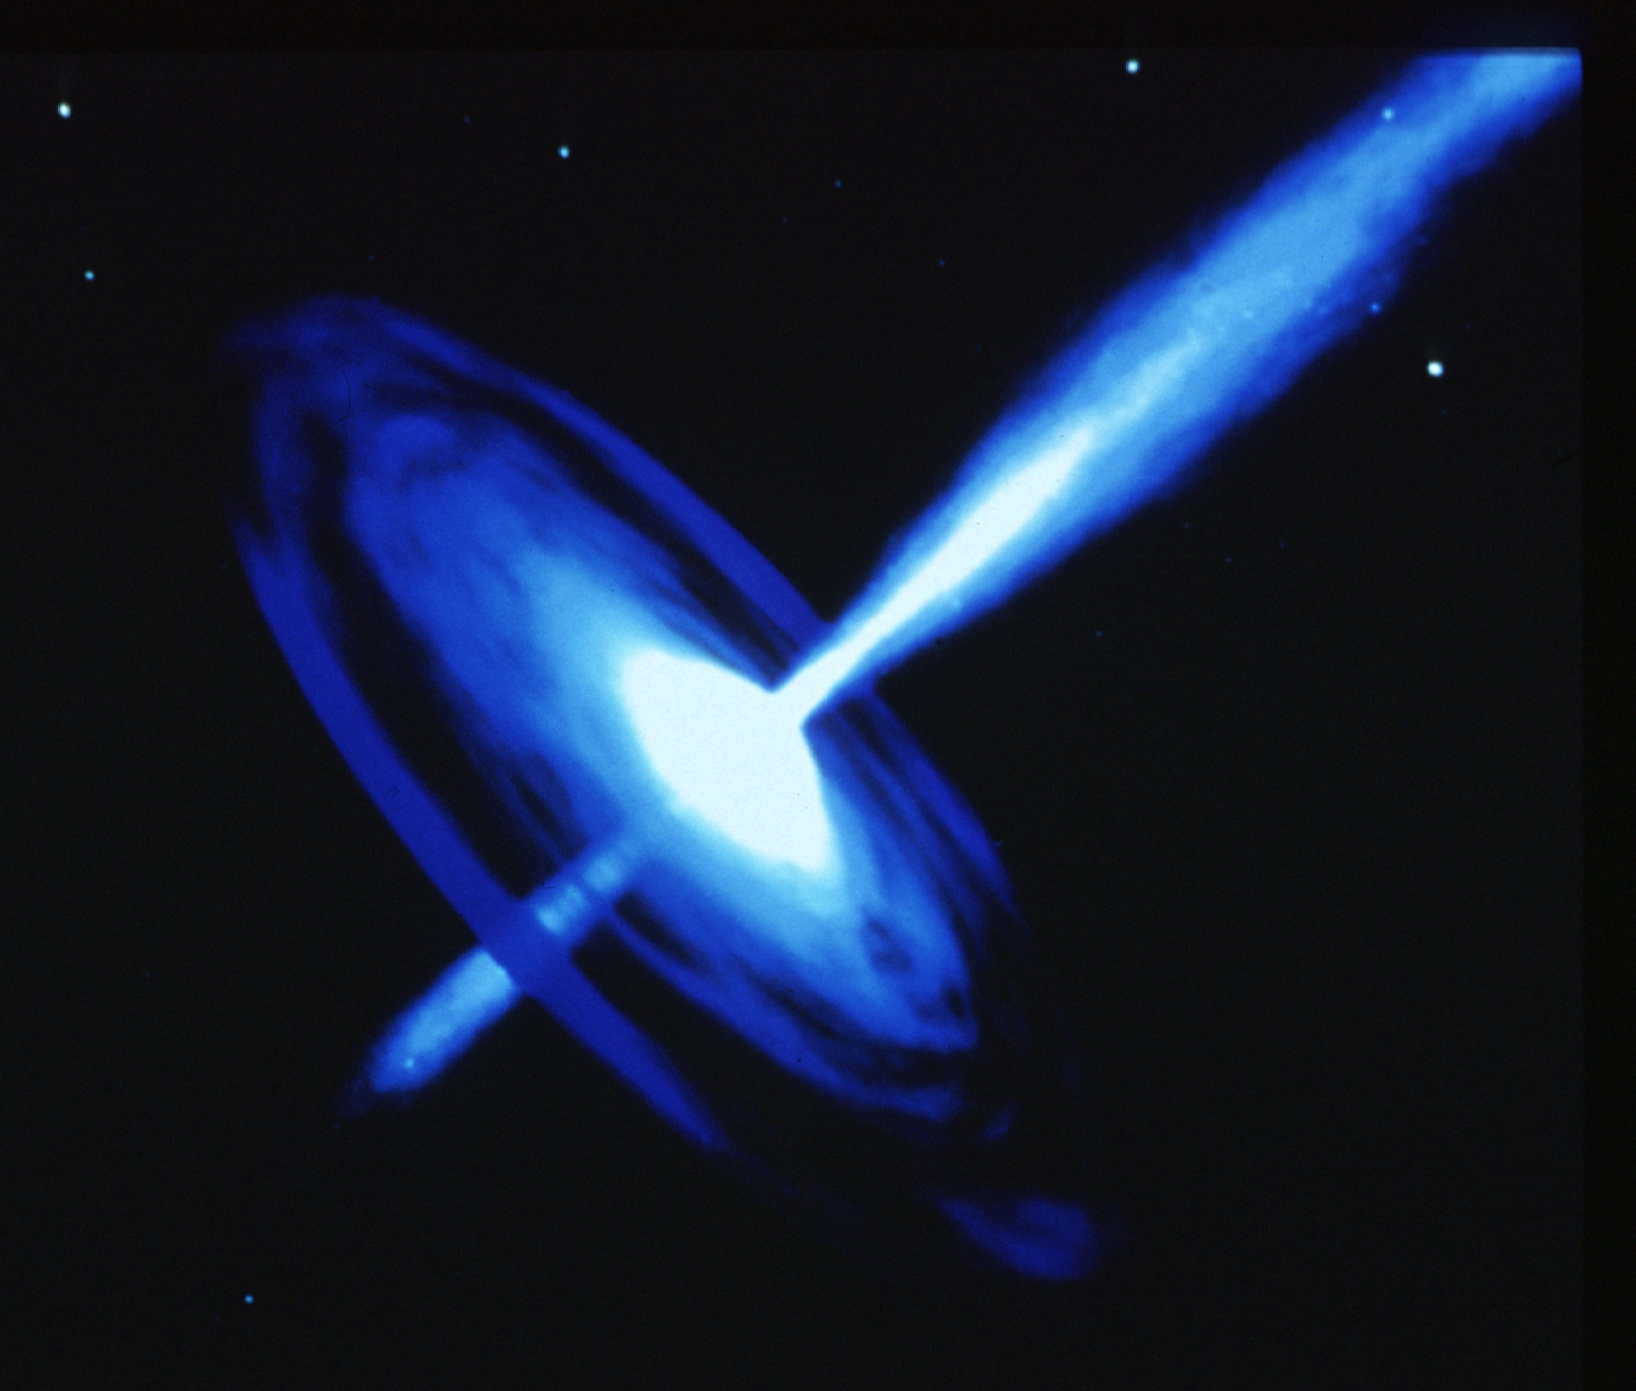

Slide 17
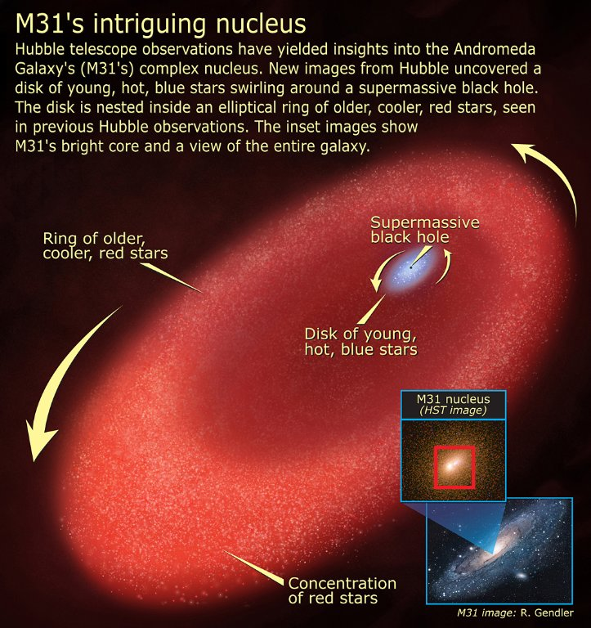

Slide 18
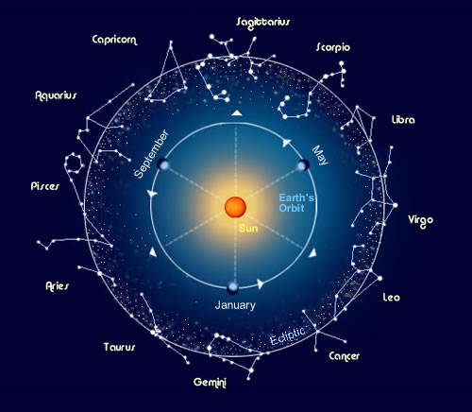
Constellations
A constellation is a pattern of stars that represent mythological characters, animals, or familiar objects.
The stars only APPEAR to be close together, due to our perspective from Earth.

Slide 19
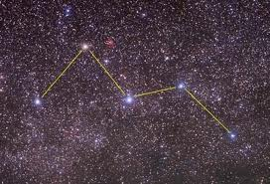

Slide 20
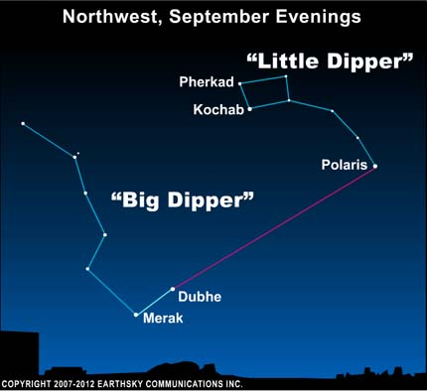

Slide 21
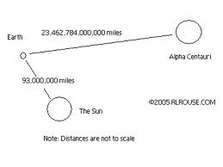
How can we measure distances to stars?
Distances to stars are too large to use normal units, such as meters or kilometers.
Instead, we use LIGHT-YEARS
A light-year is the distance that light travels in one year.
Light travels 300,000 km per second
Light can travel 9.5 trillion km per year

Slide 22
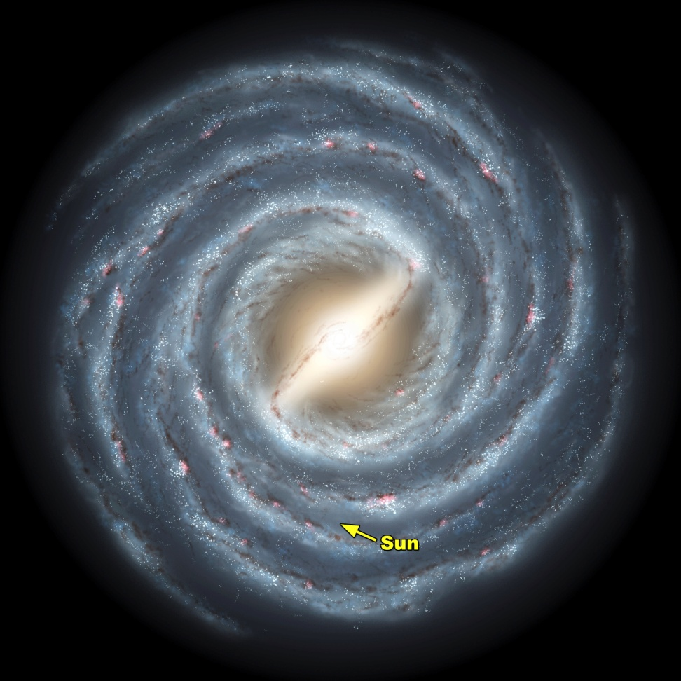
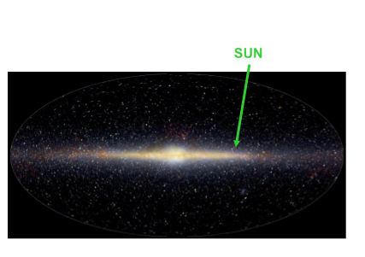
After our own Sun, the next closest star is Proxima Centauri, which is 4.3 light-years away.
Light from Proxima Centauri takes 4.3 years to reach Earth.
The distance from OUR solar system to the CENTER of the Milky Way Galaxy is about 26,000 light-years.

